Slide 1
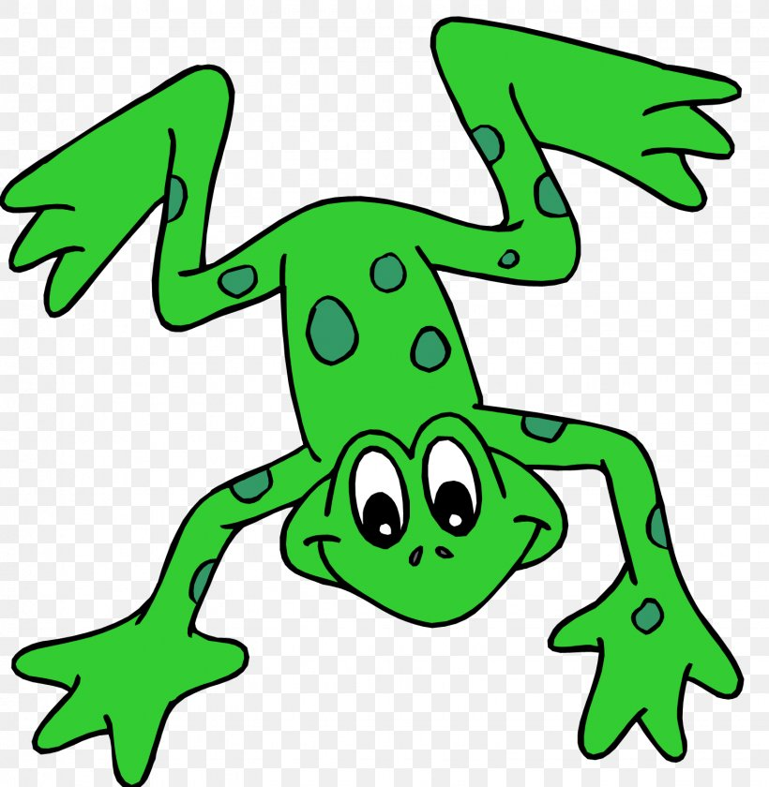
EYFS Literacy
Week 1

Slide 2
Phonics
Session 1

Slide 3
Phonics- Message for Parents
Each session has been designed to replicate how the children learn phonics at school through our scheme Read Write Inc. Although some of what they learn, they may already know, it is good practise for them to develop these skills independently.
Each session will follow the same format-
Speedy sounds- Each sound will appear automatically after the first click. DO NOT click to continue until all the sounds have been revealed. The sounds will change on a daily basis. There will be a maximum of 12 speedy sounds a day.
Fred Talk- (Fred the frog can only speak in sounds.) The children say the sounds then the whole word. The words will get progressively challenging as the weeks continue.
Ditty- These short sentences will develop your child’s ability to read. They sound out each word, re-read the word then re-read the sentence. At the end there is a ‘hold the sentence’ whereby you read the sentence to your child, they repeat back and keep repeating. At the same time they will write it down.
There will be a Fred the frog at the end for you to print out if you wish, unless you have a toy/teddy frog at home to use.

Slide 4
Phonics- Speedy Sounds
s | a | i | t
ng | e | nk | b
c | k | z | ch

Slide 5
Phonics- Fred Talk
m
u
d
b
u
s

Slide 6
Phonics- Fred Talk
r
u
n
r
u
g

Slide 7
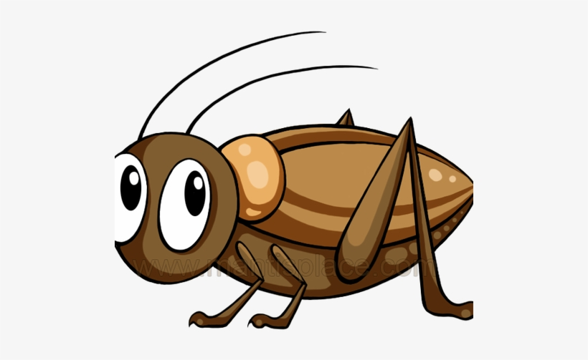
Phonics- Ditty
a | rug
a | bug | on | a | rug
a | bug | on | a | red | rug
Hold a sentence (children to keep repeating the sentence whilst writing it down):
A red rug to sit on.

Slide 8
Literacy
Session 1-
Comprehension

Slide 9
Literacy- Message for Parents
The aim of these sessions is to build the children’s confidence and independence in writing, however they will cover other skills too.
In writing children will use their phonic knowledge to write words in ways which match their spoken sounds. They will also try and write some irregular common words (High Frequency Words). They write simple sentences which can be read by themselves and others. Some words are spelt correctly and others are phonetically plausible.
Below are the Early Learning Goals for Communication and Language. These are important as children will be able to listen, think about and respond to what is asked.
Listening & Attention | Understanding | Speaking
Children listen attentively in a range of situations. They listen to stories, accurately anticipating key events and respond to what they hear with relevant comments, questions or actions. They give their attention to what others say and respond appropriately, while engaged in another activity. | Children follow instructions involving several ideas or actions. They answer ‘how’ and ‘why’ questions about their experiences and in response to stories or events. | Children express themselves effectively, showing awareness of listeners’ needs. They use past, present and future forms accurately when talking about events that have happened or are to happen in the future. They develop their own narratives and explanations by connecting ideas or events.

Slide 10
Literacy- Session 1
This week we are going to read the story of “Farmer Duck” by Martin Waddell.
If you have a copy, get your grown-up to read it to you.
If not, here is are some links to YouTube so that you can watch and listen. https://www.youtube.com/watch?v=wn4b9AqiUbw
https://www.youtube.com/watch?v=Gug6P8l1q6c

Slide 11
Literacy- Session 1
Your grown-up will now ask you some questions. I hope you were listening!
On a farm
2- Why did the farmer get fat?
1- Where did the duck live?
He stayed in bed all day
3- Where did the animals meet?
Under the moon.
They got under the bed and chased the farmer away.
4- How did the animals get rid of the farmer?

Slide 12
Now complete the accompanying activity.

Slide 13
Your own Fred the frog to cut out

