Slide 1
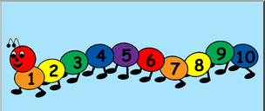
EYFS Maths
Session 3

Slide 2
Message to parents
This week the children will be learning to count on/back using a number line and solve simple addition/subtraction problems. The activities provided are to be used alongside practical examples.
Reinforce the language as this will help your child to learn the concepts.
How many jumps do you need?
count on/back
Are we going up or down the number line?
If we are adding/taking away, will our number get ‘smaller’/’bigger’?

Slide 3
Warm Up Let’s warm up our brains ready to learn.
Can you crack the code?

Slide 4
Warm Up – the answer is…
9
6
15
Well done!

Slide 5
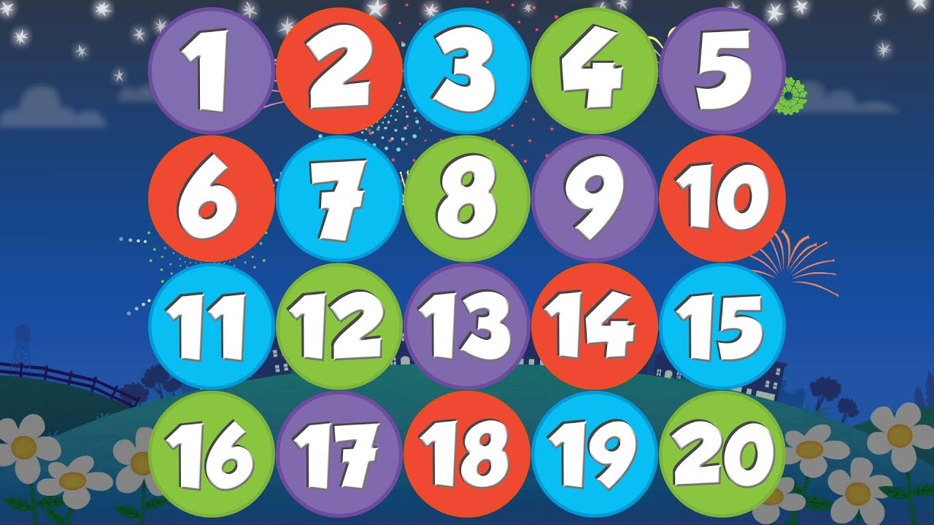
Today and tomorrow, we will focus on counting back using a number line and ‘taking away’.

Slide 6
When we have to ‘take away’ to find our answer…
-
=
7
10
-
3
=
7
our number or amount is becoming less or ‘getting smaller’.
When we take away we count back on our number line to
find our answer!
0
1
2
3
4
5
6
7
8
9
10
11
12
13
14
15
16
17
18
19
20

Slide 7
There are 9 children at the party but 5 leave and go home.
Can you count how many children will be left at the party?
-
=
?
4
9
How many jumps do you need?
0
1
2
3
4
5
6
7
8
9
10
11
12
13
14
15
16
17
18
19
20

Slide 8
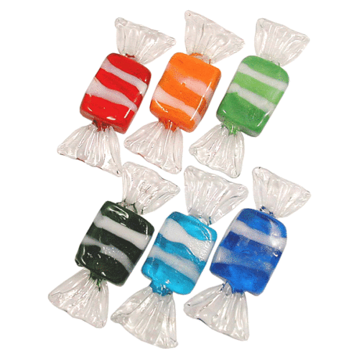
Bob had 12 sweets. He gave 6 to his friend Ben.
How many sweets did he have left?
12
-
=
6
How many jumps do you need?
0
1
2
3
4
5
6
7
8
9
10
11
12
13
14
15
16
17
18
19
20

Slide 9
There were 14 frogs in the pond. 10 frogs jump out of the pond. How many frogs are left?
0
1
2
3
4
5
6
7
8
9
10
11
12
13
14
15
16
17
18
19
20

Slide 10
There were 14 frogs in the pond. 10 frogs jump out of the pond. How many frogs are left?
4

Slide 11
Well Done!
Now have a go at the activity sheet provided.

