Slide 1
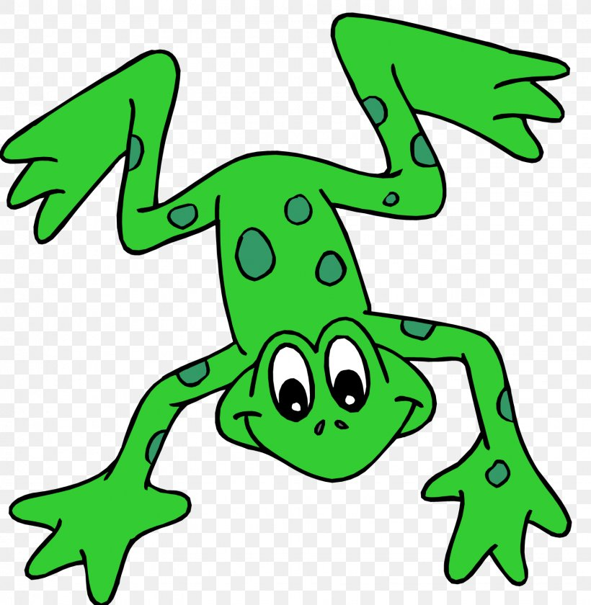
EYFS Literacy
Week 1

Slide 2
Phonics
Session 2

Slide 3
Phonics- Speedy Sounds
m | a | l | t
ng | sh | g | o
ch | qu | h | th

Slide 4
Phonics- Fred Talk
b
i
b
m
i
x

Slide 5
Phonics- Fred Talk
r
e
d
p
e
t

Slide 6
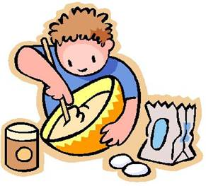
Phonics- Ditty
mix | it
mix | it | up
mix | it | up | fast
Hold a sentence (children to keep repeating the sentence whilst writing it down):
I can mix it up in the jug.

Slide 7
Literacy
Session 2-
Story Mapping

Slide 8
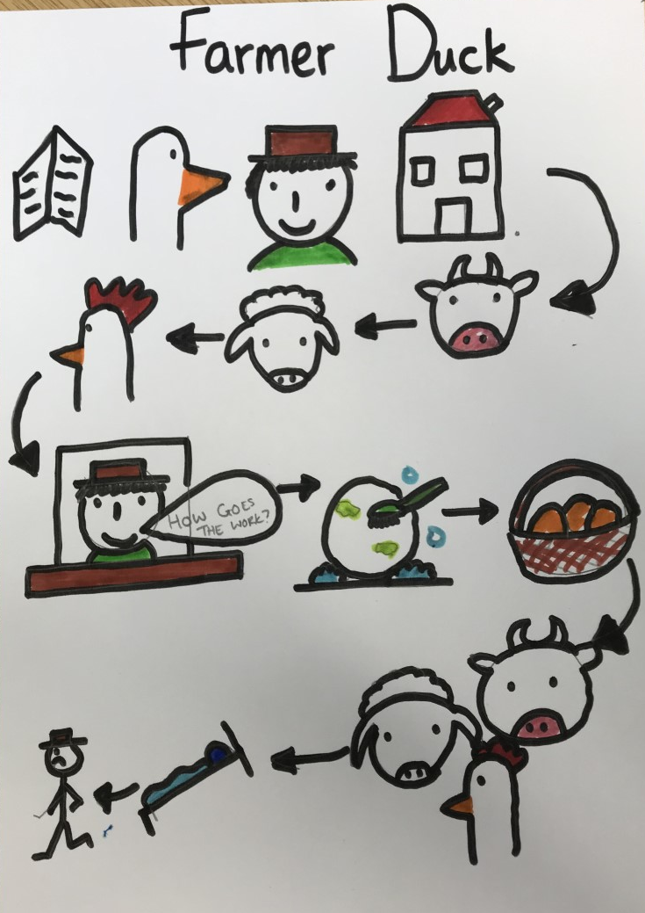
Literacy- Session 2
Can you remember what happened in the story?
Use the story map to help you remember.
Can you make some actions to go along with each of the characters?

Slide 9
Now it’s your turn to make a story map of “Farmer Duck”

