Slide 1
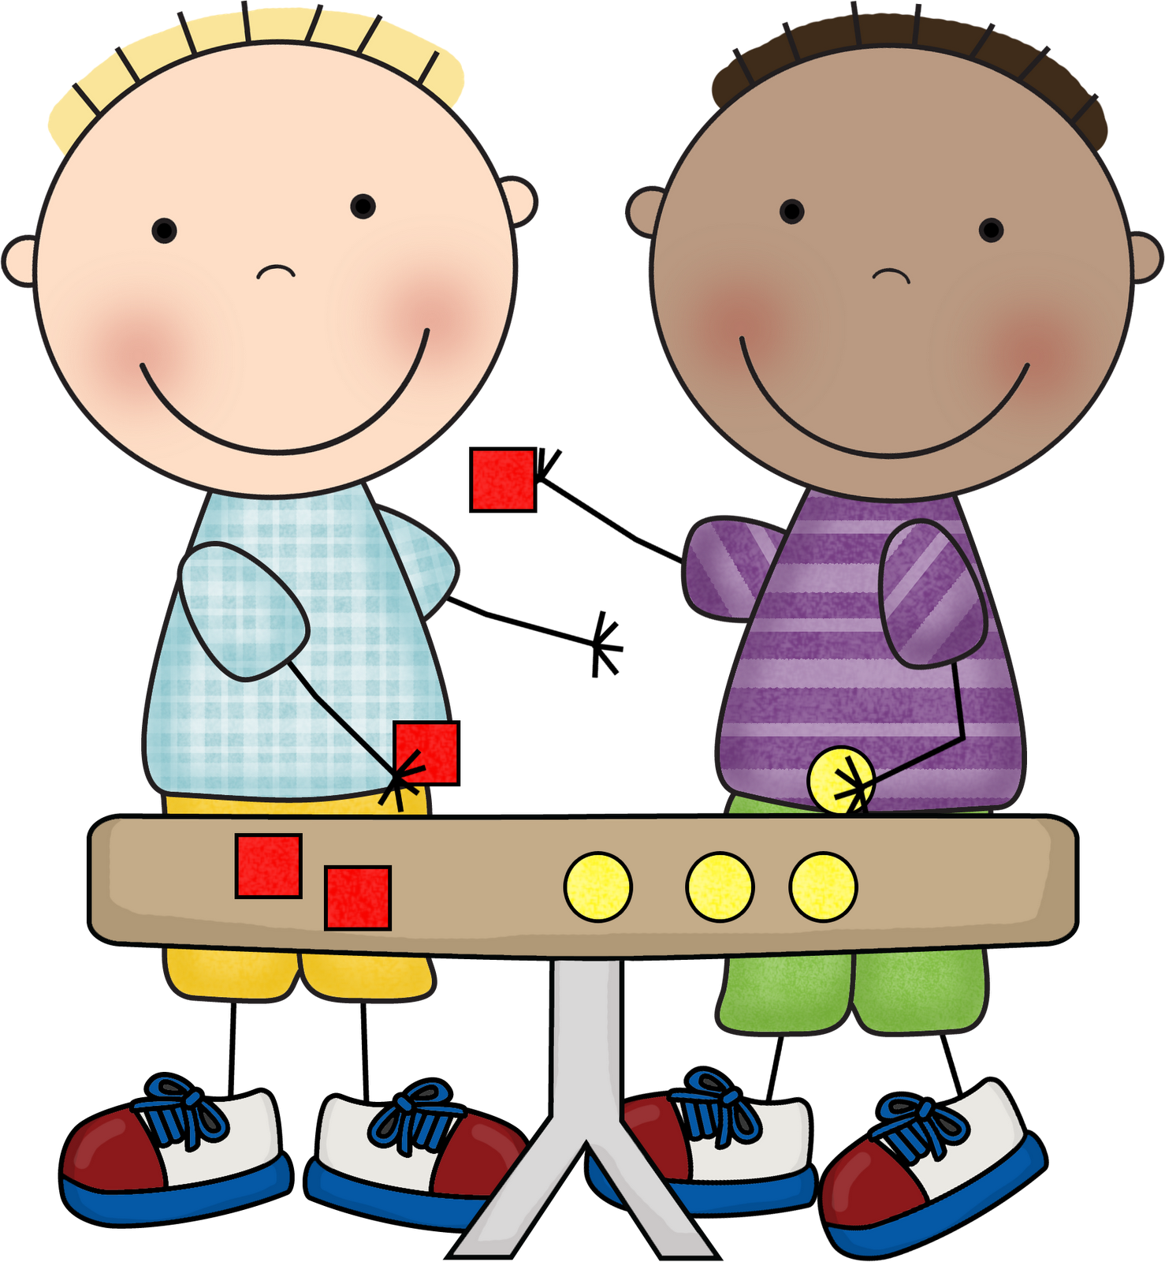
EYFS Maths
Session 1

Slide 2
Message to parents
This week the children will be sharing quantities equally. The activities provided are to be used alongside practical examples.
Reinforce the language as this will help your child to learn the concepts.
___ shared between ___ groups is ___.
groups
equal
shared

Slide 3
Warm Up Let’s warm up our brains ready to learn.
-
6
=
?
-
?
4
=
Can you write these sums as a number sentence?

Slide 4
Warm Up- Answer
-
=
10
6
4
-
=
6
4
2

Slide 5
Sharing
And this is her best friend, Harvey.
This is Meredith.

Slide 6
Everyday, after school, Meredith and Harvey walk to Mr. Matt’s Magic Sweet Shop.
Can you help Meredith and Harvey share out the sweets?

Slide 7
In this bag of sweets, there are 6 chewy chocolate stars. How many do we have to give to Meredith and Harvey so that it is fair?
Yes!
Yes!

Slide 8
So, half of 6, is 3
6 shared between 2 is 3

Slide 9
Now let’s share 6 between 3 groups.
6 shared between 3 is
?
2

Slide 10
Well Done!
Now have a go at the activity sheet provided.

