Slide 1
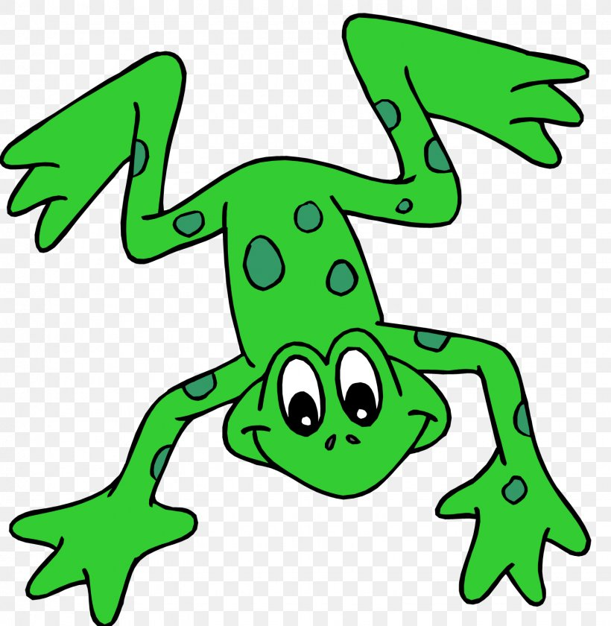
EYFS Literacy
w/c 1st June 2020

Slide 2
Phonics
Session 3

Slide 3
Phonics- Speedy Sounds
Click on the orange square to begin.
Each letter will appear and disappear each time you click.
How fast can you read each sound?
n
g
u
c
o
l
th
d
p
sh
k
e

Slide 4
Phonics- Fred Talk
cat
jug
box
pen
bat
leg
zip
Read the word and find the matching picture!

Slide 5
Phonics- Fred Talk
Did you find them all?

Slide 6
Phonics- Ditty
am | wet
I | am | wet
I | am | fed |  | up
Hold a sentence:
I am wet and fed up.

Slide 7
Literacy
Session 3- writing
(using descriptive words)

Slide 8
Literacy session 3
Today we are going to practise writing a sentence with a ‘describing’ word. Describing words make our sentences even more EXCITING!
Look at my example below:
The red house.
What about this sentence? How can I make it better?
My house has a pointy roof.
My house has a roof.

Slide 9
Literacy session 3
Let’s add a describing
word to describe the tea.
A cup of tea.
A cup of hot tea.
Let’s add a describing
word to describe the cat.
The cat sat.
The fluffy cat sat.

Slide 10
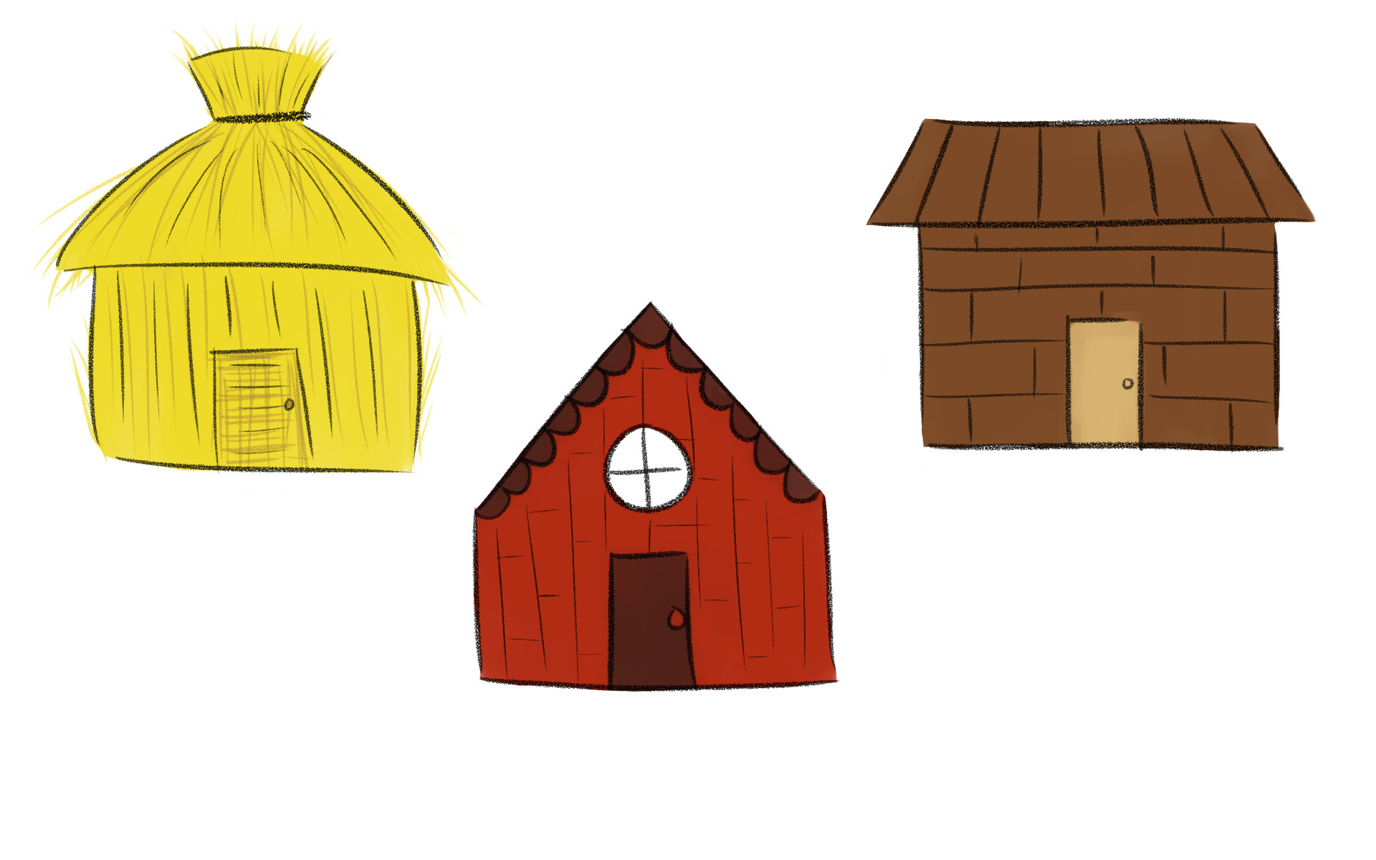
For today’s activity I would like you to design and describe a house for the little pigs from our story.
Don’t forget to write in a full sentence and to use at least one describing word
in each sentence!
My house has large windows.
For example:

