Slide 1
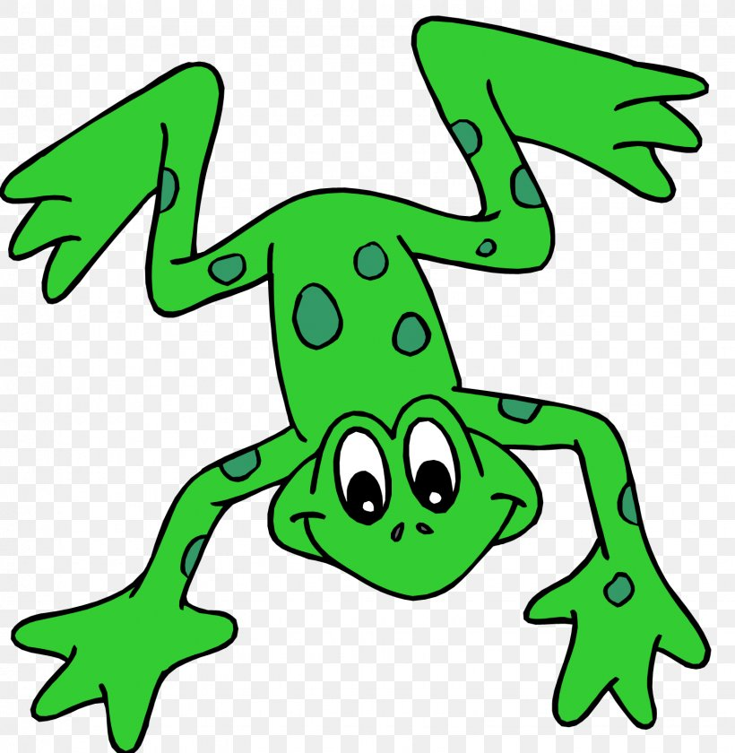
EYFS Literacy
Week 2

Slide 2
Phonics
Session 3

Slide 3
Phonics- Speedy Sounds
Click on the orange square to begin.
Each letter will appear and disappear each time you click.
How fast can you read each sound?
g
d
j
m
r
u
p
ng
th
qu
l
x

Slide 4
Phonics- Fred Talk
p
i
p
s
i
t

Slide 5
Phonics- Fred Talk
l
i
p
w
i
g

Slide 6
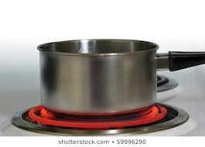
Phonics- Ditty
a | pot
a | hot | pot
a | hot | pot | on | a | hob
Hold a sentence:
Put a lid on a pot.

Slide 7
Literacy
Session 3-
Rhyming words

Slide 8
Literacy- Session 3
Here are the words leg and peg. Leg and peg rhyme because their ending sounds the same.
eg
eg
leg
peg

Slide 9
Literacy- Session 3
Here are some rhyming words. Can you match the words that rhyme?
cat
muck
hog
pen
hen
dog
duck
bat

Slide 10
Now it’s your turn to match the rhyming words

