Slide 1
I am learning to retrieve information from a non fiction text.

Slide 2
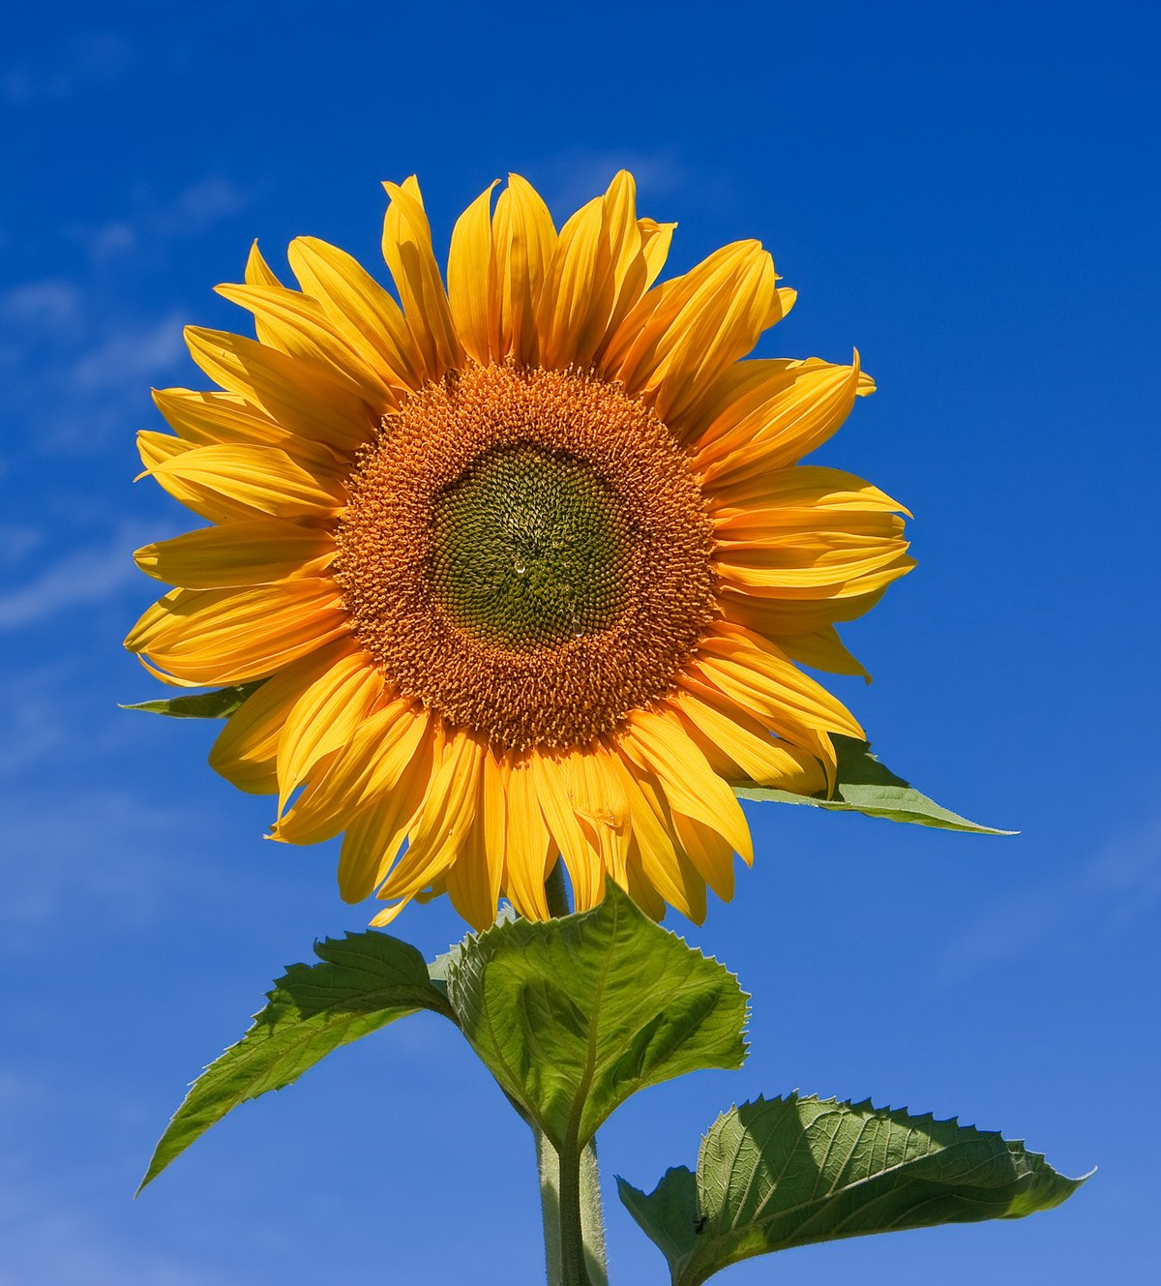
Challenge 1: Read the non fiction page all about the life cycle of a sunflower.
Remember: Non fiction texts contain real life information and facts.
Challenge 2:
Answer the questions by retrieving the information from the text.
Remember to write exactly what is written in the text.

Slide 3
Take your time when reading.
If you are stuck on a word, use your Fred fingers to help you!

Slide 5
Can you find the answers to the questions in the text?
How many types of sunflowers are there?
Name a colour that sunflowers can be.
What is the seed planted in?
When is the sunflower seed planted?
What colour are the seeds?
What grows underground?

