Slide 1
Monday 13th July2020
Reading and comprehension

Slide 2
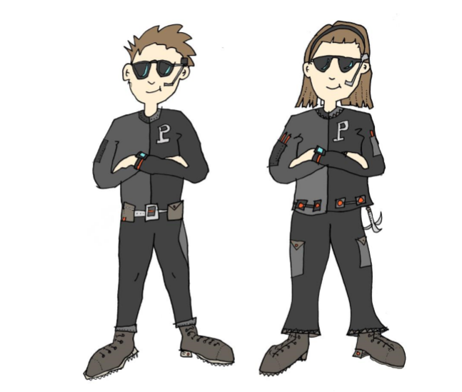
Have you ever wanted to be a spy? This week’s story is about 2 twins who have a very special secret…

Slide 4
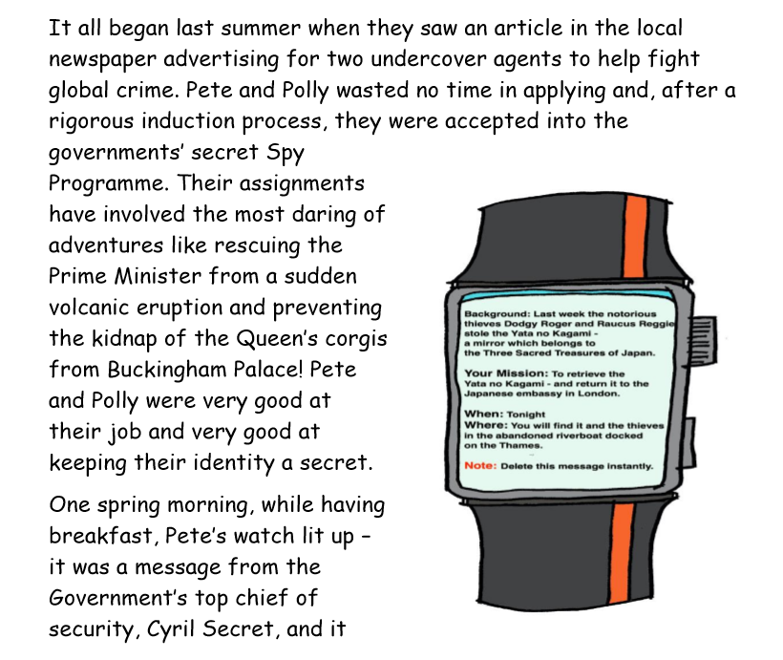
read

Slide 6
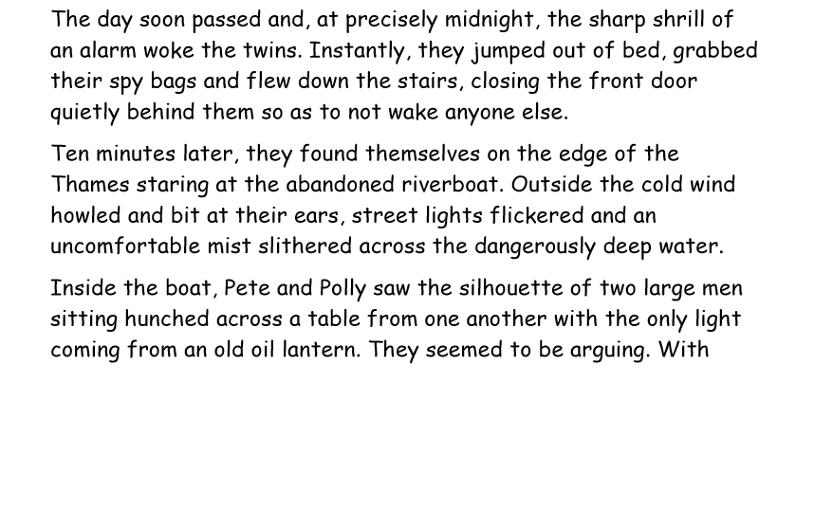

Slide 7
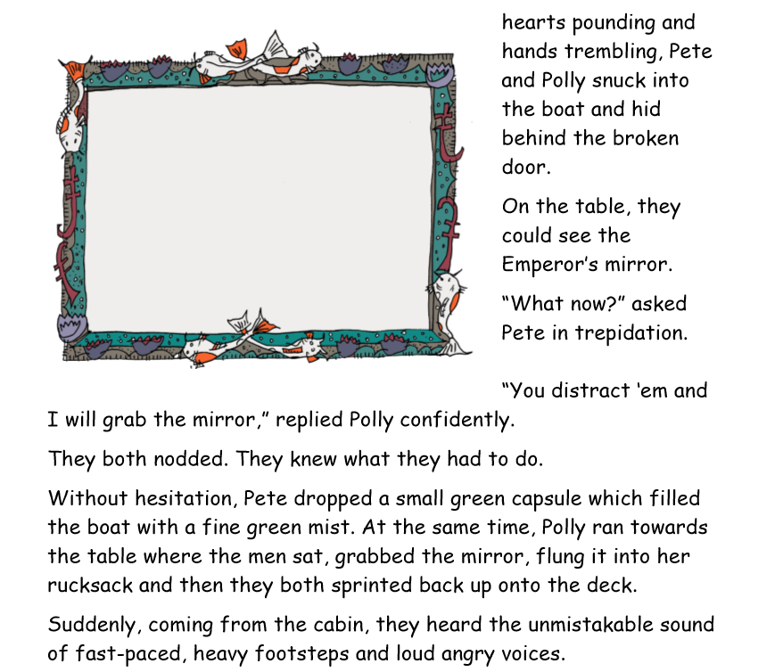
With

Slide 8
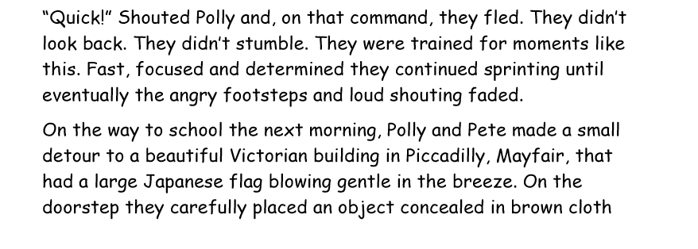
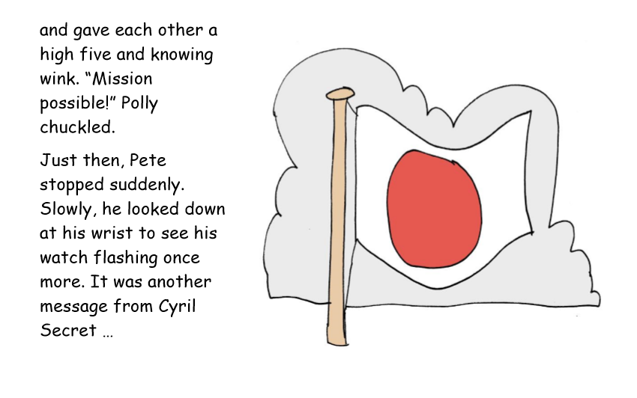

Slide 9
Let’s think about the story….
What was the story about? Can you summarise it in less than 20 words?
What did you like and dislike about the story?
Does this story remind you of any other stories
Or films?
Do you have any questions about the story?

Slide 10
Activity 1 : Can you check my answers to my true and false quiz for me?

Slide 11
Activity 2: Using your inference skills, find evidence to prove the statements.

