Slide 1
Thursday 2nd July 2020
Designing characters

Slide 2
Today we are going to start the process of adapting the story to make our own.
We are going to be focusing on
characters.

Slide 3
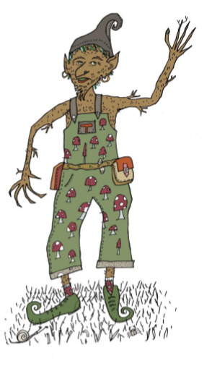
Our story is all about a boy who finds a new world filled with Tree Goblins but did you know there are lots of different goblins in the world?
When you write your story, your character could meet a different type of goblin.

Slide 4
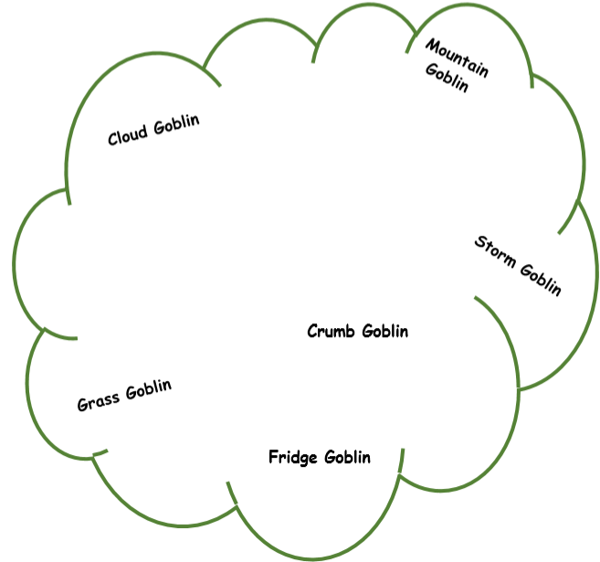
Let’s make up some new types of goblin. It is a good idea to use weather, nature or places to help. You might have other ideas too! Here are some examples, now think of your own.

Slide 5
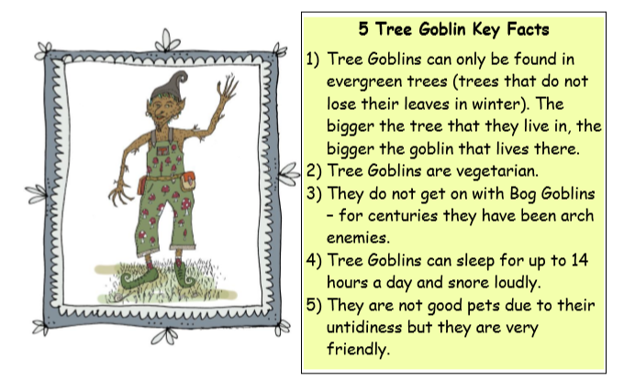
For your main task:
You are going to choose 3 of your
favourite ideas for new goblins to make
fact files like mine:

