Slide 1
Thursday 9th July 2020
Writing for fun – Using our imaginations.

Slide 2
Today, we are going to complete two simple short writing activities that need us to use our imagination.

Slide 3
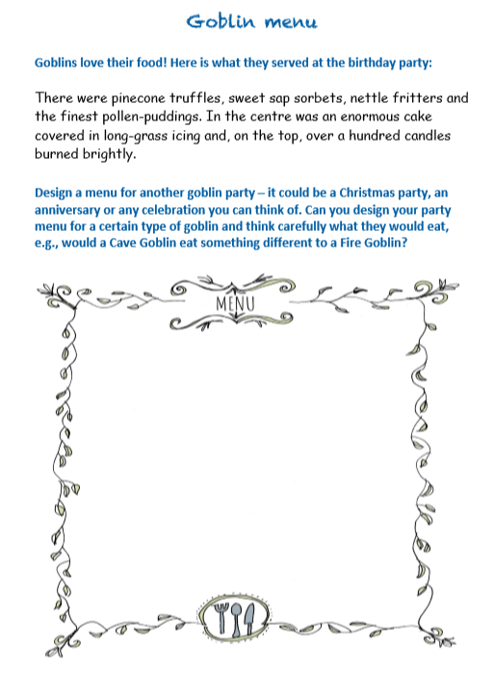

Slide 5
