Slide 1
Tuesday 21st April 2020
Reading

Slide 2
To complete today’s reading session you will need to download the extract from: The World Book Day website: Extracts - Aliens invaded my talent show

Slide 3
To start with, let’s read the extract.
This is the first chapter from a book
called
Aliens invaded my talent show by Matt Brown.
In it, we meet the two main characters from out story Eric and Vinnie.

Slide 4
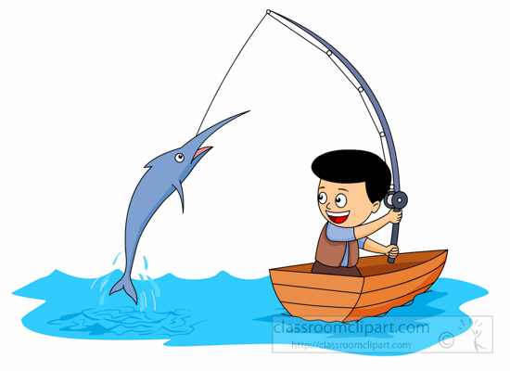
Today we are going to focus on our retrieval skills.
Retrieve and record information
Can you be a Reading Angler, and…
Skim and scan what you have read to find answers to questions?
‘Fish’ for key words?
Select important details from a text and show me where you found it?
This is Reggie. Our reading character for
Retrieval. He helps us to fish out the answer as it is right there in the text.

Slide 5
Tips from Reggie
Once you’ve read the text, you can skim and scan for key words to help you find the answer.
For example: Who was the pizza menu actually addressed to?
I would scan for the words pizza menu and addressed. These then sign post me to the answer.
In the whole of his entire, actual life, Eric Doomsday
had never got anything through the post. No letters, no postcards, no parcels, no nothing.
He did get a pizza menu once, although, as it had been addressed to a Mrs Eric Dumsday, he
didn’t think it counted.
Answer: The pizza menu was addressed to Mrs Eric Dumsday.

Slide 6
Use your copy of the extract to answer these retrieval questions. Write the answers in full sentences in your green book.
Whose Birthday Party had Eric been invited to? (Page 7)
Who else has received and invite and who are they to Eric? (Page 8)
3) How does Eric end up sat on his cornflakes? (Page 9)
4) What was Eric playing when he got the waste paper bin stuck to his head? (Page 10)
5) What did Vinnie get top marks for at school? (Page 12)
6) What is Eric and Vinnie’s secret smile? (Page 12)

