Slide 2
Answer the following questions:
What is a preposition? What examples can you remember?
What is a fronted adverbial? Can you remember the four different types?
When might we use ellipsis? What does this piece of punctuation look like?

Slide 3
Answer the following questions:
What is a preposition? What examples can you remember?
It tells you where or when something is in relation to something else.
E.g. under, next to, beneath
What is a fronted adverbial? Can you remember the four different types?
Phrase or words at the start of a sentence which are used to describe the action that follows.
When might we use ellipsis? What does this piece of punctuation look like?
To show that words have been missed out, to show the trailing off of thoughts or to create suspense. They are three dots like …

Slide 4
Relative clauses
A relative clause is not a sentence because it does not make complete sense on its own.
A relative clause is part of a sentence which adds extra information, making the sentence more detailed, specific and interesting.
Relative clauses start with a relative pronoun – who, which, that.
Relative clauses give extra information about the subject of the sentence.
Notes:
We have now recapped all essential year 5 grammar and punctuation. Today’s focus is a recap of relative clauses. I have found that children are able to identify them and accurately use them in our SPAG lessons, but are not using them often enough in their writing. Also, they should be familiar with the relative clause and the relative pronoun.
Subject knowledge – you can have clauses within sentences that do not use who, which or that but they are not relative. Other types of words may be: where, when, whose.

Slide 5
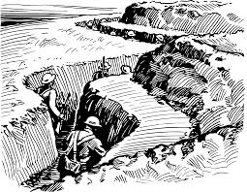
Relative clauses
World War One resulted in millions of deaths.
World War One, which ended in 1918, resulted in millions of deaths.
Notes:
Ask children if this is a complete sentence and how do they know. Tell children that this does not have a relative clause in it yet because it does not have a relative pronoun (who, which, that).
Show relative clause and completely unpick, demonstrating that if we take the clause out again, the sentence still makes sense. Identify the relative pronoun and show the purpose of the commas.
Subject knowledge – the commas separate the main clause (the part that makes sense) from the relative clause.

Slide 6
Relative clauses
Miss Nicholls loves Featherstone Primary School.
Miss Nicholls, who misses year 5, loves Featherstone Primary School.
Notes:
Repeat as last slide. ‘Who’ is relative pronoun. Why are the commas important? Does the clause make sense on its own – no! Continually emphasise the expected vocab i.e. subject, verb, object.

Slide 7
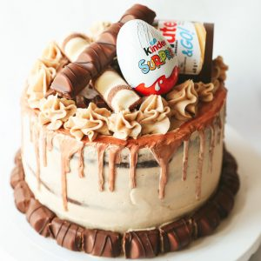
Relative clauses
The cake was impressive and delectable.
The cake, which was covered in chocolate, was impressive and delectable.
Notes:
Repeat discussion.
This time, relative pronoun - which

Slide 8
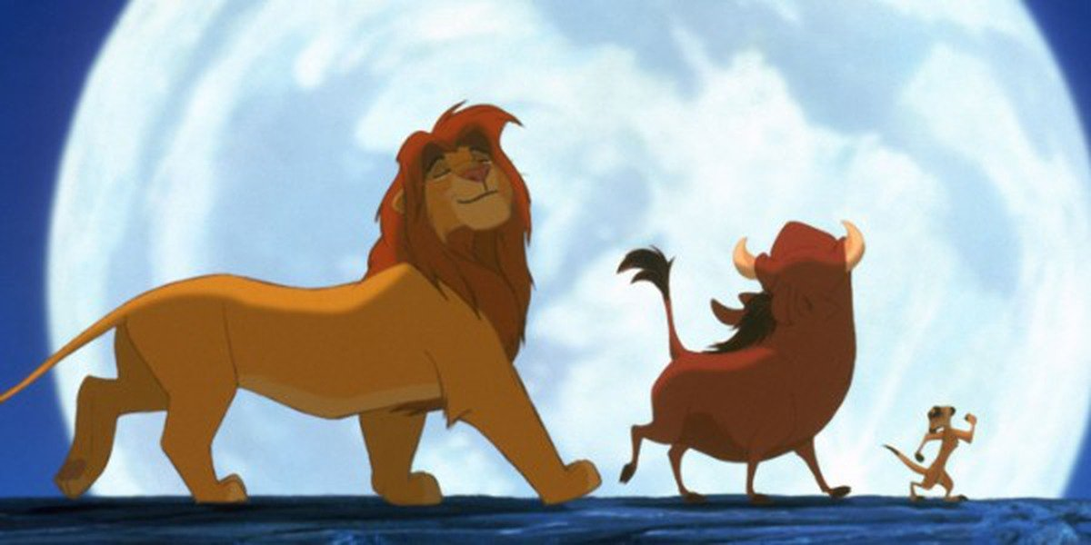
Writing relative clauses
Mr. Hunt, _____________________________, loves to play football on the weekend.
The film, _____________________________, kept me gripped throughout.
Roald Dahl __________________________ was a famous author.
Notes:
Children to complete the sentences (discussion welcomed). On the last example, children to insert the commas too.
There are no right/wrong answers as long as they make sense.
People – should start with who as relative pronoun
Encourage children to pick apart and explain sentence after. What is the main clause? What is the relative clause? What is the relative pronoun? Subject? Verb? Has it got an object>

Slide 9
True or false?
Relative clauses make complete sense on their own.
Notes:
False

Slide 10
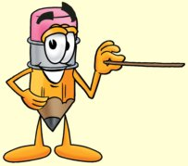
True or false?
Relative clauses are a sentence.
Notes:
False

Slide 11
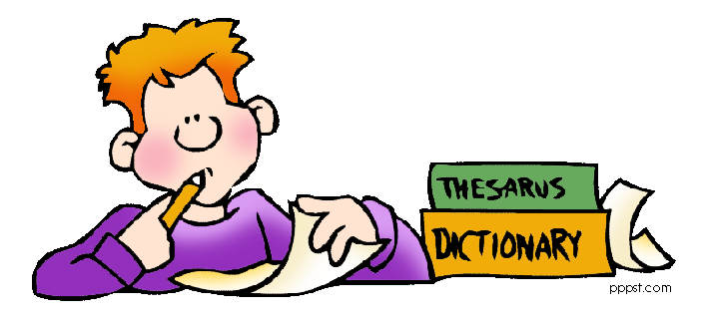
True or false?
Relative clauses start with who, which or that.
Notes:
True – although there are other pronouns too.

Slide 12
True or false?
Relative clauses need punctuation to separate them from the other part of the sentence.
Notes:
Not essential, but definitely encouraged

Slide 13
Are these all relative clauses?
Makayla, who needed the money, took on a second job.
Makayla (who needed the money) took on a second job.
Makayla – who needed the money – took on a second job.
Notes:
These are all relative clauses but they have different punctuation separating them. Tell chn that usually, brackets are for aside and dashes are for dramatic moments whilst commas are the norm.
When teaching children the three different pieces of punctuation we use to separate relative clauses, whilst any can be used, we would mainly use dashes if the sentence was dramatic,

Slide 14
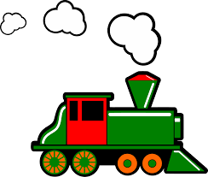
Punctuation decision
Mr. Podgett, who travelled from King’s Cross Station, stopped to get his shoes shined.
Mr. Podgett (who travelled from King’s Cross Station) stopped to get his shoes shined.
Mr. Podgett – who travelled from King’s Cross Station – stopped to get his shoes shined.
Notes:
Tell chn that these are all grammatically correct (pick them apart) but commas or brackets would be the best decision here because this is not a dramatic sentence.

Slide 15
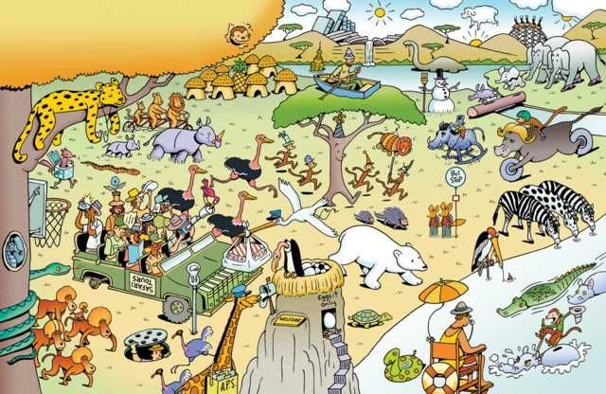
Your turn
Write three grammatically correct sentences, each containing a relative clause.
I would like each sentence to use a different pieces of punctuation to represent the relative clause.

Slide 17
What’s wrong with the relative clause?
My sunglasses, that were really expensive, they fit me really well.
Notes:
‘They’ is the error. Explain/discuss why.

Slide 18
Write your own relative clause about sunglasses

Slide 19
What’s wrong with the relative clause?
My blanket, which is really cosy, my blanket is brown and green.
Notes:
The subject of the sentence has been unnecessarily repeated.

Slide 20
Write your own relative clause about a blanket.

Slide 21
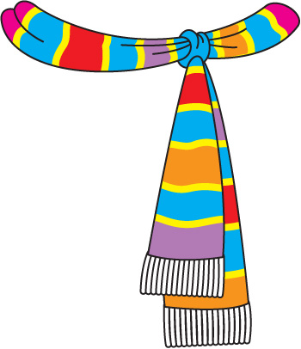
What’s wrong with the relative clause?
The scarf which I am wearing cost a lot of money.
Notes:
No punctuation!

Slide 22
Relative clauses
Write your own relative clause about a scarf.
Notes:
No punctuation!

Slide 23
Punctuation in relative clauses
Look at these boxes of words that you have been given. Re-arrange the boxes so that they make a full sentence and then punctuate them correctly.
enjoys helping children | who
is very caring | Mrs. Price
_____________________________________________________________________________________________________________________
Notes:
Remind of relative clause learning. Unpick each box + the vocab that goes with it (subject/noun/relative pronoun/verb etc). Then, rearrange the boxes (will need correct punctuation at the end of the sentence.

Slide 24
Your turn…
Look at these boxes of words that you have been given. Re-arrange the boxes so that they make a full sentence and then punctuate them correctly.
that | the naval race
was a race to build the most dreadnoughts | began in 1906
_____________________________________________________________________________________________________________________

Slide 25
Notes:
On the following slides will be SATS questions based on what they have just learnt

Slide 26
Can you do this SATs question?
Notes:
That is next to our school
Encourage children to check the rest of the sentence makes sense if the relative clause is removed.

Slide 27
Can you do this SATs question?
Notes:
Correct answer is the first one. Encourage children to pick sentence apart – main clause, relative clause, relative pronoun. Just because it doesn’t have the punctuation, it can still be a relative clause.
Take care with the 3rd one down – why might some children think that it is correct? (It has the word THAT in the sentence).

Slide 28
Can you do this SATs question?
Notes:
Remind children that it is the whole clause, not just the pronoun.
1. that came to our town
2. Who lives in Australia
3. Whose rabbit I look after

Slide 29
Can you do this SATs question?
Notes:
Box 1 is the subject/noun. Box 2 is the relative clause. Box 3 is a phrase. Box 4 is an adverbial. See if children can explain any of these.

Slide 30
Can you do this SATs question?
Notes:
Ben Green, who is in my class, went to Spain over the summer.

