Slide 1
Year 5 Measure Volume
Week 4 Lesson 4 – problem solving

Slide 2
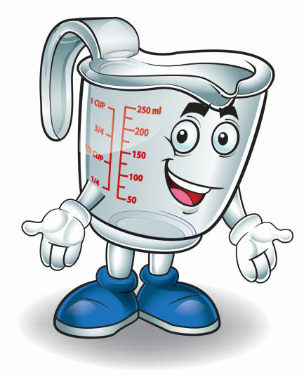
In today’s lesson
We are going to apply what we learnt on lesson 3 to answer problem solving questions with ML and L. To do this we need to:
converting between ML and L.
knowing what the question is asking me to do.
using column methods.

Slide 3
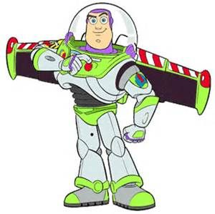
Buzz Lightyear has 3.1L of fuel in his jetpack. He uses 480ML followed by another 356ML. In litres, how much fuel does Buzz have left?
As said on the previous slide, our first step is to convert the weight so that they are the same measurement.
3.1L into ML
3.1 x 1000 = 3100
ML | to | L | ÷ 1,000
L | to | ML | X 1,000
1,000ML = 1L 1L = 1,000ML
3
1
3
1
0
0

Slide 4
Buzz Lightyear has 3.1L of fuel in his jetpack. He uses 480ML followed by another 356ML. In litres, how much fuel does Buzz have left?
To work out the calculations, I am going to find the total that Buzz has lost (480ML – 356ML).
Once I have the total I can subtract it from the amount he has.
2255ml are left. To convert this to L we need to divide by 1,000. This = 2.255L
 | ²3 | ¹⁰1 | ⁹0 | ¹0
- | 0 | 8 | 4 | 5
 | 2 | 2 | 5 | 5
 |  | 4 | 8 | 0
+ |  | 3 | 6 | 5
 |  | 8 | 4 | 5
 |  | ¹
ML | to | L | ÷ 1,000
L | to | ML | X 1,000
1,000ML = 1L 1L = 1,000ML

Slide 5
A chef adds 0.35L to this measuring cup. How many ML is in the cup now?
The measuring cup is going up in 50ml for each line.
This means it is currently at 350ml.
0.35L needs to be converted to ML which = 350ml
We need to add them both together to find the total.
 | 3 | 5 | 0
+ | 3 | 5 | 0
 | 7 | 0 | 0
 | ¹
ML | to | L | ÷ 1,000
L | to | ML | X 1,000
1,000ML = 1L 1L = 1,000ML

Slide 6
Remember…
ML |  | L | ÷ 1,000
L |  | ML | X 1,000
1,000ml = 1L 1L = 1,000ml

Slide 7
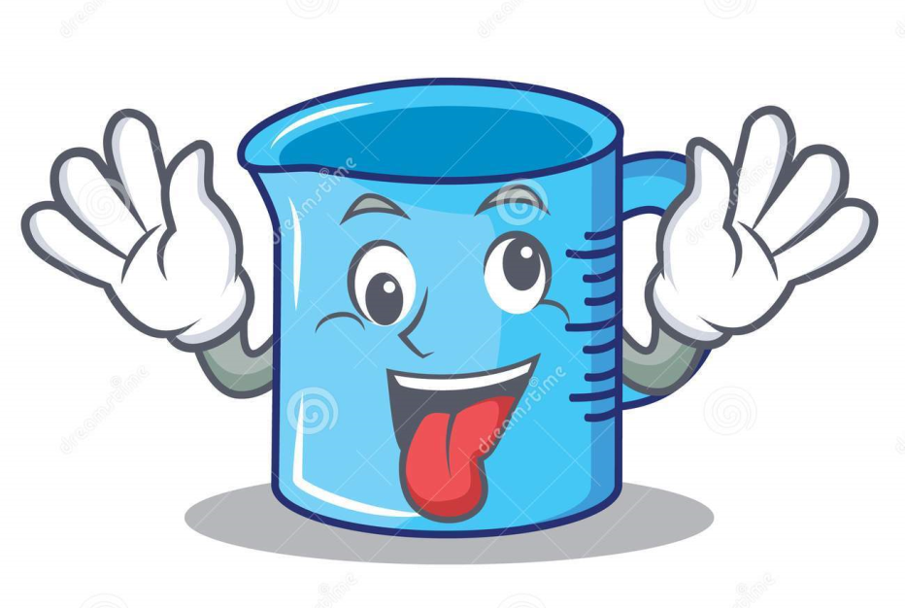
Important notes for today.
converting between ML and L.
knowing what the question is asking me to do.
using column methods.
reading scales.

