Slide 2
When do we use the following pieces of punctuation?
Parenthesis
Colons
Semi-colons
Dashes
Hyphens

Slide 3
Parenthesis
Parenthesis is a word or words written into a sentence. It is shown with brackets, dashes or commas. It adds extra information or detail that isn’t needed. It usually explains something.
Colons
Colons are used to introduce a list. Colons are also used when you are writing a direct follow-up to the main clause that you have just written. The second main clause after the colon does not have a capital letter (unless it is a proper noun).
Semi-colons
Semi-colons are used when you are writing a follow-up to the main clause that you have just written. The second main clause is linked to the first one (it might not be a complete follow-up). The second main clause after the colon does not have a capital letter (unless it is a proper noun).
Dashes
Dashes are used when there are two linked and dramatic main clauses.
Hyphens
A hyphen has several uses. They are needed before the word ‘looking’ (such as ‘good-looking’). They show that there is one object and not several (such as three-floor apartment). They are needed when writing a two-digit number which is more than 20 (such as seventy-six). They are used before the word ‘like’ (such as ‘life-like model’). They are also used to avoid ambiguity and make things clear.

Slide 4
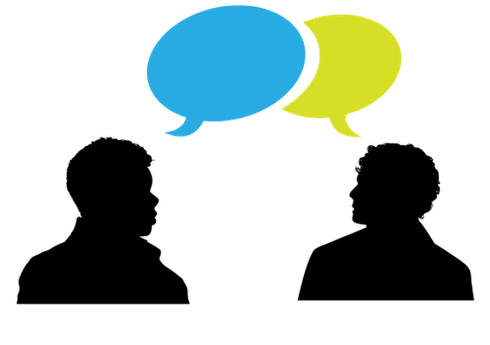
An introduction to the passive voice
Right now, we’re speaking in the active voice. Most of the time, most of the people speak in the active voice.
When you and I speak in the active voice, what order do you think the verbs, objects and subjects in our sentences go in?

Slide 5
The active voice
Subject (noun)
Verb (action)
Object
When said or written in this order, this is the active voice.
Nearly all of the people, nearly all of the time speak in the active voice.

Slide 6
The passive voice
Subject (noun)
Verb (action)
Object
The passive voice is where you take the subject of the sentence and you place it after the verb (so that it is now the object).
Then, you take the object of the sentence and you place it at the beginning of the sentence (so that it becomes the subject.

Slide 7
The passive voice
Object
Verb (action)
Subject (noun)
We write or speak in the passive voice to emphasise what is happening to the object of the sentence and perhaps make things a bit more dramatic, exciting or suspenseful.
Let’s begin to have a look…

Slide 8
The passive voice
 | Subject | Verb | Object
Active | Miss. Nicholls | blew | the whistle.
Passive
Notes:
Model to the children how the whistle is the object in this active sentence and so in passive, that would become the subject. Blew would need to become ‘was blown’ and then the subject would be ‘by Miss. Nicholls.’ Note how the ‘by Miss Nicholls’ bit is optional…remember objects are not compulsory in a sentence but at this first stage of passive voice, model it in so that the children become used to it. Tell children that of course, in a proper piece of writing, the passive voice is a bit more complex than this but for now, this is a good initial understanding.

Slide 9
The passive voice
 | Subject | Verb | Object
Active | Mr. Hunt | kicked | the ball.
Passive
Notes:
Passive - ‘The ball was kicked by Mr. Hunt.’
The ‘by Mr. Hunt’ isn’t compulsory but it is good to model it.

Slide 10
The passive voice
 | Subject | Verb | Object
Active | Mr. Douglas | took | the register.
Passive
Notes:
Passive - ‘The register was taken by Mr. Douglas.’

Slide 11
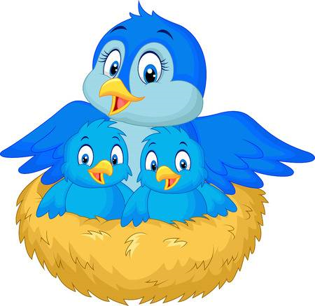
The passive voice
 | Subject | Verb | Object
Active | The bird | built | a nest.
Passive
Notes:
Passive - A nest was built (by the bird).

Slide 12
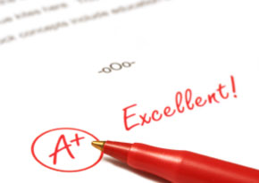
The passive voice
 | Subject | Verb | Object
Active | Mrs. Price | marked | the book.
Passive
Notes:
Passive - The book was marked (by Mrs. Price).

Slide 13
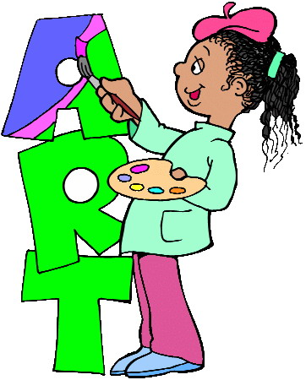
The passive voice
 | Subject | Verb | Object
Active
Passive | The artwork | was drawn by | the artist.
Notes:
Can children have a go when it is the other way around?
Active - The artist drew the artwork. Take care with verb conversion.

Slide 14
The passive voice
 | Subject | Verb | Object
Active
Passive | The test | was started by | the teacher.
Notes:
Active - The teacher started the test.

Slide 15
Active or passive?
Passive
The pizza was eaten by the children.

Slide 16
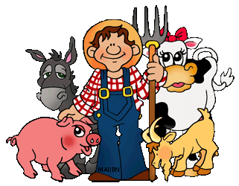
Active or passive?
Active
The farmer ploughed the field.

Slide 17
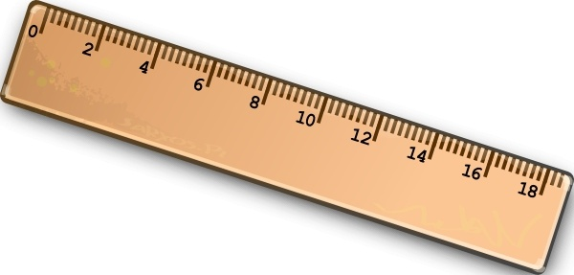
Active or passive?
Active
I drew a margin.

Slide 18
Active or passive?
Passive
The grass was mown by Mr. Morgan.

Slide 19
Recap Which is active and which is passive?
Object
Verb (action)
Subject (noun)
Subject (noun)
Verb (action)
Object
Notes:
Recap – top line is passive. Bottom line active.
Ask children to give examples of each verbally

Slide 20
Active or Passive?
Sentence | Active | Passive
Henry turned the television on.
I poured a drink.
Dinner was cooked by Mrs. Jones.
Mary answered the telephone.
The race was started.
The pilot turned on the engines.
The race was won by John.
The photograph was taken by the photographer.
The door was slammed shut.
A lot of pigs ate the food.

Slide 21
Active or Passive?
Sentence | Active | Passive
Henry turned the television on.
I poured a drink.
Dinner was cooked by Mrs. Jones.
Mary answered the telephone.
The race was started.
The pilot turned on the engines.
The race was won by John.
The photograph was taken by the photographer.
The door was slammed shut.
A lot of pigs ate the food.

Slide 22
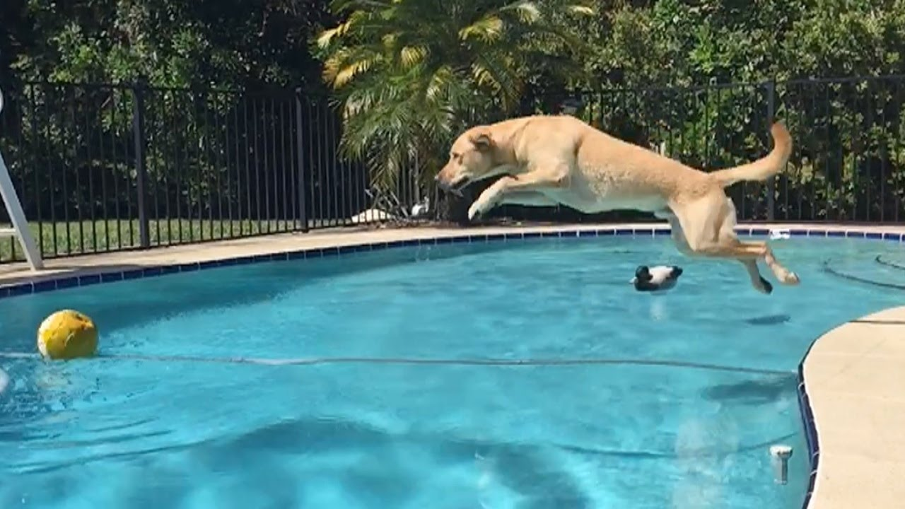
Write an active sentence about…

Slide 23
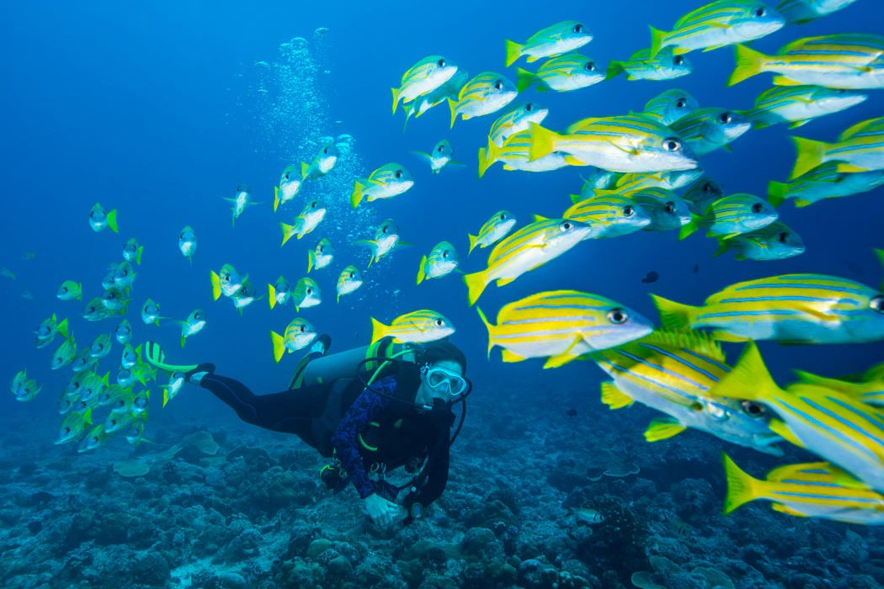
Write a passive sentence about…

Slide 24
Notes:
On the following slides will be SATS questions based on what they have just learnt

Slide 25
This is a bit tricky but remember the rules you have just learnt.
Notes:
Children might find it easier to unpick the sentence first (subject, verb, object)
Acceptable answers: ‘We were drenched by the pouring rain.’
‘We were drenched.’
‘We were drenched by the rain.’ Must have capital letter and full stop!

Slide 26
How many out of three will you get correct?
Notes:
Passive
Active
Active

Slide 27
Think carefully…
Notes:
Model each one and convert to active to check. When you get to the third one down, you can’t convert to active because that one is the answer.
I think children will spot the 4th one down straight away because of the ‘by…’

