Slide 1
The focus for reading this week is summary.
This is where we will look at the text overall.
A reading reporter looks at the ‘bigger picture’ and the main ideas.
Read the pages of the extract from the fiction text ‘Around the World in Eighty Days’. Then, carefully answer the questions. Remember to check your answers by scanning back through the text.
Notes:
https://www.lovereading4kids.co.uk/extract/7363/Around-the-World-in-Eighty-Days-Oxford-Childrens-Classics-by-Jules-Verne.html

Slide 2
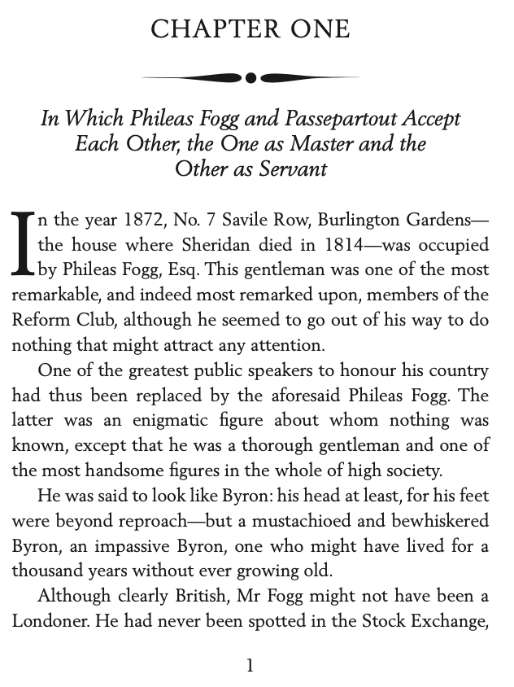
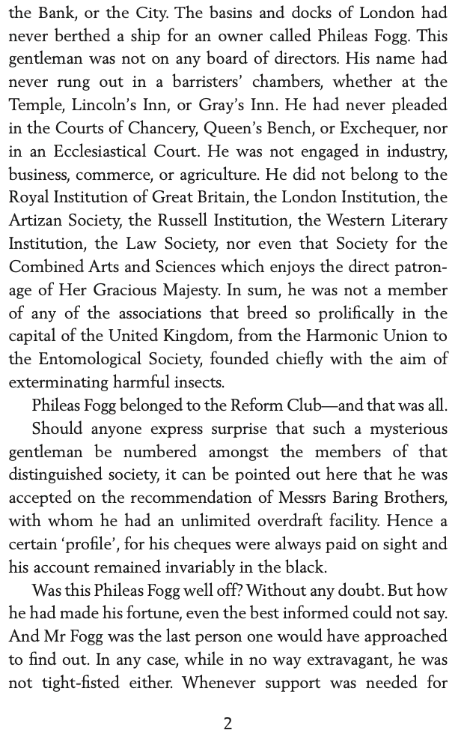
Around the World in Eighty Days by Jules Verne

Slide 3
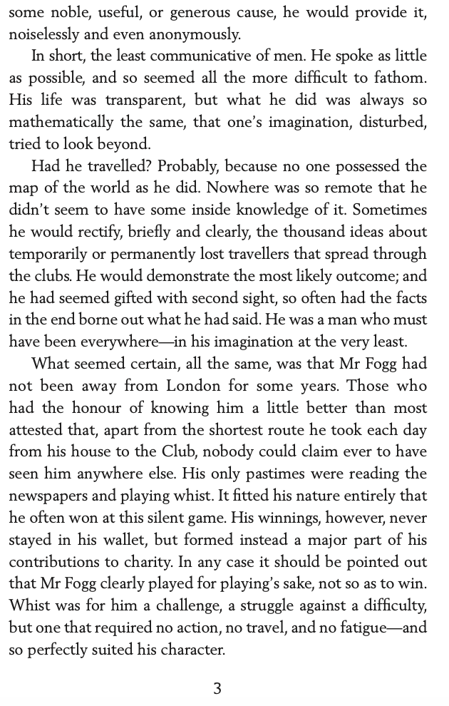
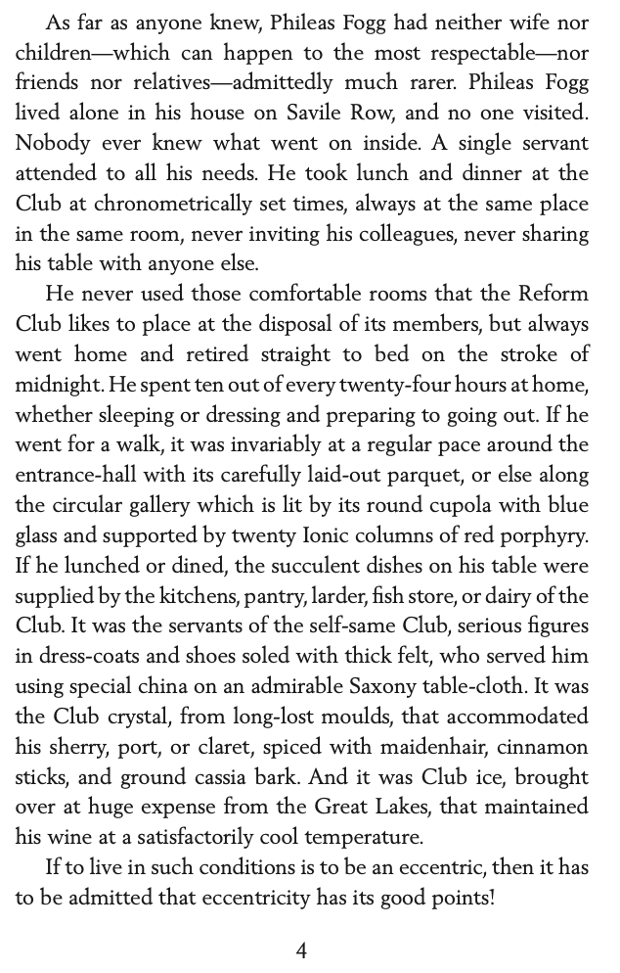

Slide 4
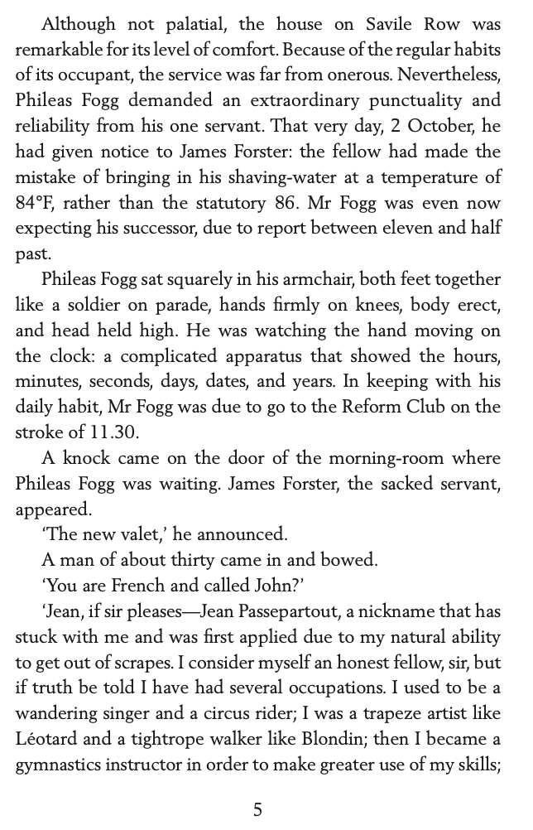
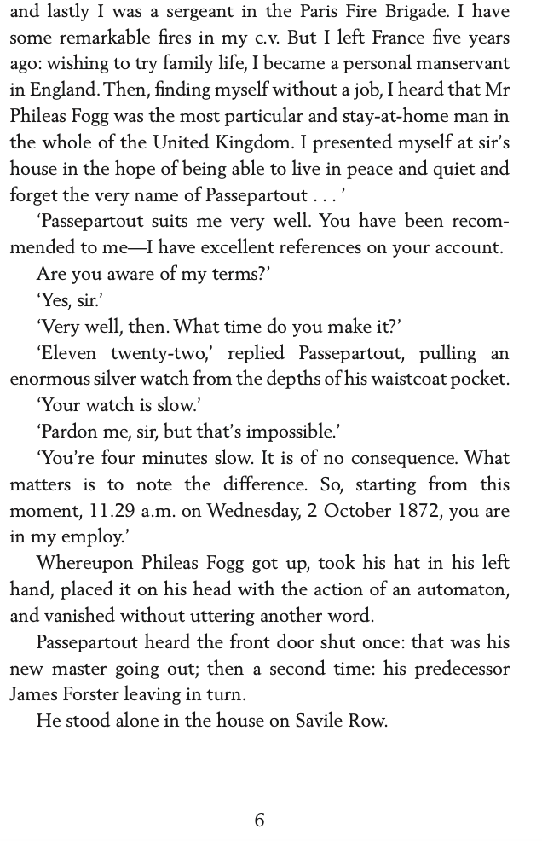

Slide 5
Around the World in Eighty Days
Choose one word to explain how the servant would have felt when sacked.
Explain why you think this.
In two sentences, summarise the events of this chapter.
Summarise what type of employer you think Phileas Fogg would be and why.
Choose two words to describe the character of Phileas Fogg. Explain your decision using evidence from the text.
Order the following events from 1-5 as they occur in the text.
Jean discussed his life experiences.
James delivered the water at the incorrect temperature.
Mr Forster left the house for the final time.
Mr Fogg met Jean.
Phileas asked for the time.

Slide 6
Around the World in Eighty Days
1. Choose one word to explain how the servant would have felt when sacked.
Several answers accepted. Disappointed, gutted.
2. Explain why you think this.
Several answers accepted. Mr Fogg would have paid good money for his servant especially as he was so particular.
3. In two sentences, summarise the events of this chapter.
Several answers accepted. In this chapter, we discover the characteristics and lifestyle of Phileas Fogg. We learn that he sacked his servant as he made a small mistake regarding the temperature of the water and replaced him immediately with a French man.
4. Summarise what type of employer you think Phileas Fogg would be and why.
I think he would be very strict and fussy as he likes things a specific way and temperature and will replaced you in seconds if you make a small mistake.
5. Choose two words to describe the character of Phileas Fogg. Explain your decision using evidence from the text.
Several answers accepted. E.g. Particular and generous.
The text describes his requests as particular but I also think he is generous as he gives a lot to charity and doesn’t want the recognition as he does this anonymously.
6. Order the following events from 1-5 as they occur in the text.
Jean discussed his life experiences. – 3
James delivered the water at the incorrect temperature. – 1
Mr Forster left the house for the final time. – 5
Mr Fogg met Jean. – 2
Phileas asked for the time. – 4

