Slide 2
What is a homophone?
A homophone is a word that is pronounced the same as another word but differs in meaning.
A homophone may also differ in spelling.
E.g. their, there, they’re

Slide 3
Homophones
aisle
Isle
Notes:
We have learnt all the year 5 homophones for the year so will spend the next few weeks recapping them.
Children should know the difference between both homophones & the spelling and be able to choose the correct one to complete a given sentence.

Slide 4
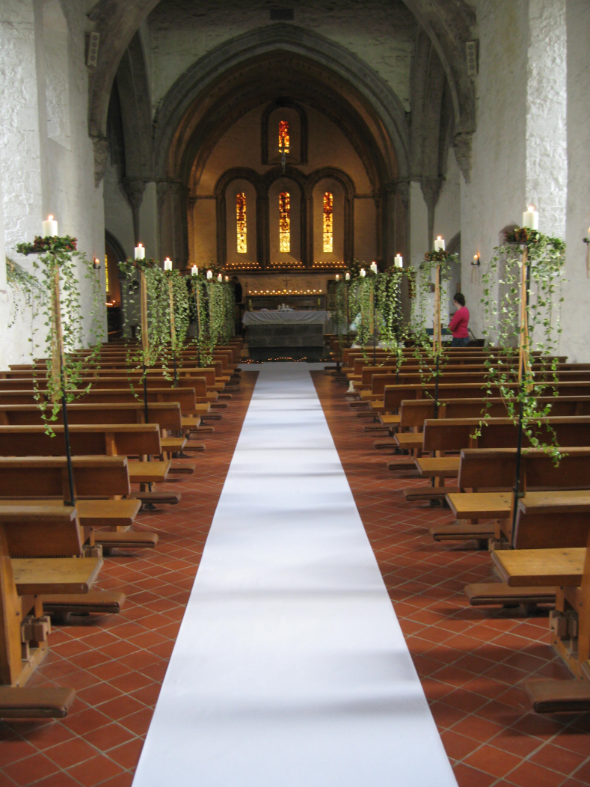
Homophones
Does this church have an aisle or an isle? Explain why.
Notes:
Aisle – as it has a runway/walkway.

Slide 5
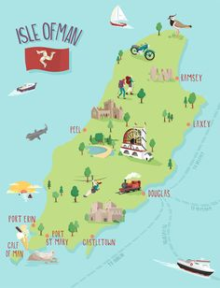
Homophones
Is this the Isle of Man or the Aisle of Man?
?
Notes:
Isle of man as it is a location.

Slide 6
Homophones
aloud
allowed

Slide 7
Homophones – which one is correct?!
Running down the isle is not allowed.
Running down the isle is not aloud.
Running down the aisle is not allowed.
Running down the aisle is not aloud.
Notes:
3 – this tests knowledge of both isle and aisle

Slide 8
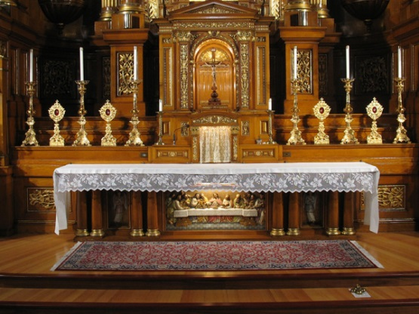
Homophones
altar
(The front table of a Christian church).
alter

Slide 9
Homophones
How many mistakes can you notice and correct?
“If I have to tell you again, you will not be aloud on your Xbox,” said Mom. “You are not allowed to run down the isle to the alter.”
The child looked sad.
“You won’t get me to altar my mind by looking at me like that!” Mom said, annoyed again.
Notes:
Tests knowledge of several homophones.

Slide 10
The perfect tense (verb form)
The perfect tense shows an event that has been completed but the effect or impact of the event is still relevant.
The easiest way to recognise the perfect tense is because it uses have, had or has. If you have everything you’ve ever wanted and you’ve had everything you’ve ever wanted then life is pretty perfect!
The perfect tense also has a past tense verb.
To decide if the tense is past, present or future, look at the auxiliary verb that is used.
Notes:
This is a new concept/term children will be looking at.
They have used it in their writing without being aware of what it is and what it shows so today we will be looking at the perfect tense in more detail.
Auxiliary verbs - An auxiliary verb is a verb that adds functional or grammatical meaning to the clause in which it appears. Auxiliary verbs usually accompany a main verb.

Slide 11
The perfect tense – past, present or future?
Had – Past
Has – Present
Have – Present
Will have – Future
have had, has

Slide 12
The perfect tense summary
have had, has
past tense verb

Slide 13
What does this show about the present?
has or have + past tense verb = present perfect
had + past tense verb = past perfect
She has downloaded her music.
Notes:
Present perfect

Slide 14
What does this show about the present?
has or have + past tense verb = present perfect
had + past tense verb = past perfect
He has gone to eat his lunch.
Notes:
Present perfect

Slide 15
What does this show about the present?
has or have + past tense verb = present perfect
had + past tense verb = past perfect
The team have completed their marathon training.
Notes:
Present perfect

Slide 16
What does this show about the present?
has or have + past tense verb = present perfect
had + past tense verb = past perfect
I have left a message on his answerphone.
Notes:
Present perfect

Slide 17
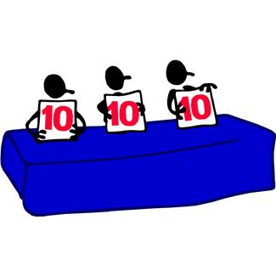
The perfect verb form
What is it?
Which words does it have?
What does it show?
If you have everything you’ve ever wanted and you’ve had everything you’ve ever wanted then life is pretty perfect!
Notes:
Quick recap – are children able to explain what the perfect verb form is?

Slide 18
The perfect tense (verb form)
The perfect tense shows an event that has been completed but the effect or impact of the event is still relevant.
The easiest way to recognise the perfect tense is because it uses have, had or has. If you have everything you’ve ever wanted and you’ve had everything you’ve ever wanted then life is pretty perfect!
The perfect tense also has a past tense verb.
To decide if the tense is past, present or future, look at the auxiliary verb that is used.

Slide 19
Show how…
has or have + past tense verb = present perfect
had + past tense verb = past perfect
Someone worked or tried their best.
Notes:
E.g. I have tried my best = This impact would be that someone feels happy or proud still.

Slide 20
Show how…
has or have + past tense verb = present perfect
had + past tense verb = past perfect
You lost an important item.
Notes:
E.g. I have lost an important item = I am still looking for it/continues to be lost.

Slide 21
Show how…
has or have + past tense verb = present perfect
had + past tense verb = past perfect
If today has been good or not.

Slide 22
What does this show about the present?
has or have + past tense verb = present perfect
had + past tense verb = past perfect
He has gone to eat his lunch.

Slide 23
What does this show about the present?
has or have + past tense verb = present perfect
had + past tense verb = past perfect
The team have completed their marathon training.

Slide 24
Write a present tense sentence about this picture. Remember to punctuate your sentence fully.
Notes:
E.g. I have been to the shops.

Slide 25
Write a present tense sentence about this picture. Remember to punctuate your sentence fully.
Notes:
E.g. I have returned off holiday.
Try to discourage ‘been.’

Slide 26
Underline the perfect tense and on the line, write whether it is past, present or future perfect
Mikey had figured out the answer before his teacher’s explanation. _______________________
I have walked every day now for a month. _______________________
Vickie had liked Neil until their argument. _______________________
Alf will have jogged 70 miles by the end of next week. _______________________
By lunch time, Joe had started cooking dinner. _______________________
Andrei has practised piano every day for a week. _______________________
At this rate, we will not have finished the work by lunchtime. _______________________
The shop has added a number of new till assistants to the staff. _______________________
The ice on the lake will have melted long before the weekend. _______________________
The window had cracked before the wind storm.
Notes:
Underline the perfect tense and on the line, write whether it is past, present or future perfect

Slide 27
Notes:
On the following slides will be SATS questions based on what they have just learnt.

Slide 28
SATs Question – The perfect tense
Notes:
B – encourage children to explain their answer. If Disha has already given a tv interview, it must be in the past.

Slide 29
SATs Question – The perfect tense
Notes:
D – use of has

Slide 30
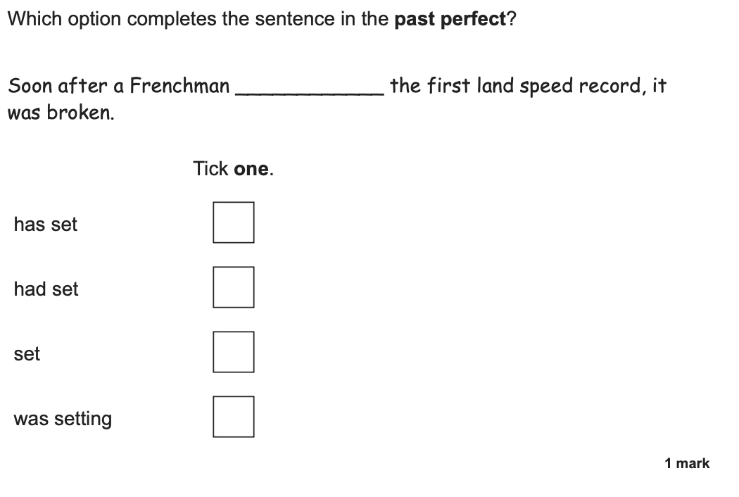
SATs Question – The perfect tense
Notes:
B – past perfect

Slide 31
SATs Question – This one is tricky!
Notes:
‘has wanted’ is the only part that must be underlined.

