Slide 1
Today, we will be exploring a well-known song by Emeli Sandé.
The song is called ‘Read All About It’.
As we are nearly coming to the end of our Year Five journey, we are going to recap all of our reading skills. Over the next few slides, I have put a reminder of our reading characters to help.
Firstly, I would like you to read the lyrics (left side first).
Then, I have attached the YouTube link so you can listen to it (and sing along if you like).
Notes:
https://www.youtube.com/watch?v=vaAVByGaON0&list=RDvaAVByGaON0&start_radio=1

Slide 2
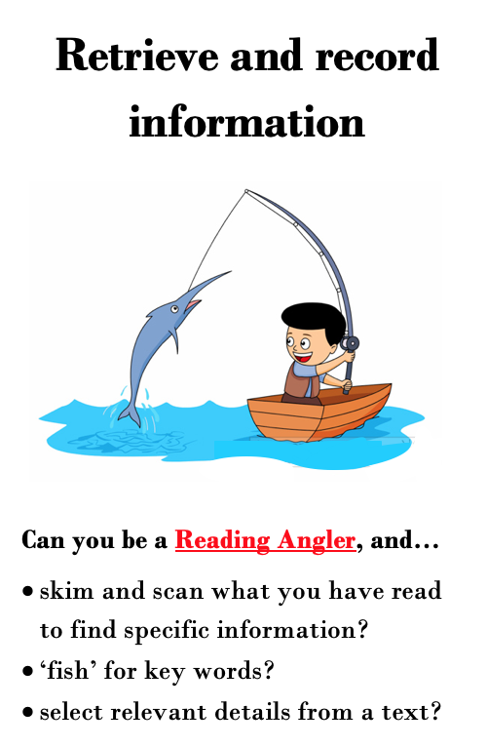

Slide 3
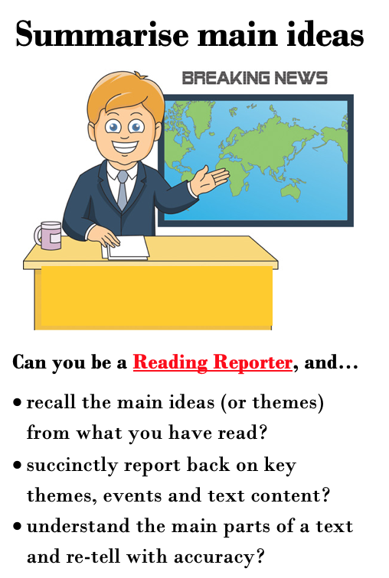

Slide 4
Read All About It - Emeli Sandé
You've got the words to change a nation
But you're biting your tongue
You've spent a lifetime stuck in silence
Afraid you'll say something wrong
If no one ever hears it how we gonna learn your song?
So come, on come on
Come on, come on
You've got a heart as loud as lions
So why let your voice be tamed?
Baby we're a little different
There's no need to be ashamed
You've got the light to fight the shadows
So stop hiding it away
Come on, Come on
I wanna sing, I wanna shout
I wanna scream till the words dry out
So put it in all of the papers,
I'm not afraid
They can read all about it
Read all about it oh
Oh-oh-oh
Oh-oh-oh
Oh-oh-oh
Oh-oh-oh
Oh-oh-oh
Oh-oh-oh

Slide 5
At night we're waking up the neighbours
While we sing away the blues
Making sure that we remember yeah
Cause we all matter too
If the truth has been forbidden
Then we're breaking all the rules
So come on, come on
Come on, come on,
Let's get the tv and the radio
To play our tune again
It's 'bout time we got some airplay of our version of events
There's no need to be afraid
I will sing with you my friend
Come on, come on
I wanna sing, I wanna shout
I wanna scream till the words dry out
So put it in all of the papers,
I'm not afraid
They can read all about it
Read all about it oh
Oh-oh-oh
Oh-oh-oh
Oh-oh-oh
Oh-oh-oh
Oh-oh-oh
Oh-oh-oh

Slide 6
Yeah we're all wonderful, wonderful people
So when did we all get so fearful?
Now we're finally finding our voices
So take a chance, come help me sing this
Yeah we're all wonderful, wonderful people
So when did we all get so fearful?
And now we're finally finding our voices
So take a chance, come help me sing this
I wanna sing, I wanna shout
I wanna scream till the words dry out
So put it in all of the papers,
I'm not afraid
They can read all about it
Read all about it oh
Oh-oh-oh
Oh-oh-oh
Oh-oh-oh
Oh-oh-oh
Oh-oh-oh
Oh-oh-oh
I wanna sing, I wanna shout
I wanna scream till the words dry out
So put it in all of the papers,
I'm not afraid
They can read all about it
Read all about it oh

Slide 7
https://www.youtube.com/watch?v=vaAVByGaON0&list=RDvaAVByGaON0&start_radio=1

Slide 8
Read All About It
'You've got the words to change a nation' - what does the writer mean by this phrase?
What does it mean if you are 'biting your tongue’? In two sentences, summarise the events of this chapter.
How have some people spent their lifetime?
In the song, the singer appears to be singing to someone. In the first stanza, what does the singer say their problem is?
Find and copy one word that means 'to be controlled’.
Do you think that this song has a message? If so, what is it?
What is a key theme of this song? Explain your reasons.

Slide 9
Read All About It – Answers
1. 'You've got the words to change a nation' - what does the writer mean by this phrase?
Several answers accepted. E.g. You have the ability to make a difference in the world.
2. What does it mean if you are 'biting your tongue’?
To stop yourself from saying something you would really like to say.
3. How have some people spent their lifetime?
Stuck in silence
4. In the song, the singer appears to be singing to someone. In the first stanza, what does the singer say their problem is?
If people don’t vocalise their thoughts/problems, people won’t know about it/nothing will change.
5. Find and copy one word that means 'to be controlled’.
tamed
6. Do you think that this song has a message? If so, what is it?
Several answers accepted. E.g. Yes. I think the message is for people to speak up and stand up for what they believe in so that the world can become a better place.
7. What is a key theme of this song? Explain your reasons.
Several answers accepted. E.g. Freedom could be a key theme as it continuously address the need for freedom of speech/the freedom to say how you feel in order to change what you are unhappy with. It suggests that there has been unfair situations and people deserve more freedom and equality.

