Slide 1
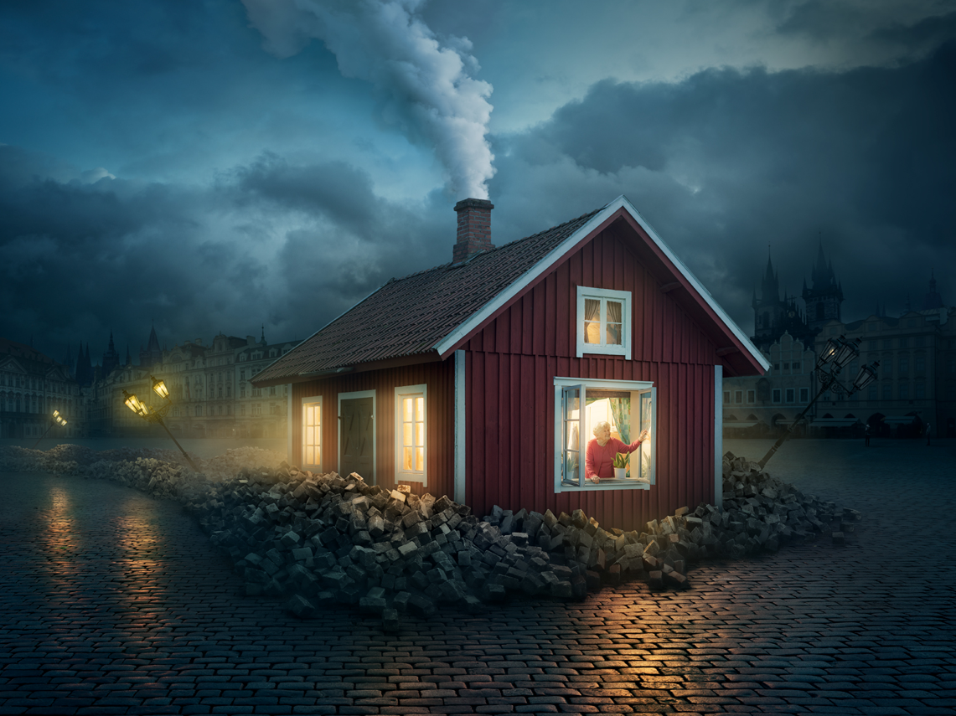
You are going to write a short narrative using this picture as a stimulus.
Use the checklist to help you include some great Year 3 writing techniques.
This presentation will help you remember what those techniques are for.

Slide 2

Sentences
What must a sentence have?
Capital letter.
Noun.
Verb.
Something happens.
Full stop/Exclamation/Question mark.
A sentence is one complete idea.
Notes:
Discuss ideas first.

Slide 3

Conjunctions!
A conjunction links two sets of words together.
Co-ordinating conjunctions link two sets of words together to make an equal pair.

Slide 4
Co-ordinating conjunctions!
Let’s have a look at how they work…
For
And
Nor
But
Or
Yet
So
Notes:
For, and, nor, but, or, yet, so

Slide 5
Strong Word Mat!
Adjectives (describing words) |  | Verbs (doing words)
☺ Tropical Beautiful Lush Green Gorgeous Peaceful Magnificent Bright Brilliant Colourful Enormous | ☹ Black Grey Smokey Horrible Vile Noisy Dull Flat | ☺ Scuttling Slithering Shuffling Scurrying Rustling Crunching Cracking Squeaking Squawking | ☹ Roaring Rumbling Crashing Destroy Chop Cut Burn Blackened Burnt Ruined Trashed
Notes:
Word bank to help

Slide 6

What is a simile?
A simile is a descriptive sentence. It compares two things together using AS or LIKE so that the sentence is interesting.

Slide 7
You are going to write a short narrative using this picture as a stimulus.
Use the checklist to help you include some great Year 3 writing techniques.

