Slide 1

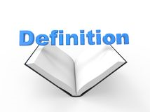
Year 5/6 word list
opportunity
A time or set of circumstances which mean that it is possible to do something.
Notes:
The first four slides are some of the year 5/6 statutory words they are due to learn

Slide 2
Year 5/6 word list
prejudice
A negative opinion you have about somebody or something before you have the facts.

Slide 3
Year 5/6 word list
privilege
Honour or big treat

Slide 4
Year 5/6 word list
profession
What you do for a living – your occupation or job.

Slide 5
Can you think of any words that end in the suffix ‘ible’ or ‘able’?

Slide 6
–ible and –able
forgivable
comfortable
excitable
reliable
breakable
desirable
vegetable
spreadable
responsible
legible
edible
irresistible
(ir)reversible
invincible
invisible

Slide 7
When is it –ible and when is it –able?
The general rule is… if we take away the suffix and we ARE left with a ‘real’ root word, then it is –able:
understandable
comfortable
If we take away the suffix and we are left with a nonsense word, then it is –ible:
edible
invisible
Notes:
A suffix is a string of letters that go at the end of a root word, changing or adding to its meaning. Suffixes can show if a word is a noun, an adjective, an adverb or a verb.

Slide 8
Add the correct suffix!
ible
invis

Slide 9
Add the correct suffix!
ible
leg

Slide 10
Add the correct suffix!
able
break

Slide 11
Add the correct suffix!
able
spread

Slide 12
Sometimes, the root word changes before adding –able
Forgive ________________
Excite ________________
Rely ________________
Desire ________________
Response ________________
Notes:
Show what happens to the last letter of each of these words, meaning that the root word slightly changes.
E.g. Rely - depend on with full trust or confidence
Reliable - consistently good in quality or performance; able to be trusted

Slide 13
–ible and –able
-able
forgivable _________________________________________________________________________________________
comfortable _________________________________________________________________________________________
excitable _________________________________________________________________________________________
reliable _________________________________________________________________________________________
breakable _________________________________________________________________________________________
desirable _________________________________________________________________________________________
vegetable _________________________________________________________________________________________
spreadable _________________________________________________________________________________________
-ible
responsible _________________________________________________________________________________________
(il)legible _________________________________________________________________________________________
edible _________________________________________________________________________________________
irresistible _________________________________________________________________________________________
(ir)reversible _________________________________________________________________________________________
invincible _________________________________________________________________________________________
invisible _________________________________________________________________________________________
Notes:
Good opportunity for children to use dictionary to identify definitions of unfamiliar words

Slide 14
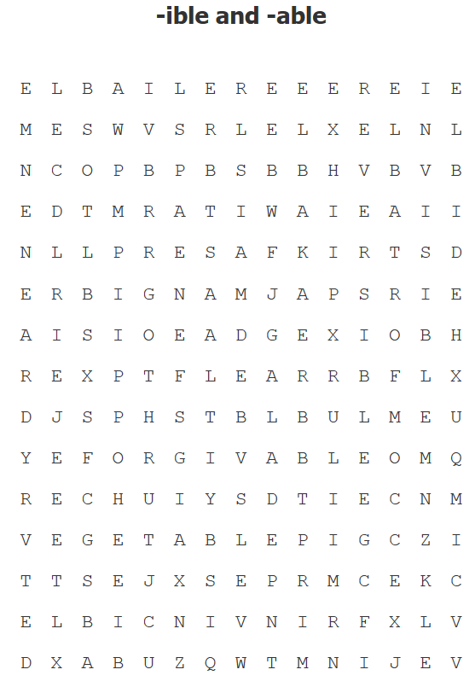
forgivable
comfortable
excitable
reliable
breakable
desirable
vegetable
spreadable
responsible
legible
edible
irresistible
reversible
invincible
invisible
Notes:
Children have the choice of completing a word search or crossword to consolidate their knowledge of the new spelling pattern

Slide 15
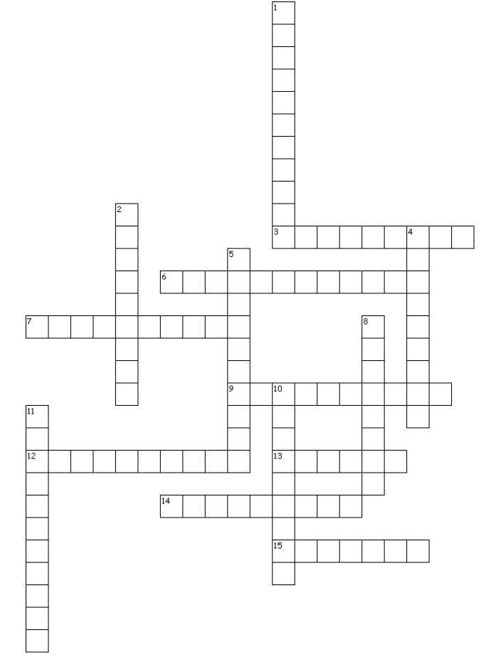
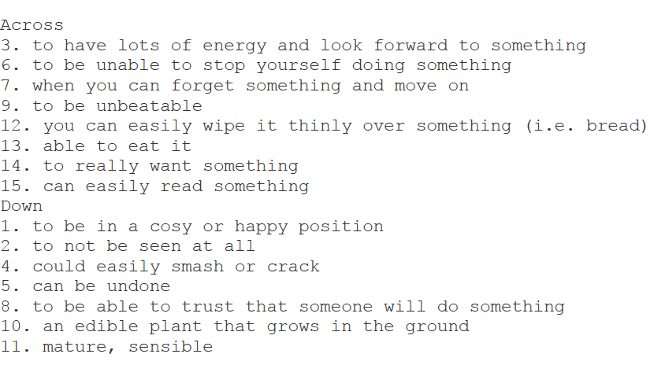
-ible and –able crossword

