Slide 1

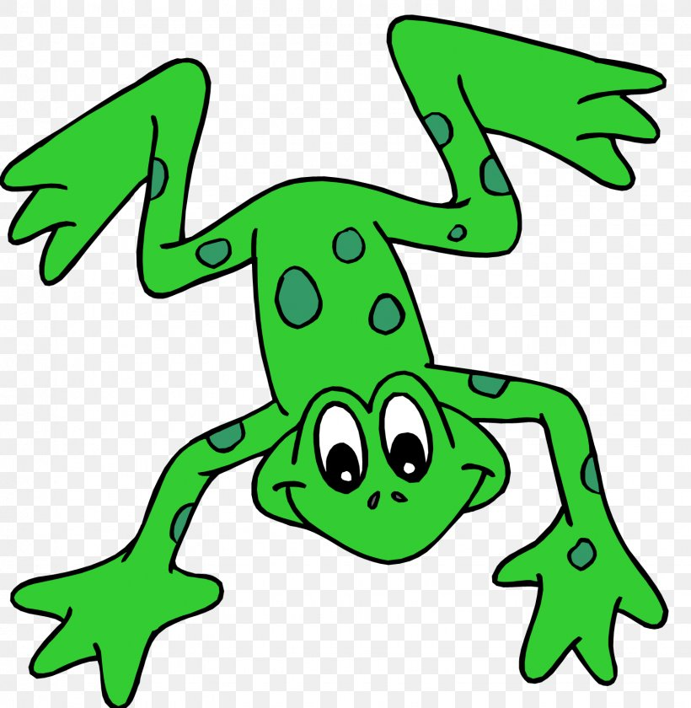


EYFS Literacy
Week 2

Slide 2
Phonics
Session 4

Slide 3
Phonics- Speedy Sounds
Click on the orange square to begin.
Each letter will appear and disappear each time you click.
How fast can you read each sound?
k
nk
z
x
n
l
w
v
r
s
f
i

Slide 4
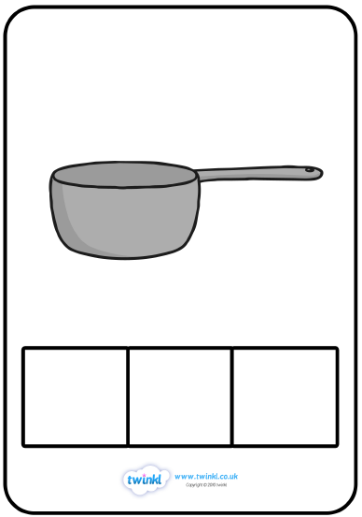
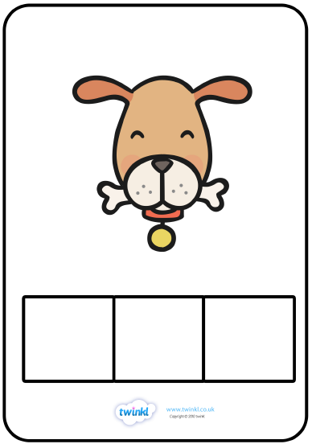
Phonics- Fred Talk
p
o
t
d
o
g

Slide 5
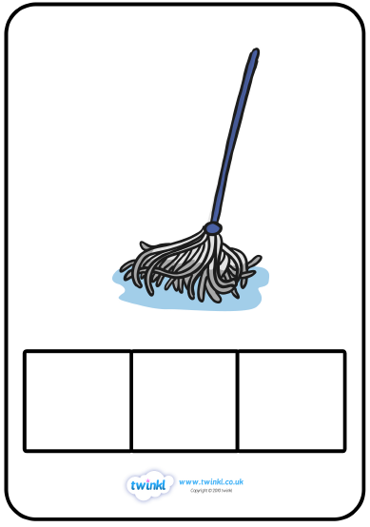
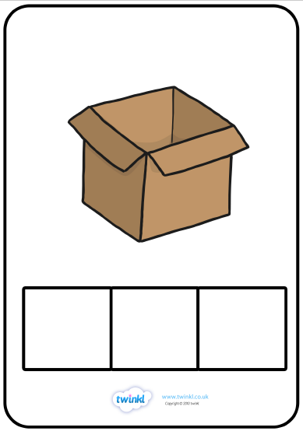
Phonics- Fred Talk
m
o
p
b
o
x

Slide 6

Phonics- Ditty
a | hat
a | red | hat
a | red | hat | on | top
Hold a sentence:
Put on the red hat.

Slide 7
Literacy
Session 4-
Making a sentence

Slide 8
Literacy- Session 4
Here are 3 sentences. They are jumbled up! Can you unscramble them to make sense?
The
cat
is
black
.
cat
black
is
.
The

Slide 9
Literacy- Session 4
Here are 3 sentences. They are jumbled up! Can you unscramble them to make sense?
The
dog
can
run
.
dog
run
can
.
The

Slide 10
Literacy- Session 4
Here are 3 sentences. They are jumbled up! Can you unscramble them to make sense?
The
rabbit
can
hop
.
rabbit
hop
can
.
The

Slide 11
Now it’s your turn to write a sentence.

