Slide 1
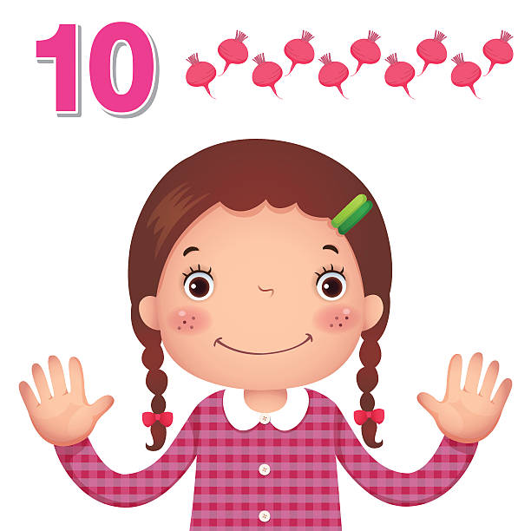
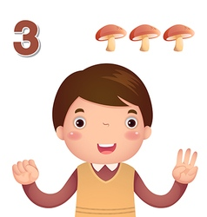
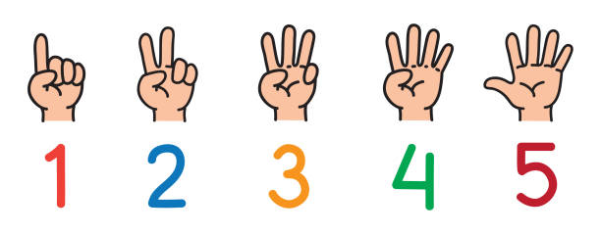
EYFS Maths
Session 1

Slide 2
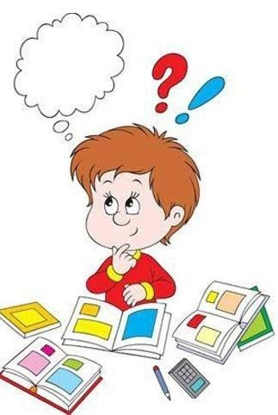
Message to parents
This week the children will be practising counting on and back to solve mathematical problems.
The focus of this week’s home learning is to
encourage mathematical thinking and reasoning.
On the next slide there are different question
types you can use to develop your child’s
mathematical thinking and reasoning.

Slide 3
Reinforce the language as this will help your child to learn the concepts.
Describing How many were there at the start? How many are there now?
Reasoning How do you know? How did you work it out?
Opening Out What if we add two more? What if we take one out? Two out? Imagine there are 10 in there and I take out 6 – how would you know how many were left?
Recording Can you show how many there were? Can you show how many there are now? Can you show how many there were and what happened?

Slide 4
Warm Up Let’s warm up our brains ready to learn.
The Prince looked for Cinderella for
1 week.
How many days is that?
_______________

Slide 5
Warm Up- answer Let’s warm up our brains ready to learn.
The Prince looked for Cinderella for
1 week.
How many days is that?
_______________
seven
7

Slide 6
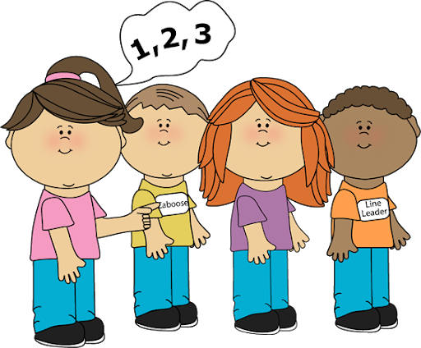
Today we’re going to be practising our counting on skills…. You can count on using a number line, your fingers or even in your head!

Slide 7
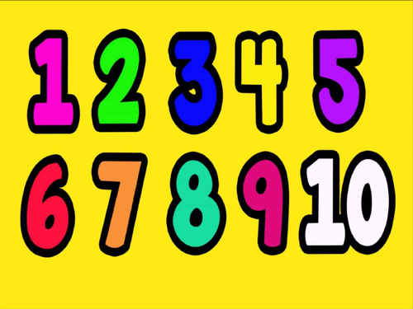
When we count on, you have a ‘starter number’. The number you start with before you start counting. My starter number is 5.
Now I need to find out how many I’m counting on…
5
So we started with 5… now count on 6 (you can use your fingers to help you)…
What answer did you get?

Slide 8
The answer is…..
11!
Well done!

Slide 9
This time I’m going to start with…
Now I need to find out how many I’m counting on…
4
So we started with 4… now count on 5 (you can use your fingers to help you)…
What answer did you get?

Slide 10
The answer is…..
9!
Well done!

Slide 11
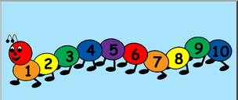
Well Done!
Now have a go at the activity sheet provided.

