Slide 1
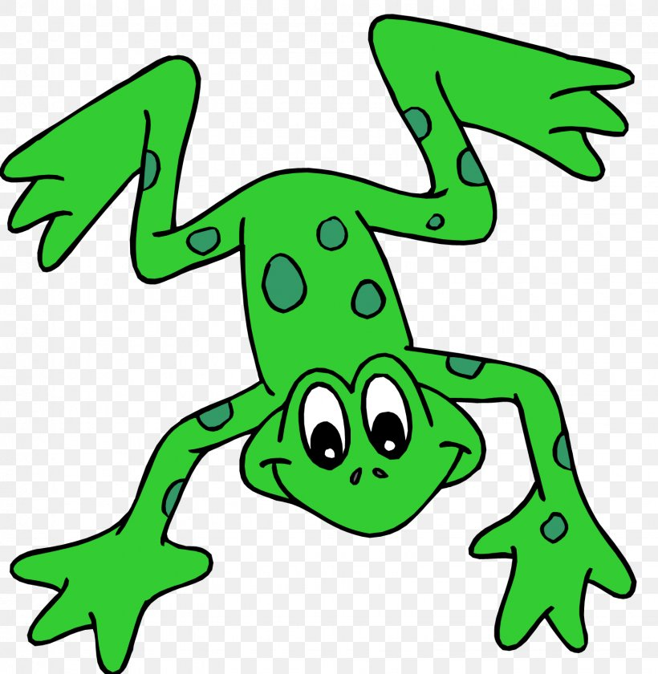
EYFS Literacy
Week 3

Slide 2
Phonics
Session 2

Slide 3
Phonics- Speedy Sounds
Click on the orange square to begin.
Each letter will appear and disappear each time you click.
How fast can you read each sound?
u
ng
th
o
v
h
f
ch
sh
w
j
a

Slide 4
Phonics- Fred Talk
ch
i
ck
ch
o
c

Slide 5
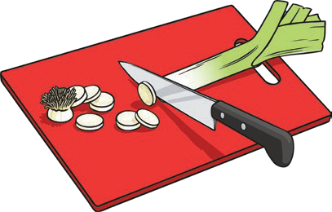
Phonics- Fred Talk
ch
i
n
ch
o
p

Slide 6
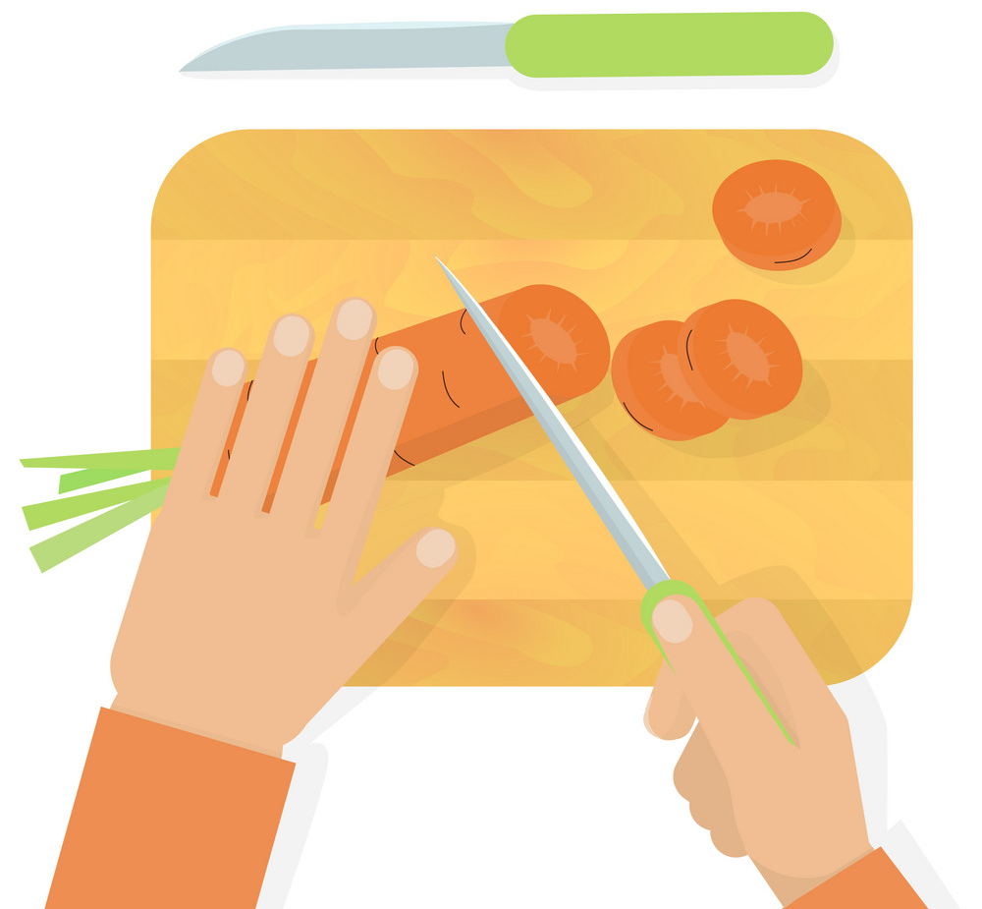
Phonics- Ditty
chop | it
chop | it | up
chop | it | up | quick
Hold a sentence:
Chop up the carrot quick.

Slide 7
Literacy
Session 2-
Story Sequencing

Slide 8
Literacy- Session 2
Can you remember the order of what happened in the story?
1
2
3
4

Slide 9
Now it’s your turn to sequence the story of “The magic paintbrush”

