Slide 1
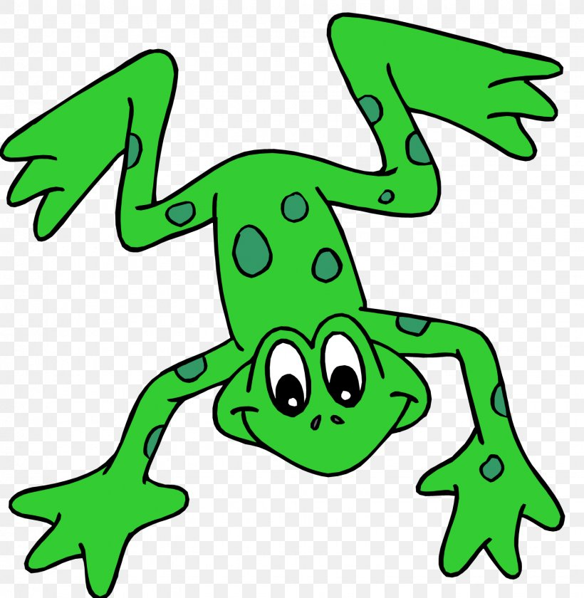
EYFS Literacy
Week 1

Slide 2
Phonics
Session 3

Slide 3
Phonics- Speedy Sounds
v | y | w | b
th | x | nk | p
f | e | a | i

Slide 4
Phonics- Fred Talk
p
i
n
h
o
t

Slide 5
Phonics- Fred Talk
m
e
n
r
a
m

Slide 6
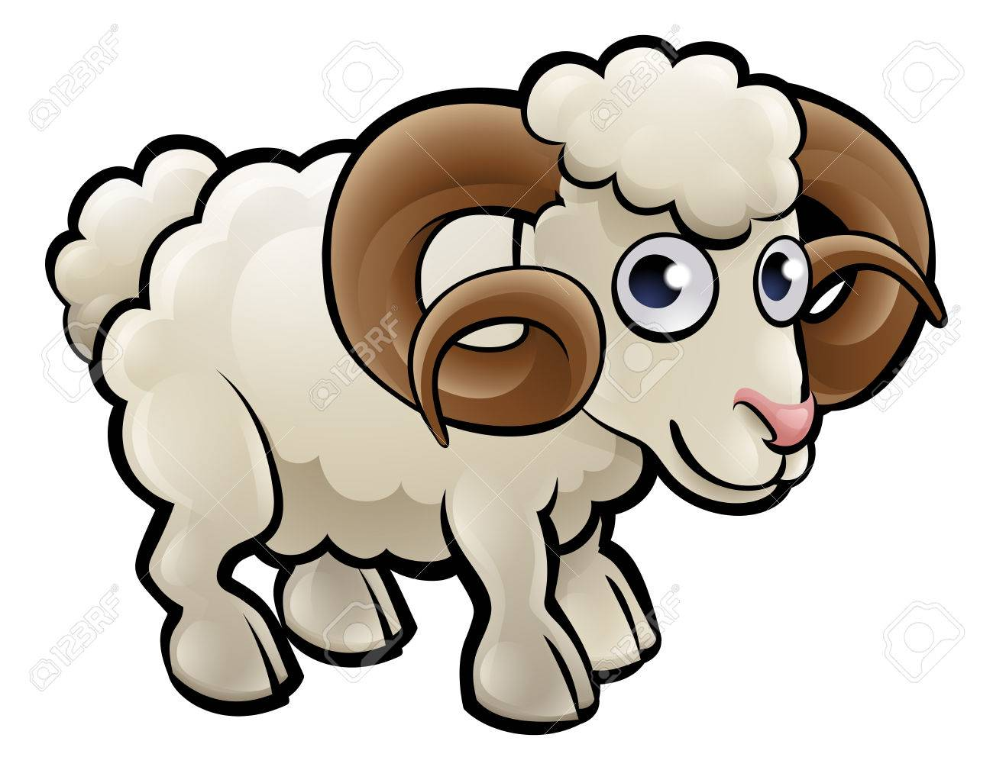
Phonics- Ditty
a | ram
a | ram | on | a | hill
a | ram | on | a | big | hill
Hold a sentence (children to keep repeating the sentence whilst writing it down):
It is a ram on a hill.

Slide 7
Literacy
Session 3- describing words

Slide 8
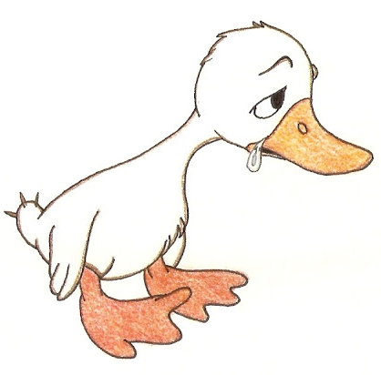
Literacy- Session 3
When we use describing words, we are saying what something is like.
The duck is sad.
The word sad describes how the duck is feeling.

Slide 9
Literacy- Session 3
You could use
Colour
Feelings
Shape
Texture
Size
Time

Slide 10
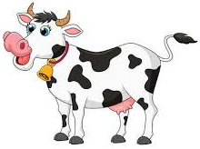
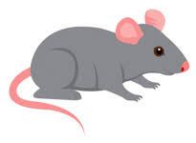
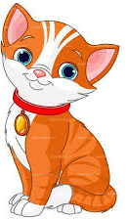
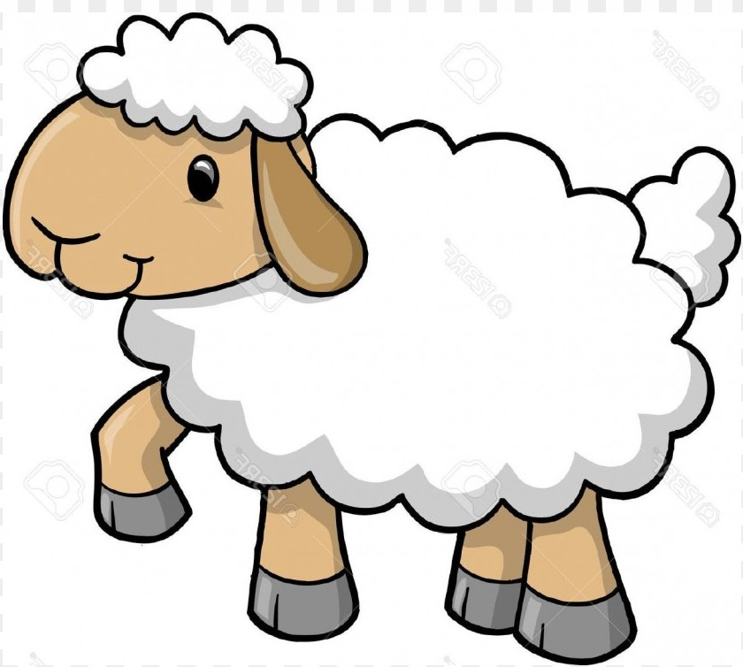
Literacy- Session 3
Here are some pictures of animals. Describe these animals to your grown-up.

Slide 11
Literacy- Session 3
You may have said…
A small mouse
A happy cow
A brown hen
An orange cat
A woolly sheep

Slide 12
Now it’s your turn to use some describing words

