Slide 1
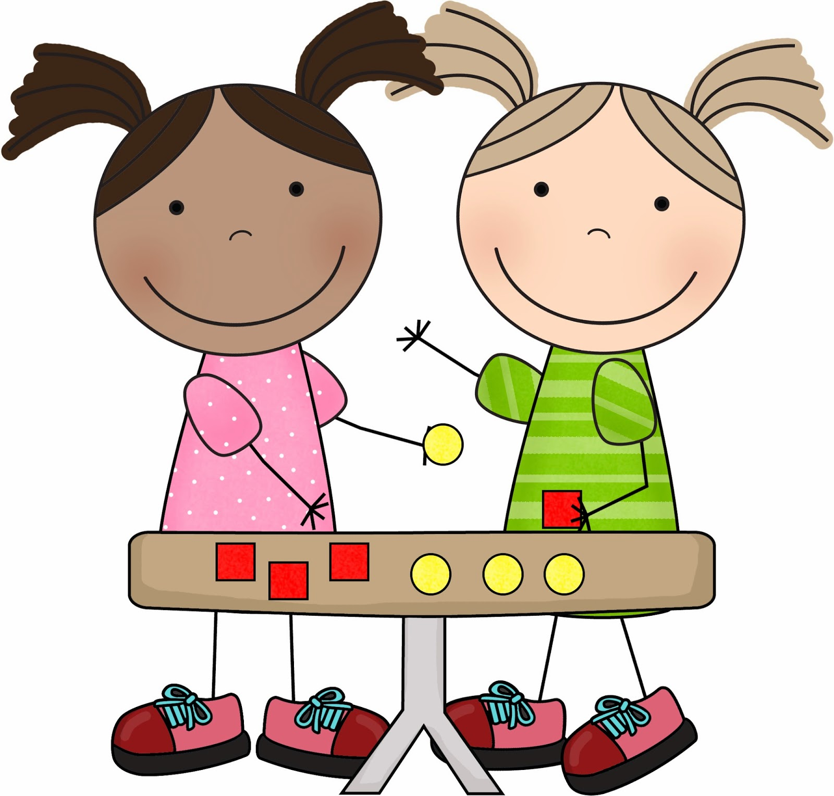
EYFS Maths
Session 2

Slide 2
Message to parents
This week the children will be sharing quantities equally. The activities provided are to be used alongside practical examples.
Reinforce the language as this will help your child to learn the concepts.
___ shared between ___ groups is ___.
groups
equal
shared

Slide 3
Warm Up Let’s warm up our brains ready to learn.
Last week we were learning to find ‘half’.
Half of 8 is ______

Slide 4
Warm Up Answer
4
Half of 8 is ______

Slide 5
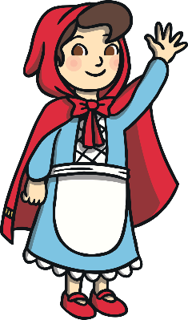
Can you help share the cakes fairly. How many does each guest get? What is 10 shared between 5?
?
2

Slide 6
Can I share 6 cakes fairly between 4 plates?
Is it fair?
Yes or No ?

Slide 7
Well Done!
Now have a go at the activity sheet provided.

