Slide 1
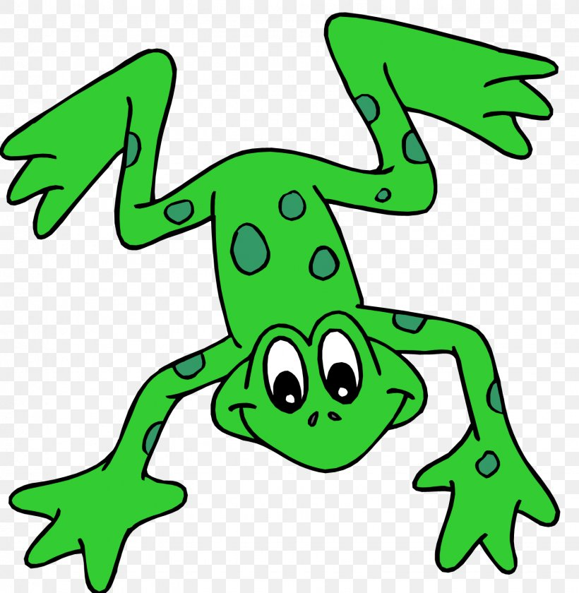
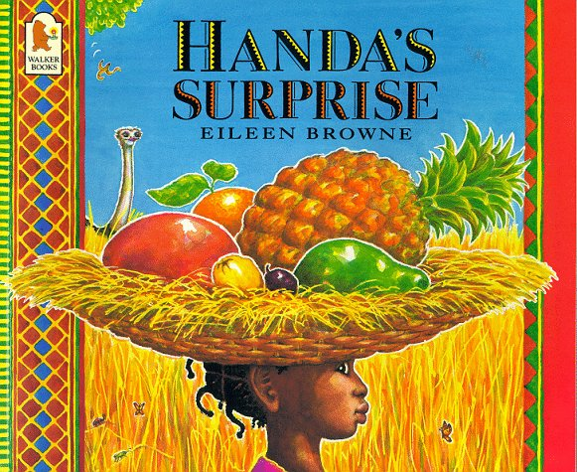
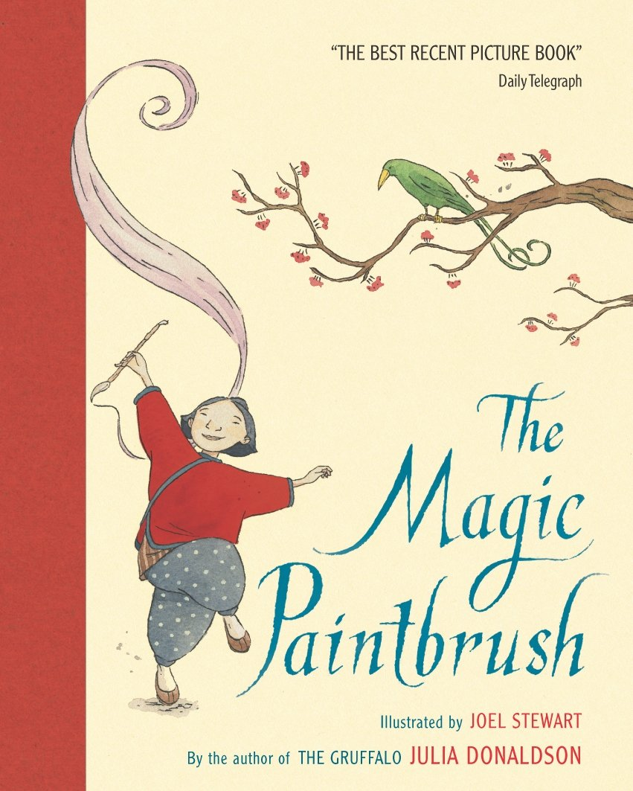
EYFS Literacy
Week 4

Slide 2
Phonics
Session 3

Slide 3
Phonics- Speedy Sounds
Click on the orange square to begin.
Each letter will appear and disappear each time you click.
How fast can you read each sound?
i
f
a
z
j
l
o
x
y
ch
th
ng

Slide 4
Phonics- Fred Talk
b
e
ll
th
i
nk

Slide 5
Phonics- Fred Talk
d
o
ll
th
e
m

Slide 6
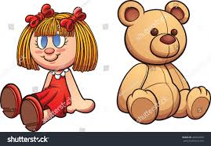
Phonics- Ditty
my | doll
my | sick | doll
my | sick | doll | in | bed
Hold a sentence:
My doll is sat with my ted.

Slide 7
Literacy
Session 3- word play

Slide 8
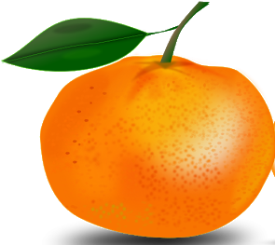
Literacy- Session 3
Let’s think about the words that Eileen Browne uses to describe each fruit. Here are two examples:
Soft yellow banana
Round, juicy orange
You can see the orange is round like a ball. When you cut into it, you can see the juice squirt or run out of it. When you bite into it, you can feel the juice in your mouth.
You can see the banana is the colour yellow. When you hold a banana it feels firm (quite hard) in its skin. When you peel the banana, you can feel it is soft when you bite into it.

Slide 9
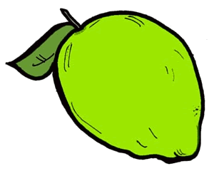
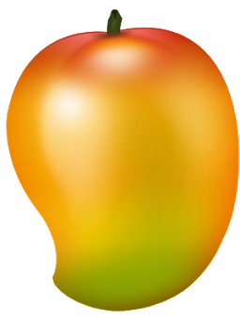
Literacy- Session 3
Have you seen or tried any of these fruits? If so, do you agree with the author’s descriptions?
Soft yellow banana
Creamy green avocado
Sweet smelling guava
Round, juicy orange
Tiny purple passion fruit
Spikey leaved pineapple
Ripe red mango

Slide 10
Now it’s your turn to describe foods.

