Slide 1

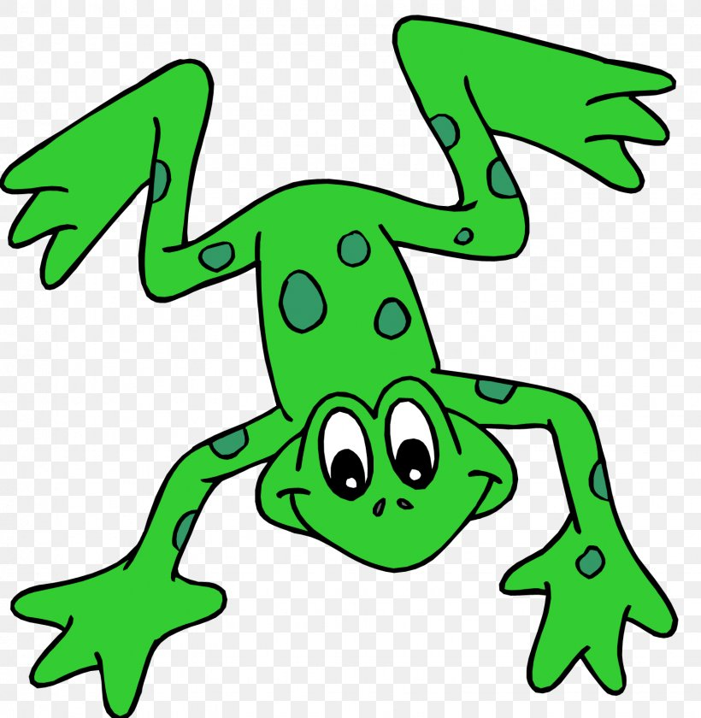


EYFS Literacy
Week 4

Slide 2
Phonics
Session 2

Slide 3
Phonics- Speedy Sounds
Click on the orange square to begin.
Each letter will appear and disappear each time you click.
How fast can you read each sound?
o
ng
u
w
v
a
th
h
u
ch
f
sh

Slide 4
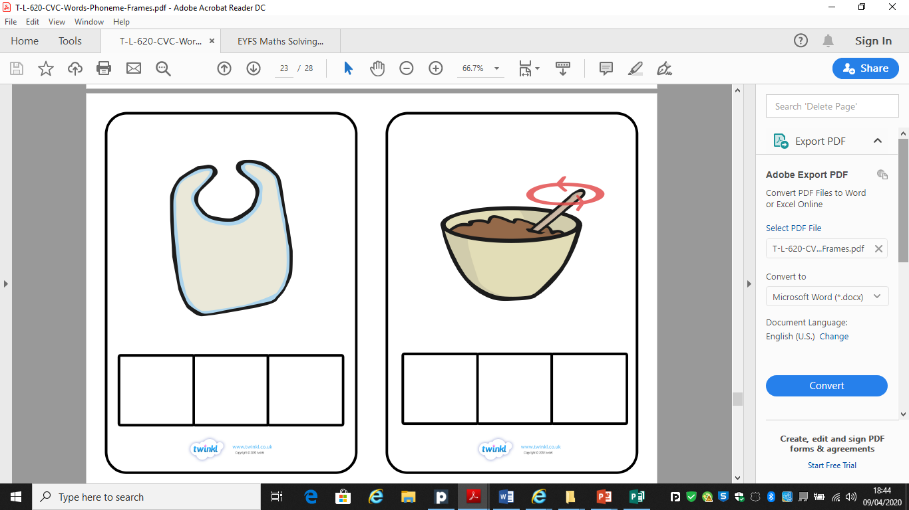
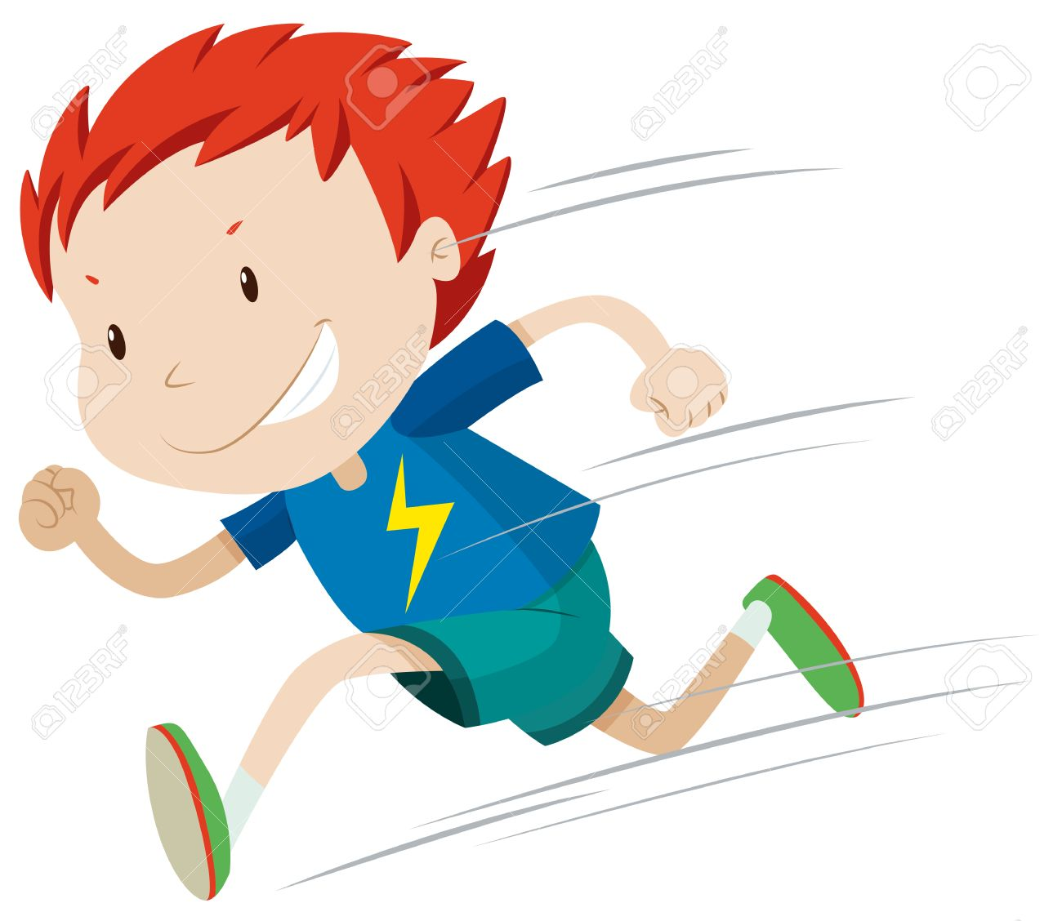

Phonics- Fred Talk
qu
i
ck
qu
a
ck

Slide 5
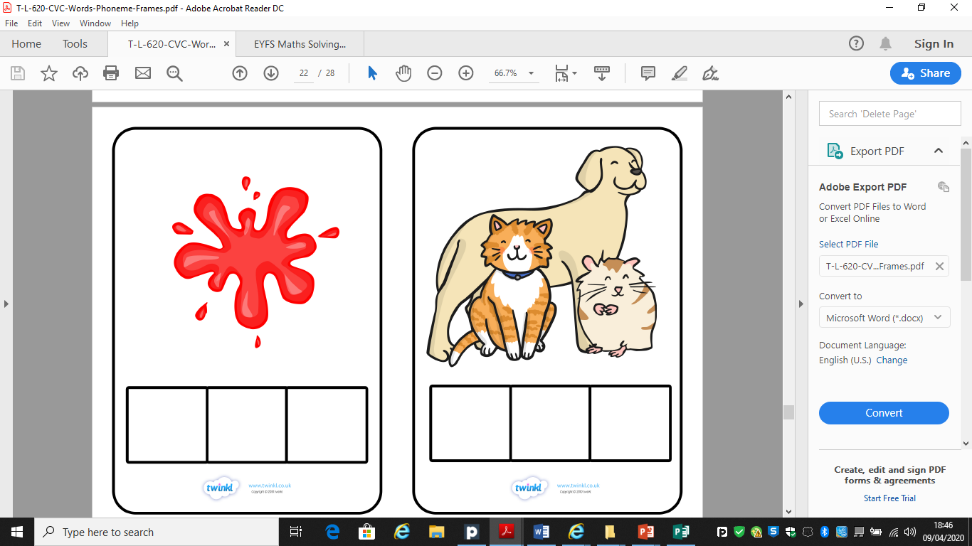


Phonics- Fred Talk
b
a
ng
w
i
ng

Slide 6
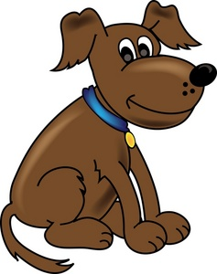
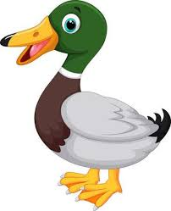
Phonics- Ditty
the | duck
the | duck | can | quack
my | dog | can | not | quack
Hold a sentence:
Can a dog quack?

Slide 7
Literacy
Session 2-
Story Sequencing

Slide 8

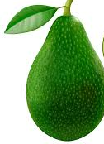
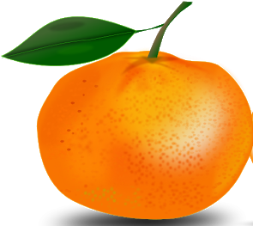



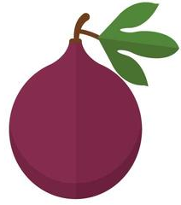
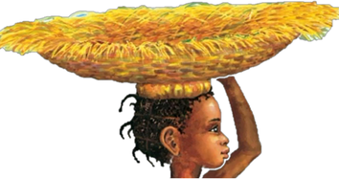
Literacy- Session 2
What order did the fruit get taken by the animals?
1
3
5
7
2
4
6

Slide 9
Now it’s your turn to sequence the story of “Handa’s surprise.”

