Slide 1
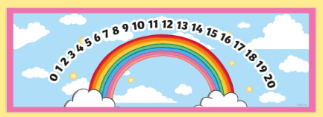



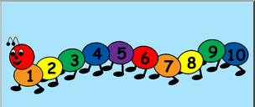
EYFS Maths
Session 4

Slide 2
Message to parents
This week the children will be learning to count on/back using a number line and solve simple addition/subtraction problems. The activities provided are to be used alongside practical examples.
Reinforce the language as this will help your child to learn the concepts.
How many jumps do you need?
count on/back
Are we going up or down the number line?
If we are adding/taking away, will our number get ‘smaller’/’bigger’?

Slide 3

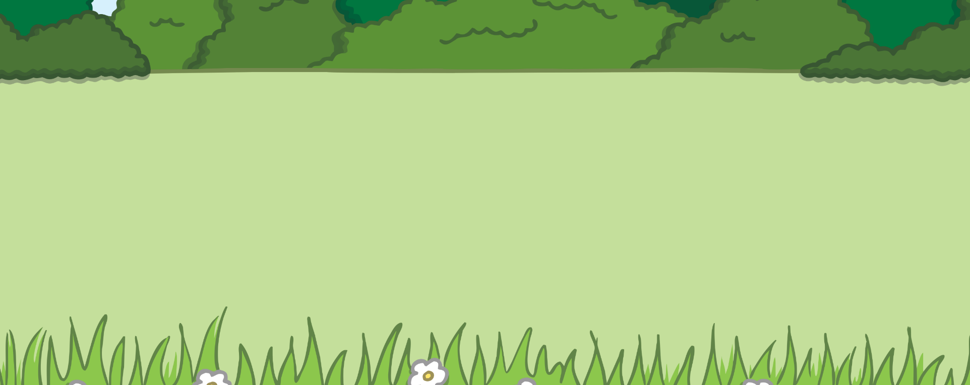

Warm up - Counting Flowers in the Meadow
Click here
How many flowers are growing in the meadow?
20!
start flowers
click again to find the answer.
reset

Slide 4

Yesterday we learnt how to ‘take away’ using a number line…
Do we count on or count back when taking away?
We count back!
0
1
2
3
4
5
6
7
8
9
10
11
12
13
14
15
16
17
18
19
20

Slide 5
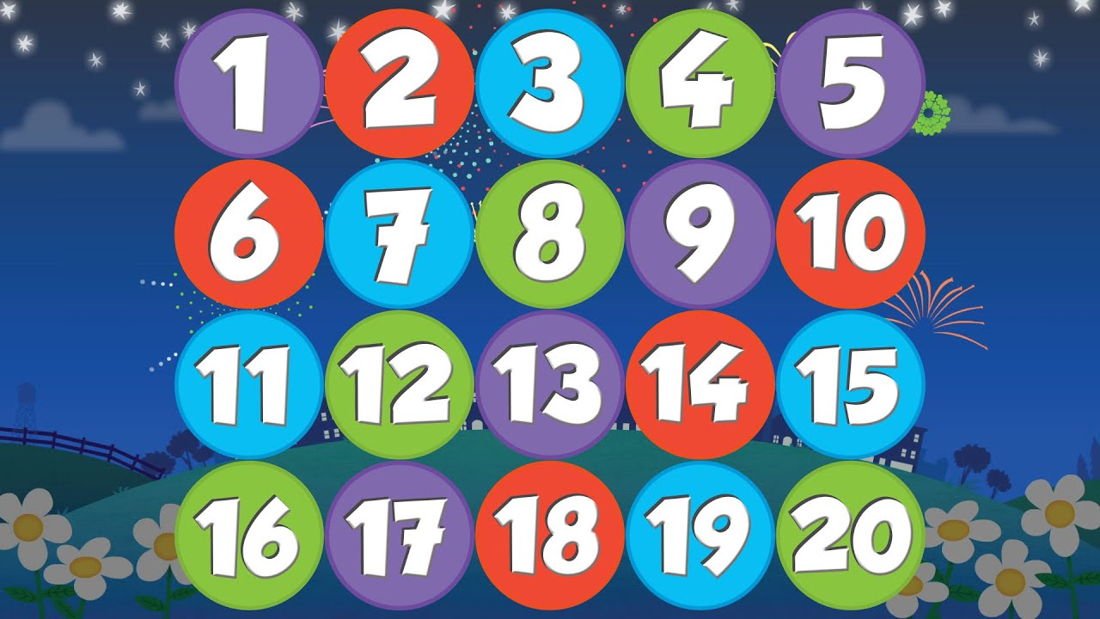
When we ‘take away’ to find our answer…
-
=
3
6
-
3
=
3
our number or amount is becoming less or ‘getting smaller’.
When we take away we count back on our number line to
find our answer!
0
1
2
3
4
5
6
7
8
9
10
11
12
13
14
15
16
17
18
19
20

Slide 6



There are 8 leaves on the tree. The wind blew 4 away. How many leaves are left?
4
0
1
2
3
4
5
6
7
8
9
10
11
12
13
14
15
16
17
18
19
20

Slide 7

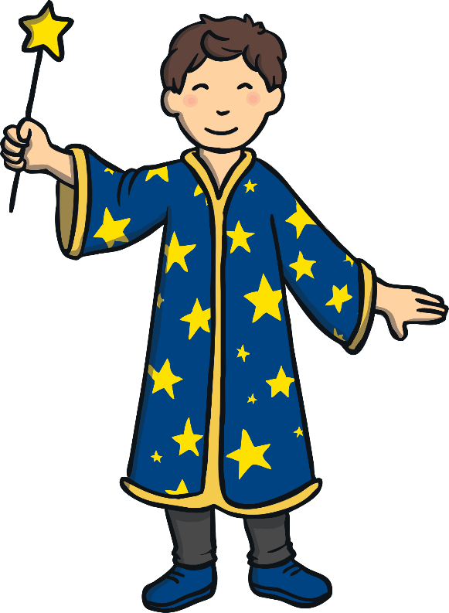
There are 13 rabbits. A wizard cast a spell and 5 disappear.
How many rabbits are left
13 – 5 =
?
0
1
2
3
4
5
6
7
8
9
10
11
12
13
14
15
16
17
18
19
20

Slide 8
There are 13 rabbits. A wizard cast a spell and 5 disappear.
How many rabbits are left
13 – 5 =
8
?

Slide 9
Well Done!
Now have a go at the activity sheet provided.

