Slide 1
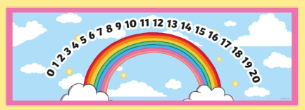
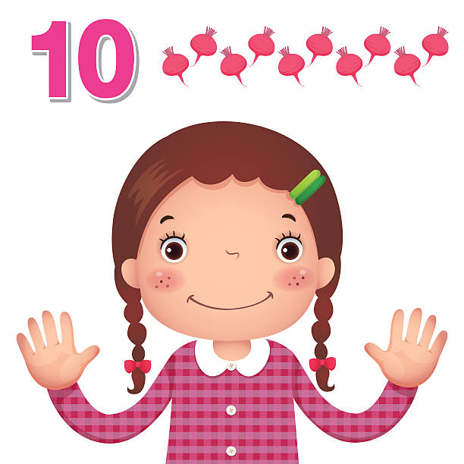

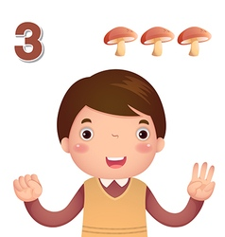
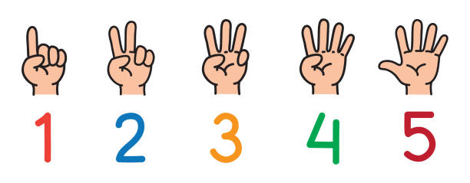
EYFS Maths
Session 3

Slide 2
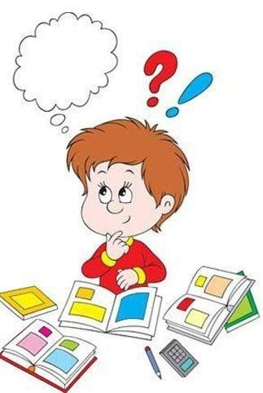
Message to parents
This week the children will be practising counting on and back to solve mathematical problems.
The focus of this week’s home learning is to
encourage mathematical thinking and reasoning.
On the next slide there are different question
types you can use to develop your child’s
mathematical thinking and reasoning.

Slide 3
Reinforce the language as this will help your child to learn the concepts.
Describing
How many were there at the start?
How many are there now?
Reasoning
How do you know?
How did you work it out?
Opening Out
What if we add two more?
What if we take one out? Two out?
Imagine there are 10 in there and I take out 6 – how would you know how many were left?
Recording
Can you show how many there were?
Can you show how many there are now?
Can you show how many there were and what happened?

Slide 4

Warm Up
Let’s warm up our brains ready to learn.
How fast can you write your numbers
from zero to ten…
(Ask a grown up to time you!)

Slide 5
How fast were you…?

Slide 6
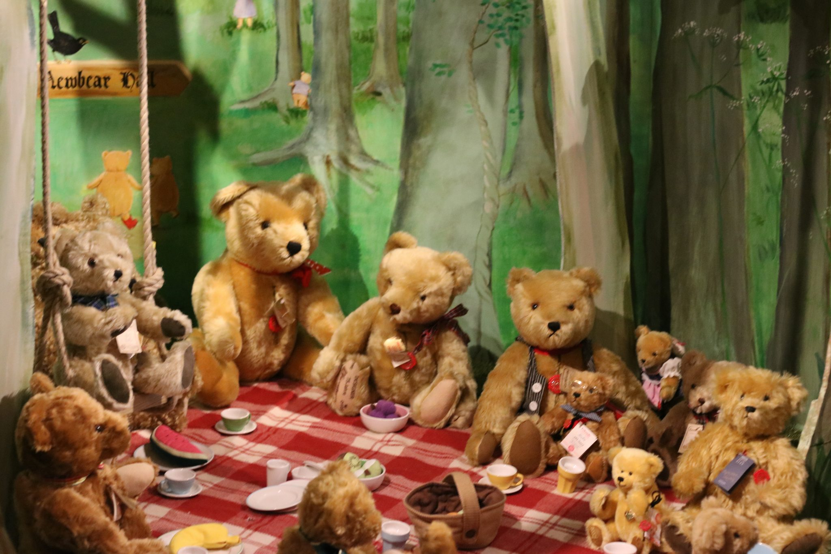
There were 5 teddy bears at the picnic. Then 7 more teddy bears joined the picnic. How many teddy bears are there altogether?
What’s my starter number?
5
How many do I need to
count on?
7

Slide 7
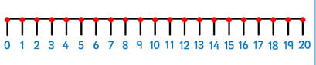
Can you find 5 on the number line?
Are we counting up or down the number line?
How many jumps?
There are 12 teddies altogether!

Slide 8

I picked 11 roses from my garden. I then picked 5 daisies. How many flowers did I pick altogether?
What’s my starter number?
11
How many do I need to
count on?
5

Slide 9
Can you find 11 on the number line?
Are we counting up or down the number line?
How many jumps?
There are 16 flowers altogether!

Slide 10
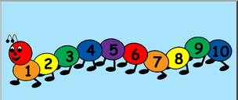


Well Done!
Now have a go at the activity sheet provided.

