Slide 1




EYFS Maths
Week 1- Session 4

Slide 2
Message to parents
This week the children will be learning about doubling. The activities provided are to be used alongside practical examples.
Reinforce the language as this will help your child to learn the concepts.
The double of ___ is ___
double
___ is the double of ___

Slide 3


Warm Up
Let’s warm up our brains ready to learn.
+
=
?
+
=
?
Which one is a double?

Slide 4
Warm Up- Answer
+
=
2
2
4
+
=
3
4
7

Slide 5
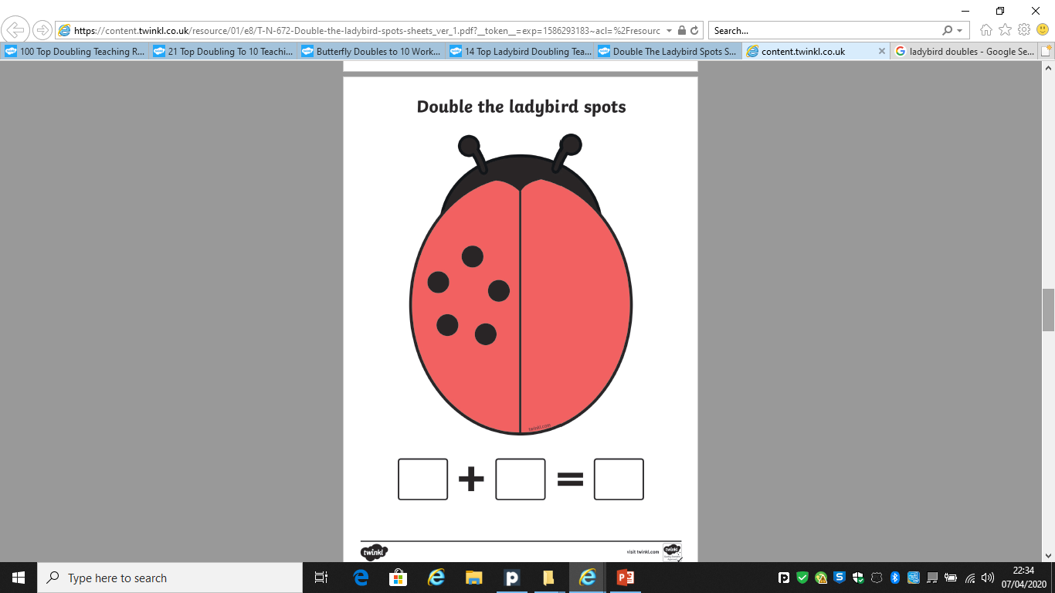
Doubling
12
10
8
6
4
What is the double?

Slide 6
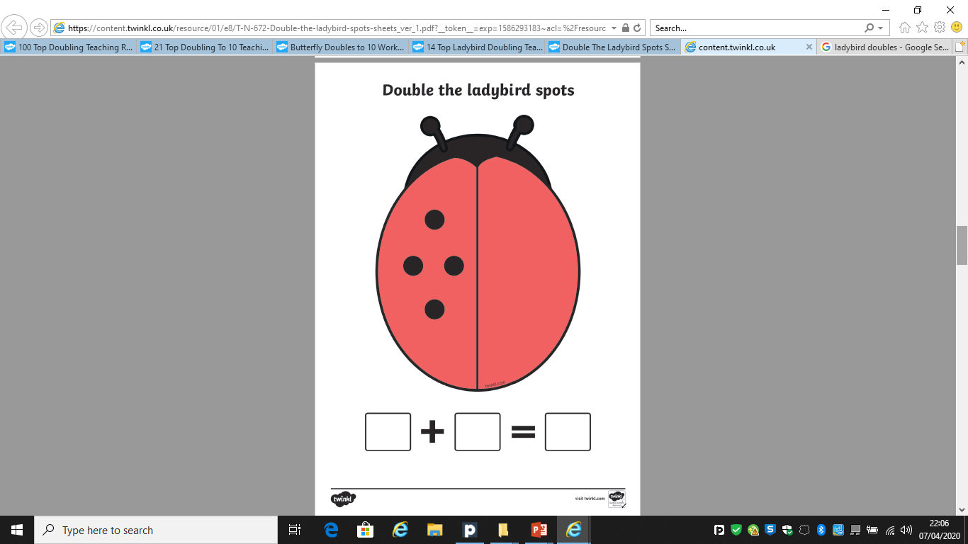
Doubling
0
2
4
6
8
What is the double?

Slide 7
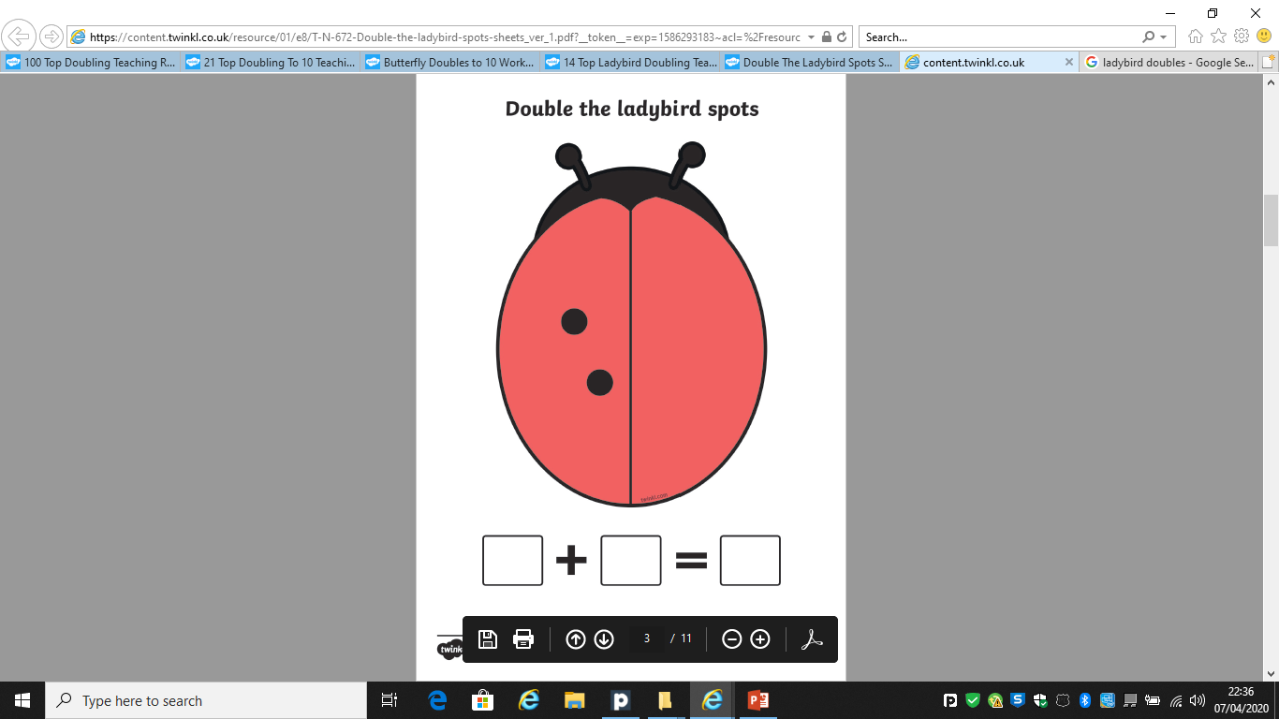
Doubling
2
4
6
8
10
What is the double?

Slide 8
Well Done!
Now have a go at the activity sheet provided.

