Slide 1
EYFS Literacy
w/c 1st June 2020

Slide 2
Phonics
Session 2

Slide 3
Phonics- Speedy Sounds
Click on the orange square to begin.
Each letter will appear and disappear each time you click.
How fast can you read each sound?
u
ng
th
o
v
h
f
ch
sh
w
j
a

Slide 4
Phonics- Fred Talk
Read the word to identify the correct picture:
c
u
p

Slide 5
Phonics- Fred Talk
s
o
ck

Slide 6
Phonics- Ditty
hot | pot
the | pot | is | hot
stop | that | pot | is | hot
Hold a sentence:
The pot is very hot.

Slide 7
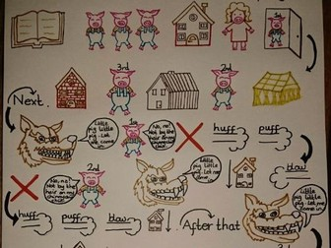
Literacy
Session 2-
Story Sequencing

Slide 8
Literacy- Session 2
Today we are going to be recapping how to use a story map.
A story map is made up of pictures and some key words. They remind you what comes next when you are retelling the story.

Slide 9
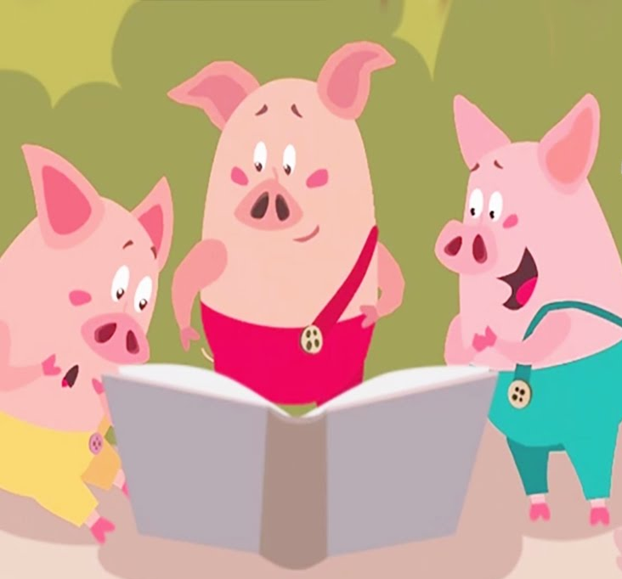
Once you’ve drawn your story map, you can use it to retell the story. You can even add actions!
Double click me
or copy the link:
https://www.youtube.com/watch?v=WYjHX3aKW3M

Slide 10
Now complete the accompanying activity.

