Slide 1
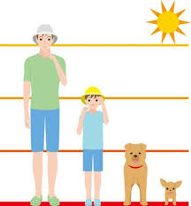
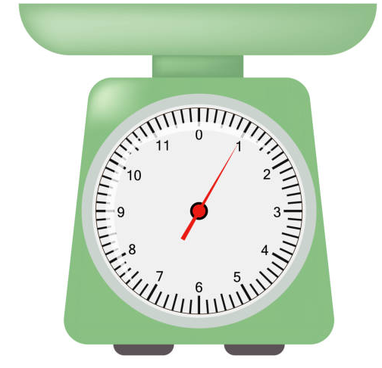
EYFS Maths
Session 1

Slide 2
Message to parents
Today the children will be learning about height. The activities provided are to be used alongside practical examples.
In EYFS, we use non-standard measures- cubes, hands, feet.
Reinforce the language as this will help your child to learn the concepts.
tall
short
taller
shorter

Slide 3
Warm Up Let’s warm up our brains ready to learn.
Name the shapes
What do we call all these shapes?

Slide 4
Warm Up- Answer
square
circle
rectangle
triangle
We call these shapes 2D flat shapes!

Slide 5
Height
How many bricks tall is the house? Let’s find out!

Slide 6
Height
Did you measure the house correctly?
The house is 6 bricks tall!
How do you know?

Slide 7
Height
Try and get as close to the top of your object. It won’t be spot on but it will be very close.
When measuring the height of an object, you need to make sure that you start as close to the bottom as you can.

Slide 8
Height
How many bricks tall is the house? Let’s find out!
Has the house been measured correctly?
How many bricks tall should the house be?

Slide 9
Height
The house should be 7 bricks tall.

Slide 10
Well Done!
Now have a go at the activity sheet provided.

