Slide 1

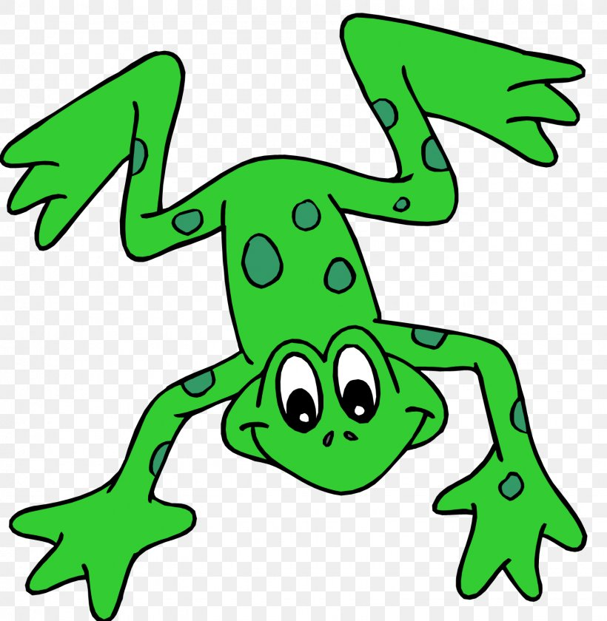



EYFS Literacy
Week 4

Slide 2
Phonics
Session 4

Slide 3
Phonics- Speedy Sounds
Click on the orange square to begin.
Each letter will appear and disappear each time you click.
How fast can you read each sound?
j
p
b
a
l
n
w
sh
u
e
ch
th

Slide 4
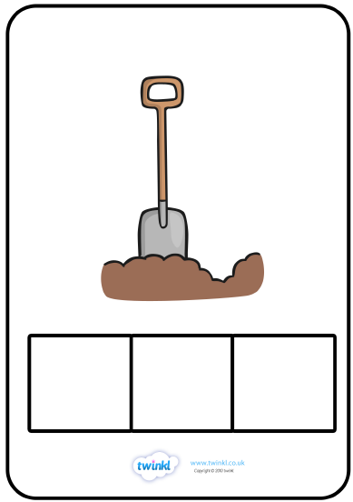
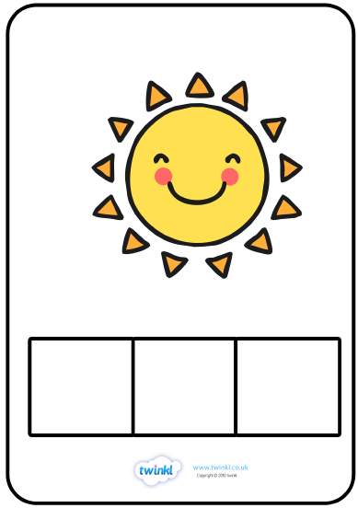
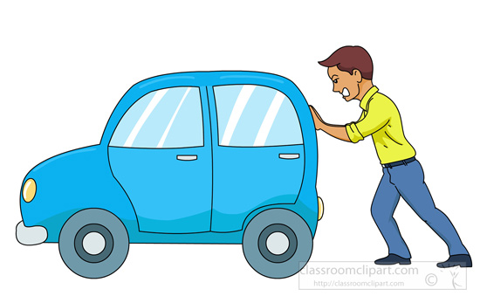
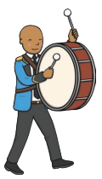
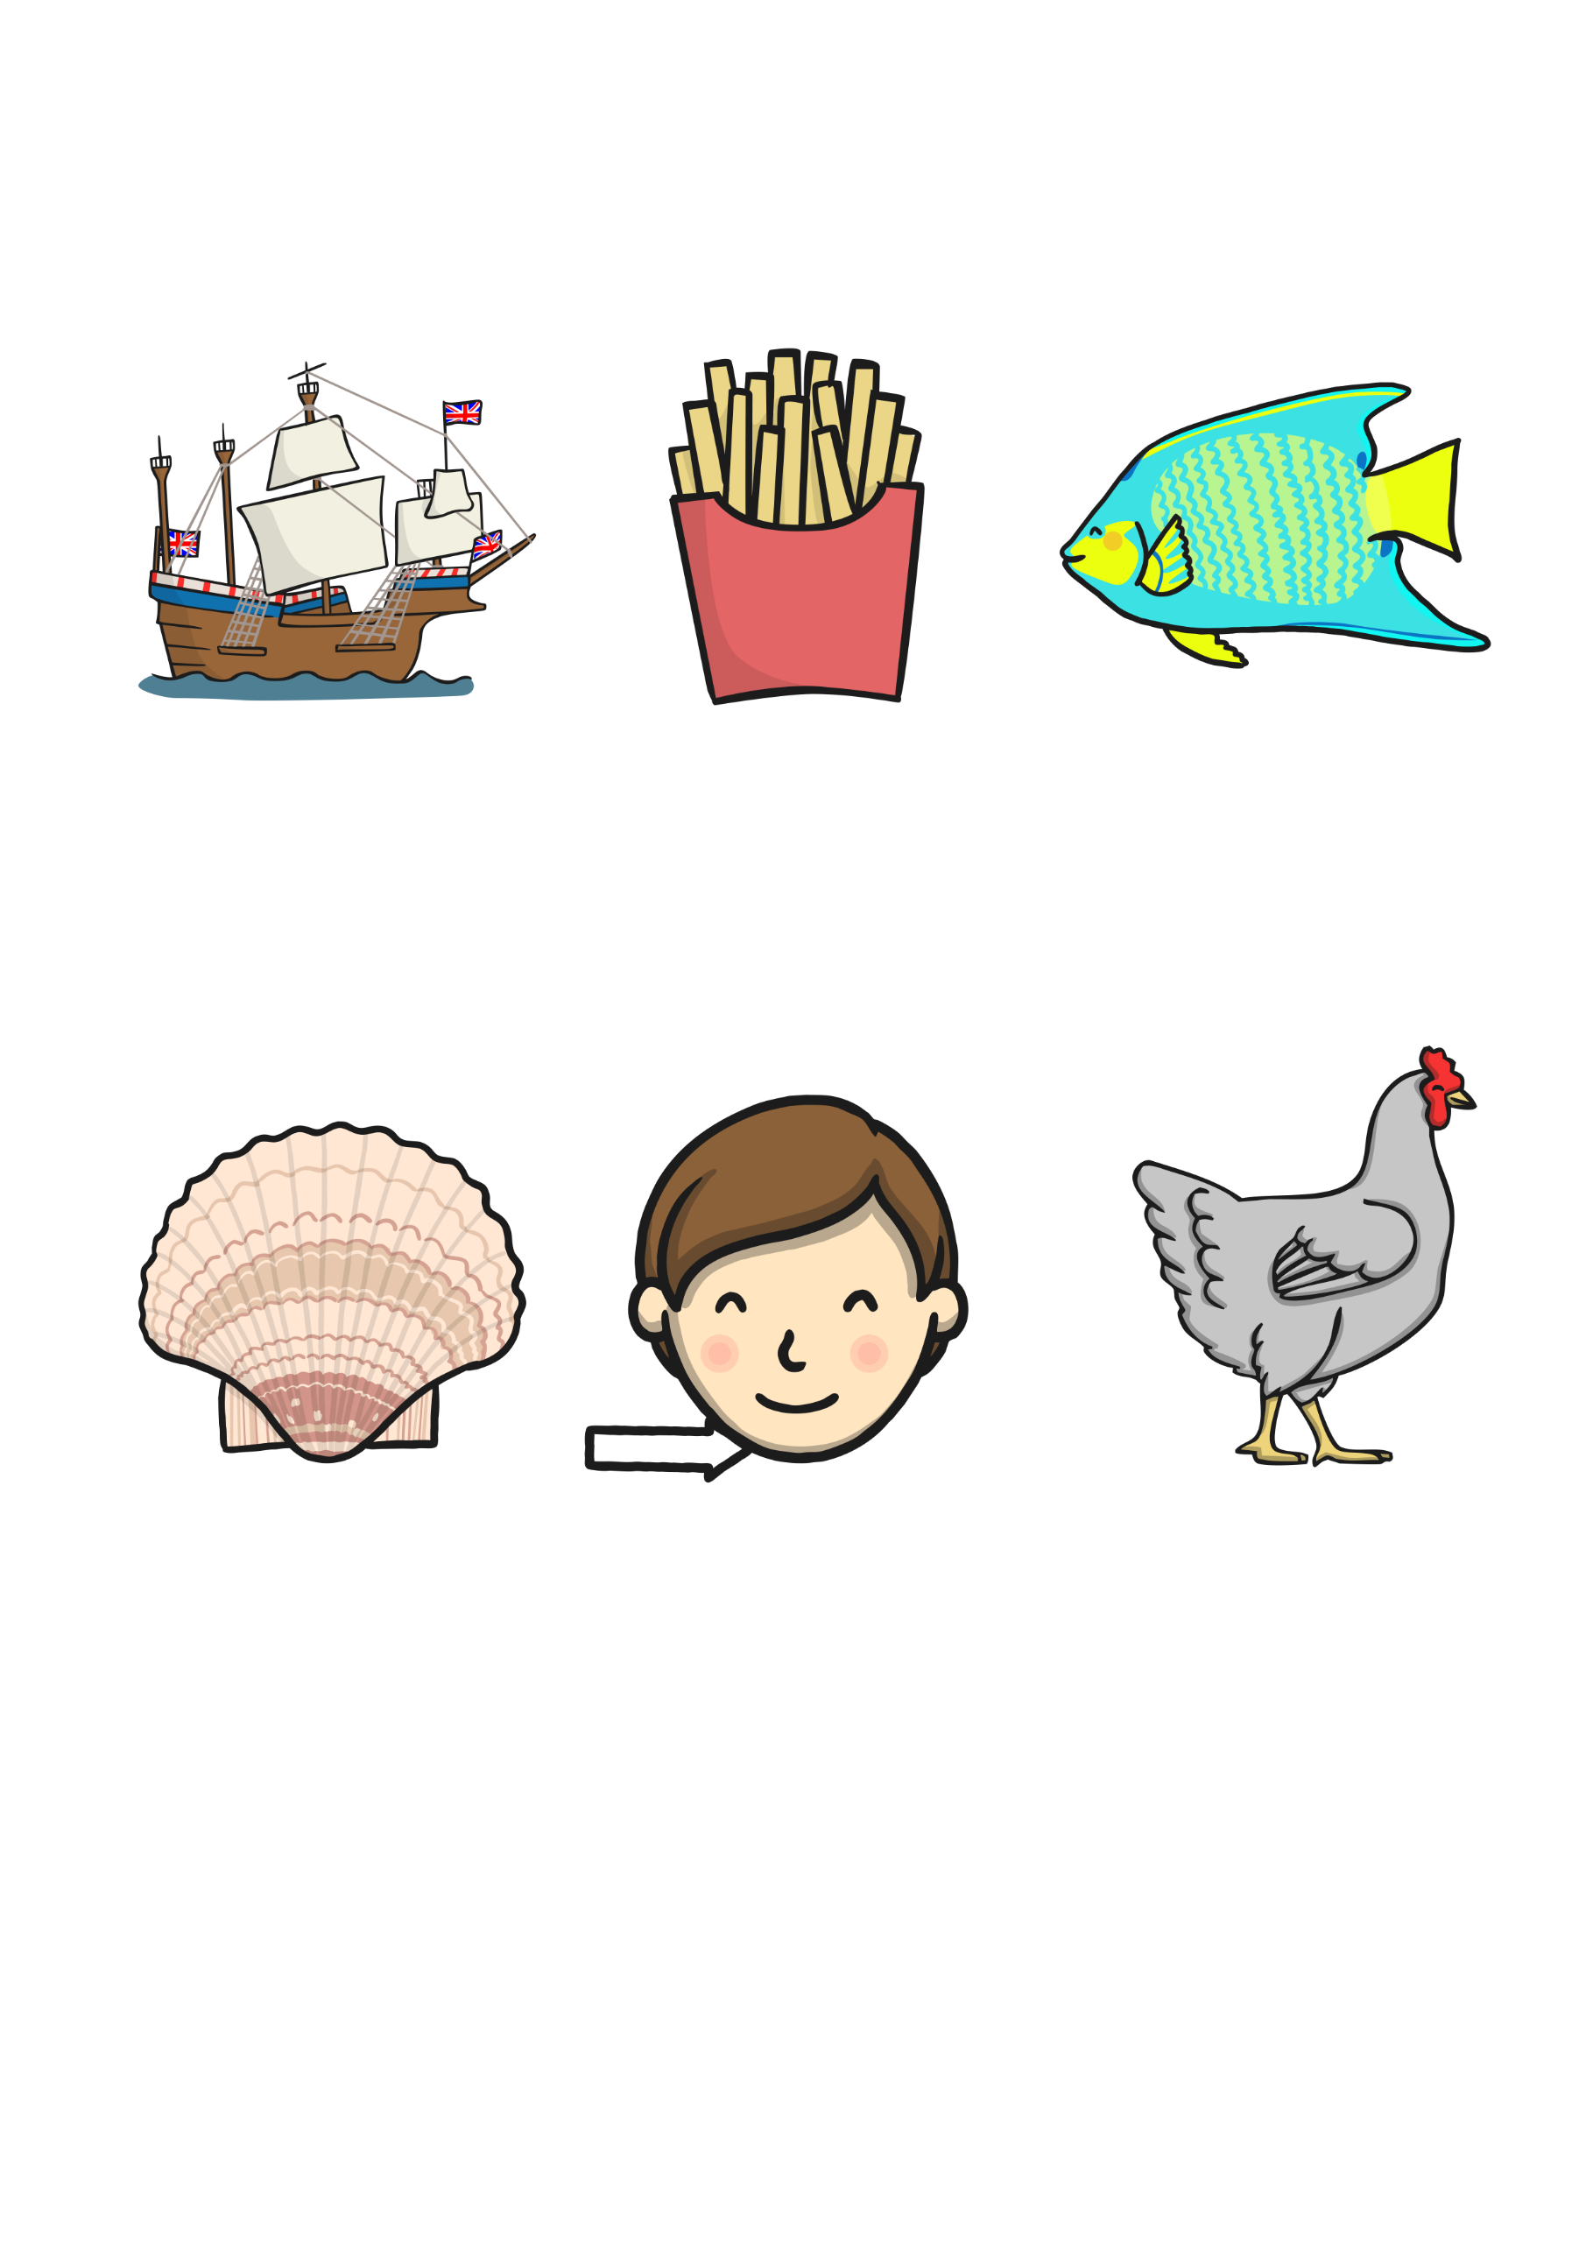
Phonics- Fred Talk
f
i
sh
p
u
sh

Slide 5
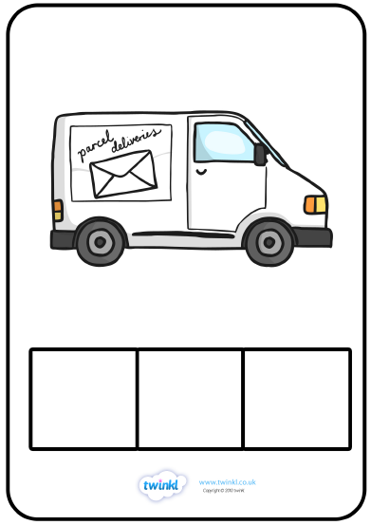
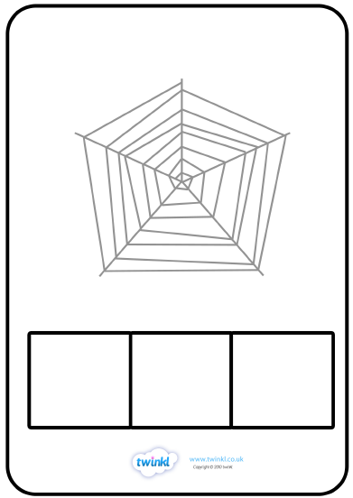
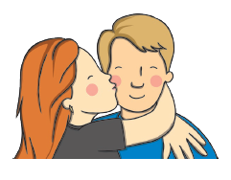
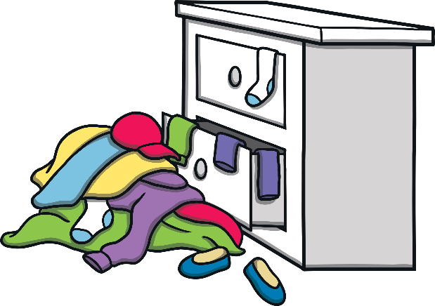
Phonics- Fred Talk
k
i
ss
m
e
ss

Slide 6
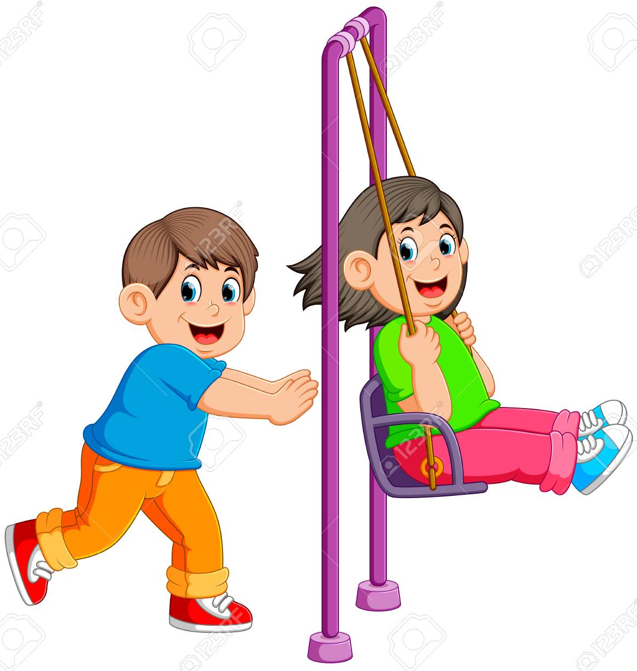
Phonics- Ditty
push | me
push | me | fast
push | me | on | the | swing
Hold a sentence:
Can a fish push the swing?

Slide 7
Literacy
Session 4-
Making sentences

Slide 8
Literacy- Session 4
Note to parents-
Today’s activity is an interactive one.
Click on each vegetable to take you to a pre-set sentence.
There are three different adjectives for each vegetable for your child to choose from.
They can write a sentence using any of the vegetables and any of the adjectives.
Once they have finished, just click the vegetable in the right hand corner to take you back to the start.

Slide 9
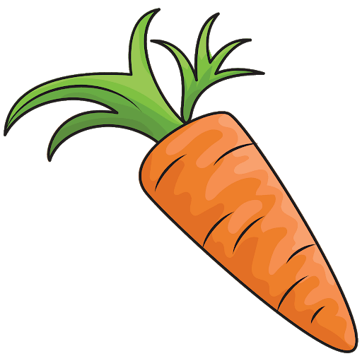
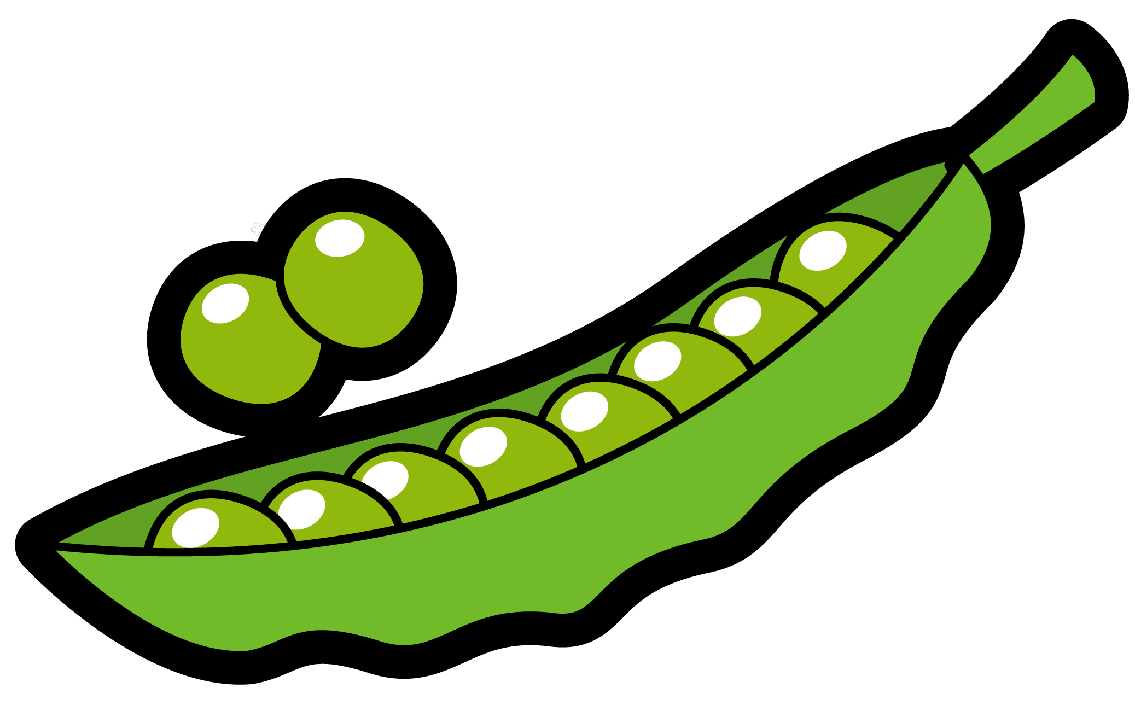
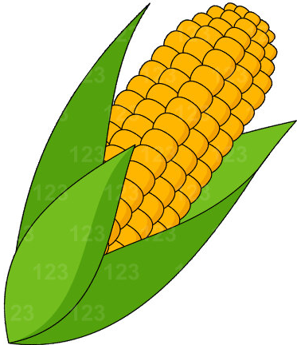
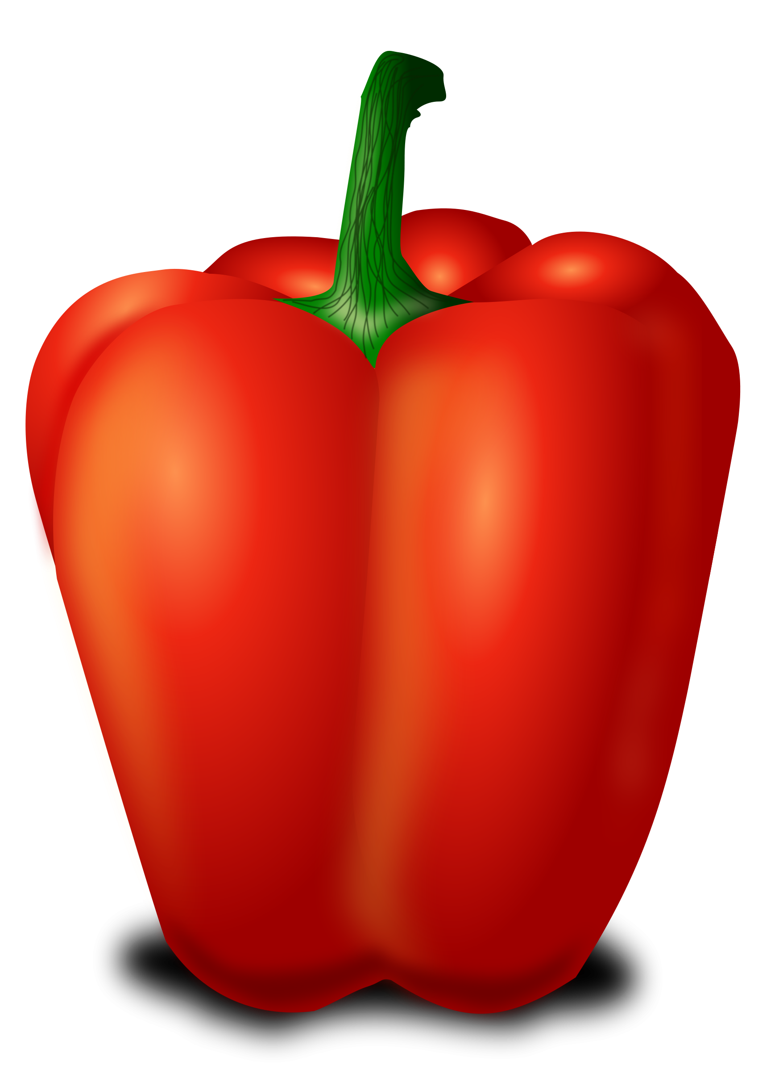
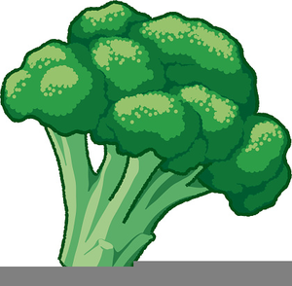

Literacy- Session 4
We are going to change the story of Handa’s surprise. Instead of fruit, we are going to use vegetables. Click on three vegetables that you want to write about.

Slide 10
Literacy- Session 4
Choose a describing word to put in the box.
Which word describes the sweetcorn best?
I | like | the | _________ | sweetcorn | .
tasty
yellow
sweet
yellow
sweet
tasty
Use your activity sheet to write your chosen sentence.

Slide 11
Literacy- Session 4
Choose a describing word to put in the box.
Which word describes the peas best?
I | like | the | _________ | peas | .
soft
green
small
green
small
soft
Use your activity sheet to write your chosen sentence.

Slide 12
Literacy- Session 4
Choose a describing word to put in the box.
Which word describes the carrot best?
I | like | the | _________ | carrot | .
orange
crunchy
sweet
crunchy
orange
sweet
Use your activity sheet to write your chosen sentence.

Slide 13
Literacy- Session 4
Choose a describing word to put in the box.
Which word describes the broccoli best?
I | like | the | _________ | broccoli | .
healthy
fluffy
green
green
fluffy
healthy
Use your activity sheet to write your chosen sentence.

Slide 14
Literacy- Session 4
Choose a describing word to put in the box.
Which word describes the pepper best?
I | like | the | _________ | pepper | .
red
crunchy
sweet
red
sweet
crunchy
Use your activity sheet to write your chosen sentence.

