Slide 1
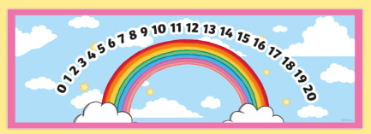



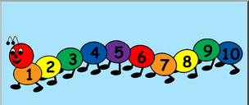
EYFS Maths
Session 2

Slide 2
Message to parents
This week the children will be learning to count on/back using a number line and solve simple addition/subtraction problems. The activities provided are to be used alongside practical examples.
Reinforce the language as this will help your child to learn the concepts.
How many jumps do you need?
count on/back
Are we going up or down the number line?
If we are adding/taking away, will our number get ‘smaller’/’bigger’?

Slide 3
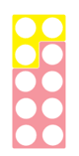
Warm Up
Let’s warm up our brains ready to learn.
Add the Numicon together… what number have you made?

Slide 4
Warm Up – the answer is…
10!
Well done!

Slide 5
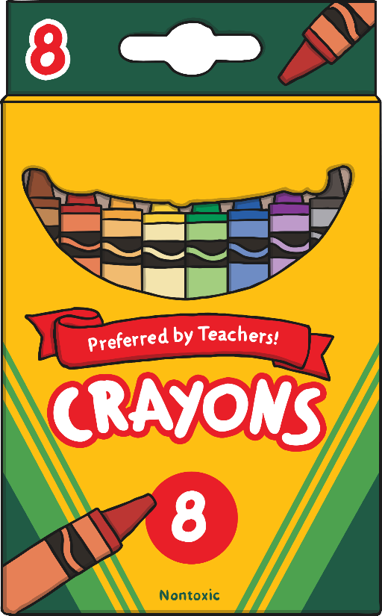

How many crayons are there?
+
=
10
0
1
2
3
4
5
6
7
8
9
10

Slide 6

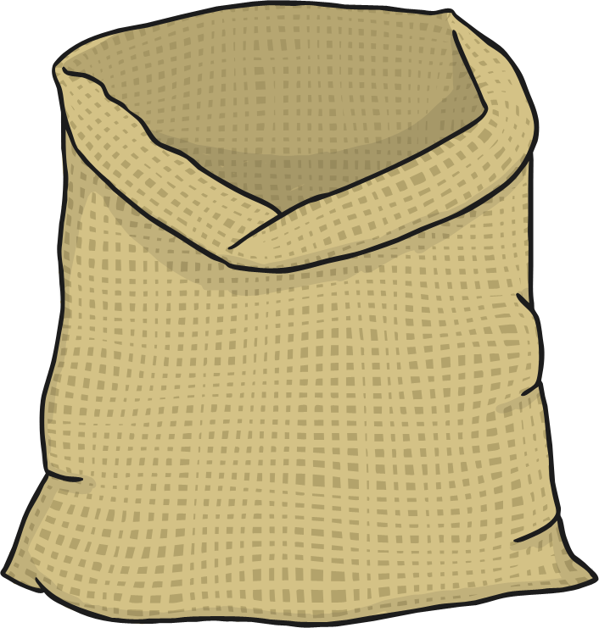

How many carrots are there?
+
=
15
10
0
1
2
3
4
5
6
7
8
9
10
11
12
13
14
15
16
17
18
19
20

Slide 7


How many icecreams are there?
+
=
16
12
0
1
2
3
4
5
6
7
8
9
10
11
12
13
14
15
16
17
18
19
20

Slide 8
Well Done!
Now have a go at the activity sheet provided.

