Slide 1




EYFS Literacy
Week 5

Slide 2
Phonics
Session 2

Slide 3
Phonics- Speedy Sounds
Click on the orange square to begin.
Each letter will appear and disappear each time you click.
How fast can you read each sound?
u
ng
th
o
v
h
f
ch
sh
w
j
a

Slide 4
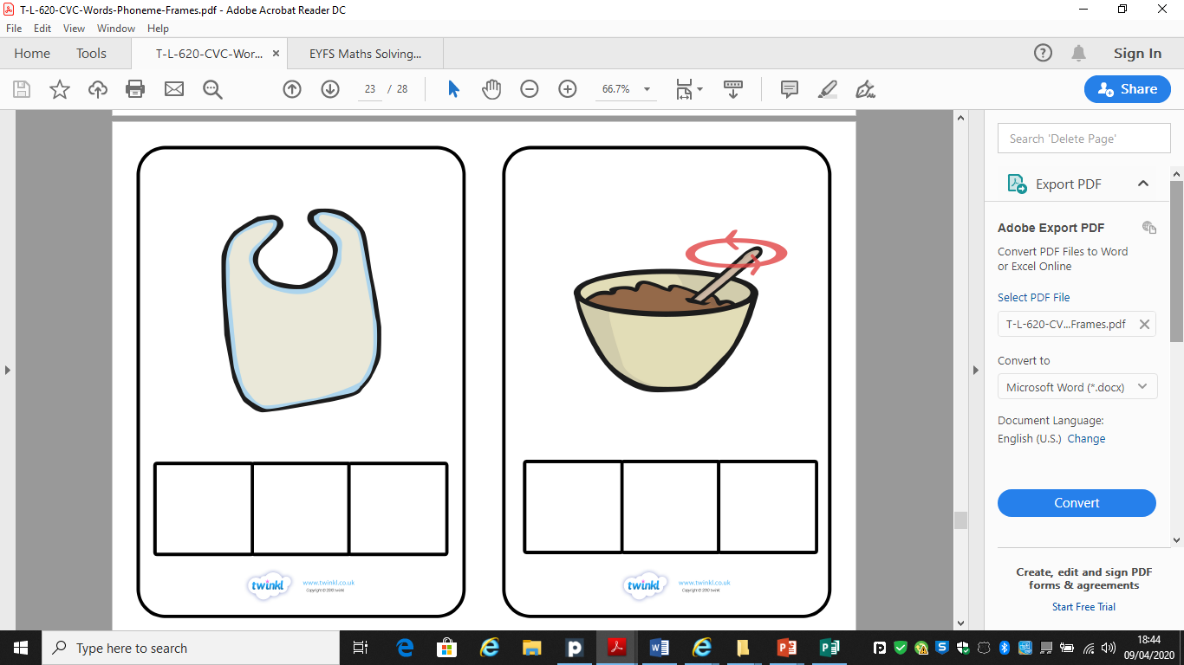
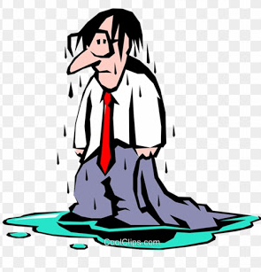
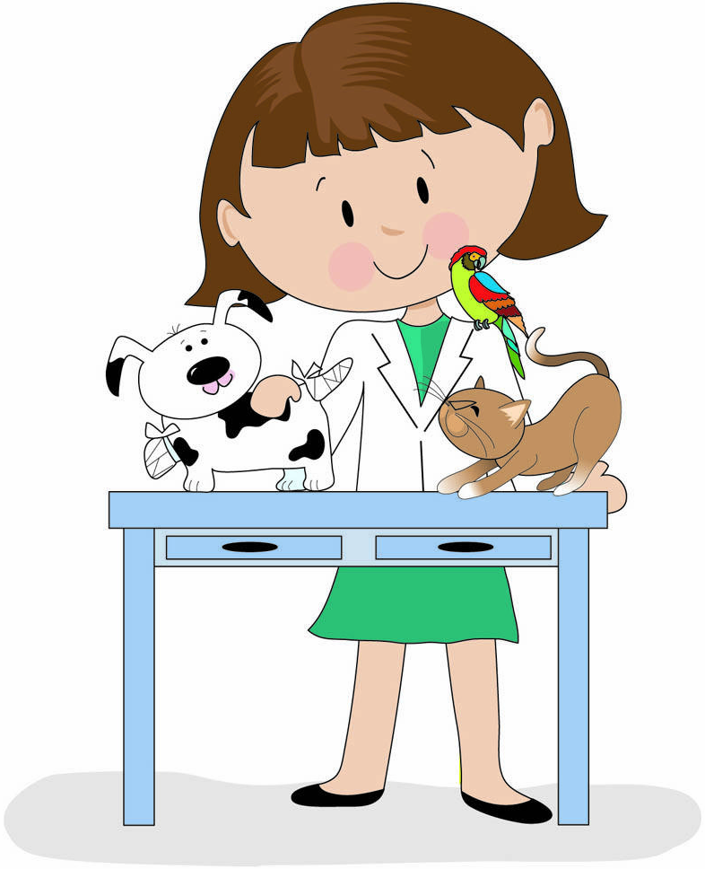
Phonics- Fred Talk
w
e
t
v
e
t

Slide 5
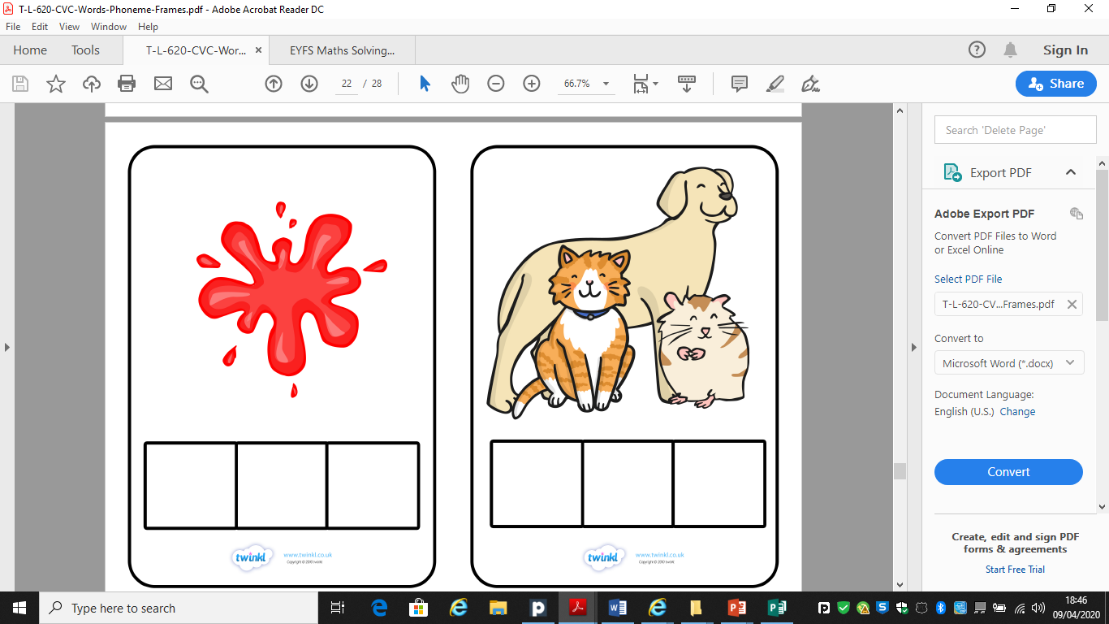
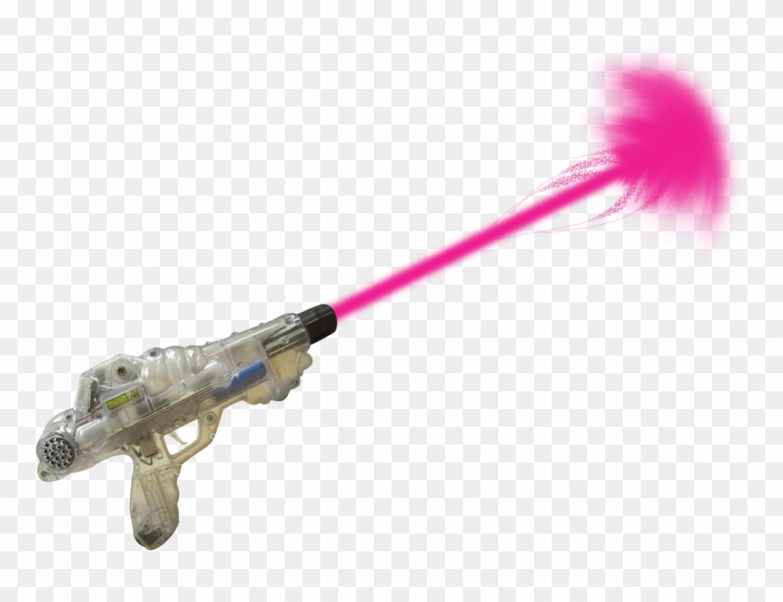
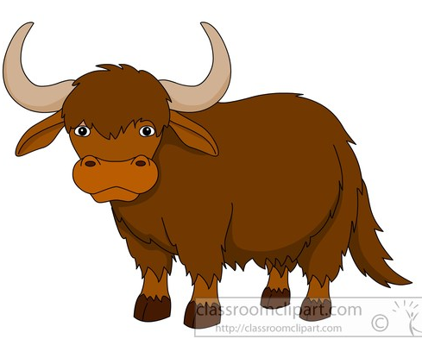
Phonics- Fred Talk
z
a
p
y
a
k

Slide 6

Phonics- Ditty
a | vet
the | vet | can | help
the | vet | can | help | my | dog
Hold a sentence:
get my cat to the vet.

Slide 7
Literacy
Session 2-
Story Sequencing

Slide 8
Literacy- Session 2
On the next slide is your activity for today.
Can you find the aliens and underpants from the bottom of the picture? They’re hidden around. How many can you find?
When you click, a yellow circle will appear around each alien or pair of underpants.

Slide 9
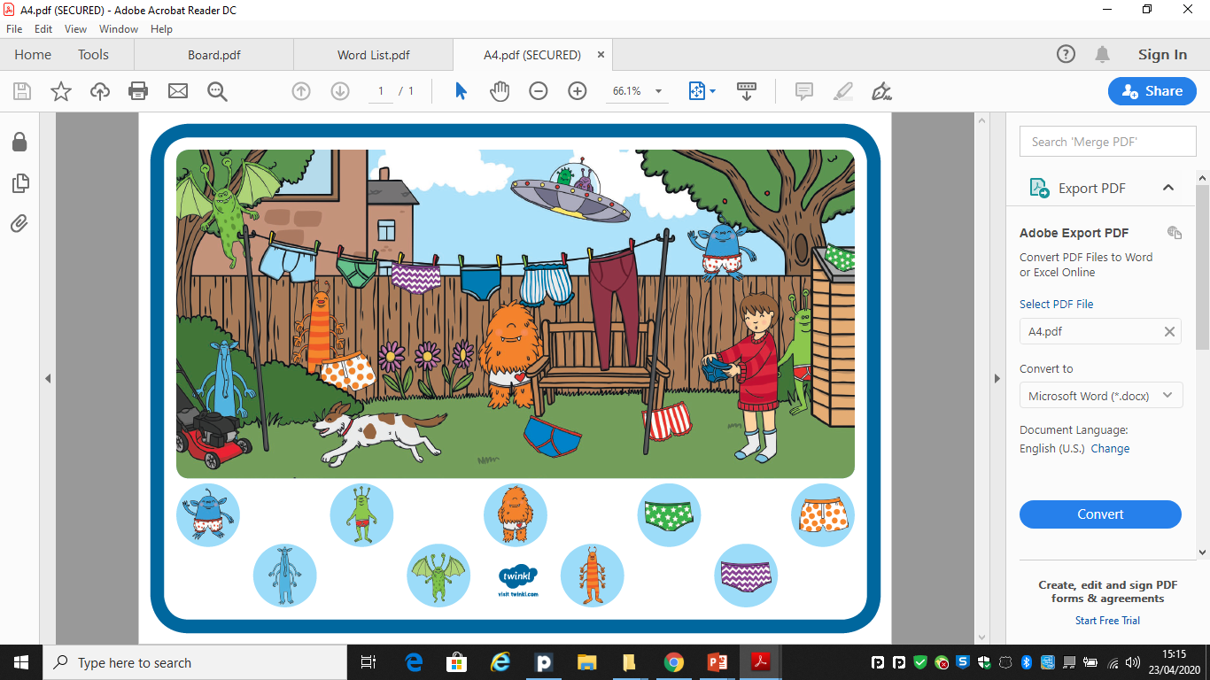
Find me!
Find me!
Find me!
Find me!
Find me!
Find me!
Find me!
Find me!
Find me!

Slide 10
Now it’s your turn to play a guessing game!
See the activity sheet provided!

