Slide 1

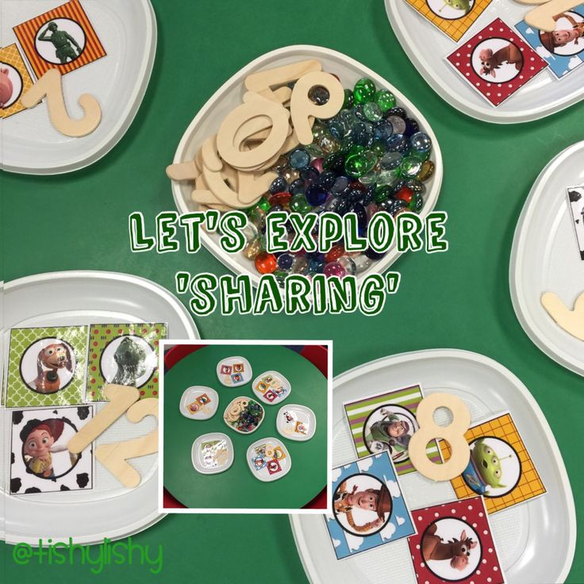
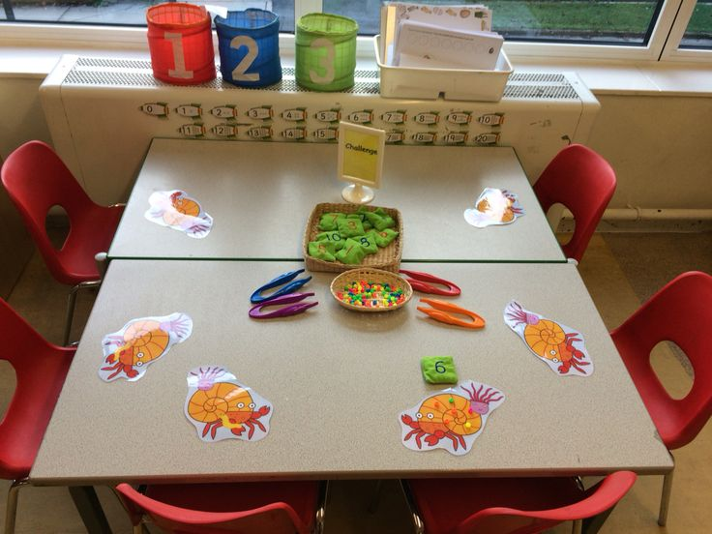

EYFS Maths
Session 4

Slide 2
Message to parents
This week the children will be sharing quantities equally. The activities provided are to be used alongside practical examples.
Reinforce the language as this will help your child to learn the concepts.
___ shared between ___ groups is ___.
groups
equal
shared

Slide 3
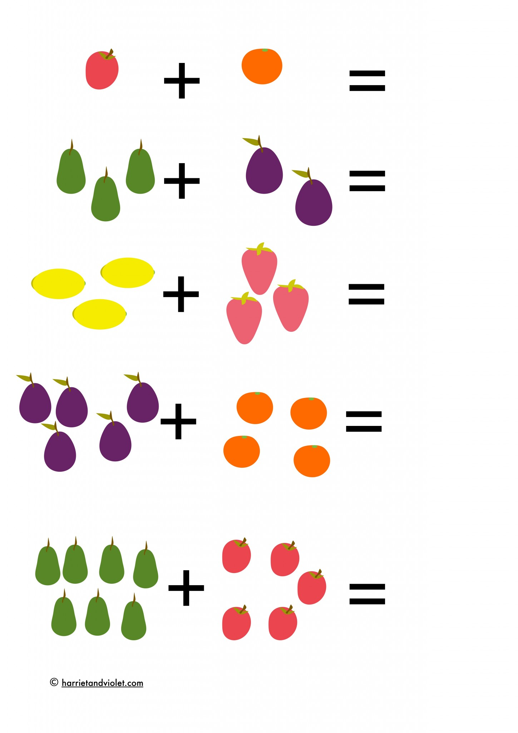
Warm Up
Let’s warm up our brains ready to learn.
Can you work out what my number sentences are?

Slide 4
Warm Up Answer
5 + 4 = 9
7 + 5 = 12

Slide 5


Solving word problems - sharing
A squirrel collects 10 nuts to share between her 5 babies. How many nuts will each baby have? Draw the nuts to check.
Answer
The answer is 2!

Slide 6
Solving word problems - sharing
A squirrel collects 10 nuts to share between her 5 babies. How many nuts will each baby have? Draw the nuts to check.
Answer
The answer is 2!

Slide 7


Solving word problems - sharing
If a packet has 20 sweets in and you share them equally between you and 3 friends, how many will you get each?
Split a piece of paper into 4 and draw 20 sweets, equally sharing them into the 4 corners of the paper. Count how many are in each corner.

Slide 8
Answer
The answer is 5 sweets each

Slide 9

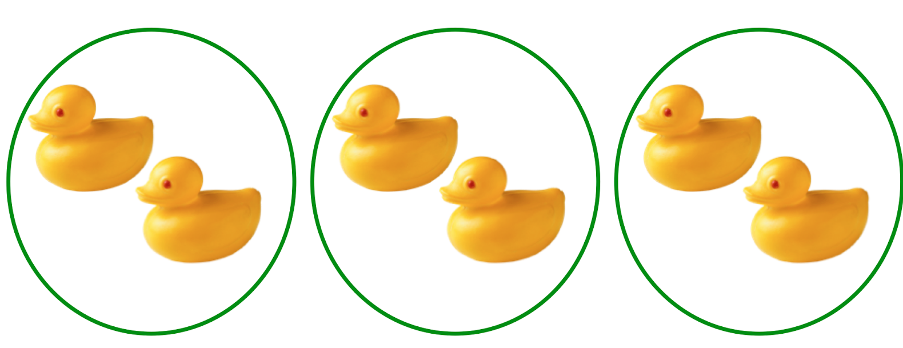
Well Done!
Now have a go at the activity sheet provided.

