Slide 1
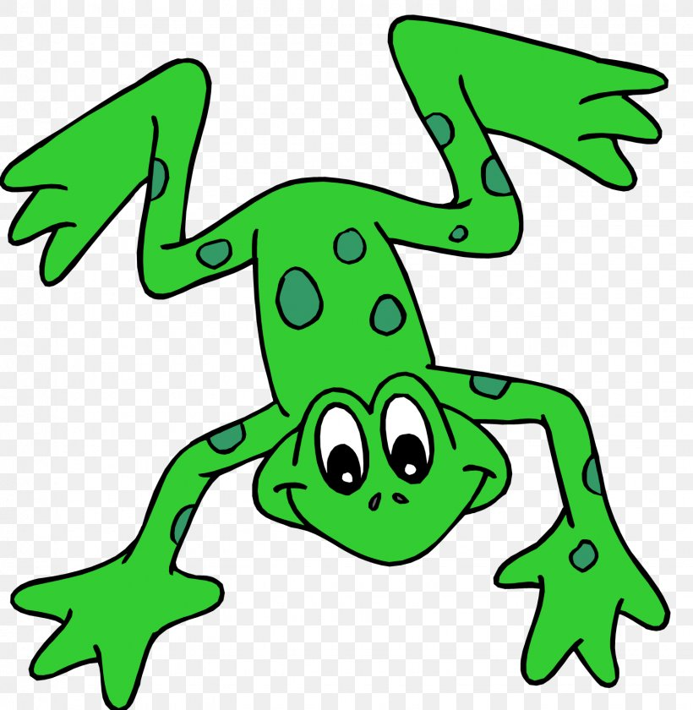
EYFS Literacy
Week 5

Slide 2
Phonics
Session 3

Slide 3
Phonics- Speedy Sounds
Click on the orange square to begin.
Each letter will appear and disappear each time you click.
How fast can you read each sound?
n
g
u
c
o
l
th
d
p
sh
k
e

Slide 4
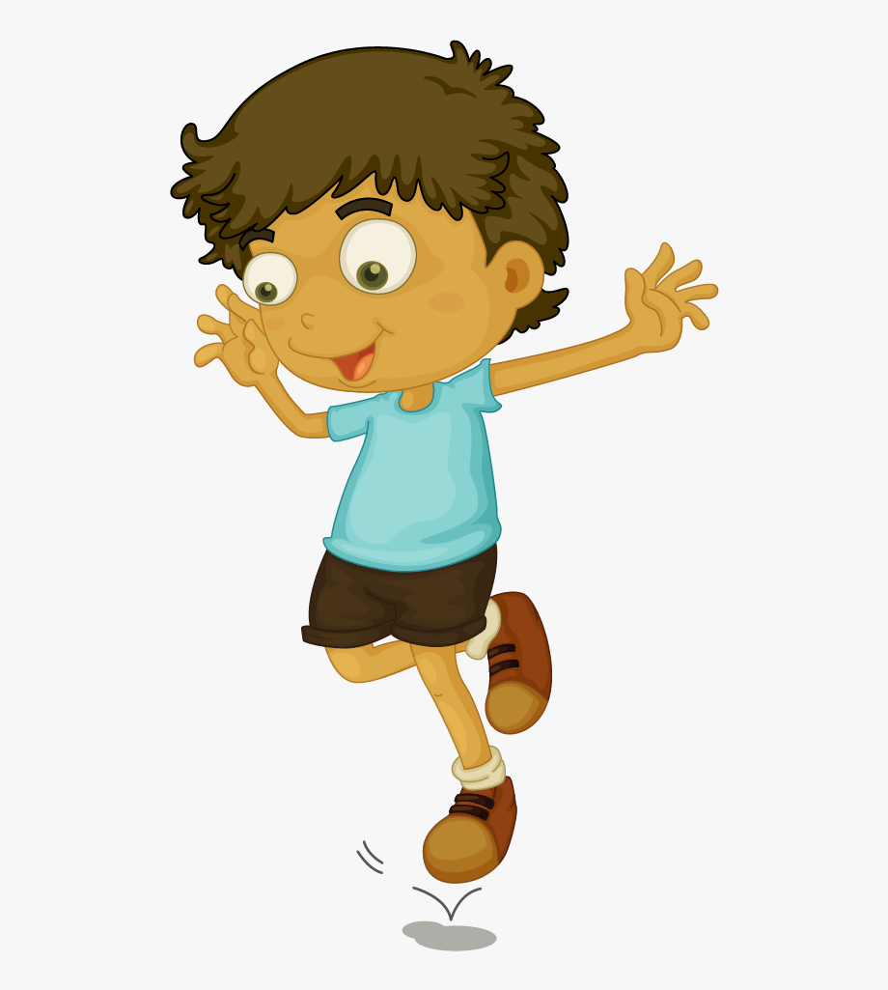
Phonics- Fred Talk
c
a
n
h
o
p

Slide 5
Phonics- Fred Talk
w
e
ll
b
u
ll

Slide 6
Phonics- Ditty
a | can
a | can | of |  | pop
I | will | sip |  | it | up
Hold a sentence:
I like to sip my can of pop.

Slide 7
Literacy
Session 3- word play
(Alien words)

Slide 8
Literacy- Session 3
Today we are going to make up some words. We are going to make alien names!
Here is an alien. I will choose some letters to name him.
I chose green letters for the first and last sound.
f
a
z
I chose an orange letter for the middle sound.
d
f
l
z
a
i

Slide 9
Literacy- Session 3
Use the green letters for the first and last sound.
a
b
c
d
e
f
g
h
i
j
k
l
m
n
o
p
q
r
s
t
u
v
w
x
y
z
ch
sh
th
Use the orange letters for the middle sound.

Slide 10
Now complete the accompanying activity.

