Slide 1
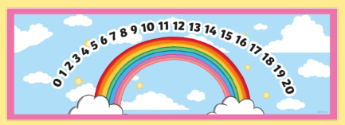



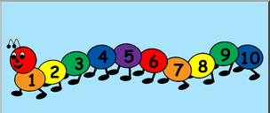
EYFS Maths
Session 1

Slide 2
Message to parents
This week the children will be learning to count on/back using a number line and solve simple addition/subtraction problems. The activities provided are to be used alongside practical examples.
Reinforce the language as this will help your child to learn the concepts.
How many jumps do you need?
count on/back
Are we going up or down the number line?
If we are adding/taking away, will our number get ‘smaller’/’bigger’?

Slide 3
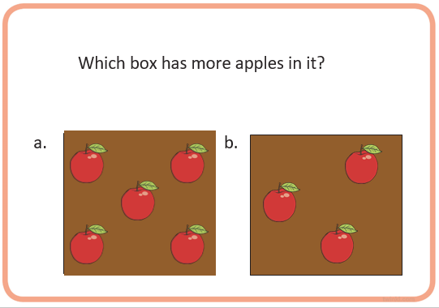
Warm Up
Let’s warm up our brains ready to learn.
Try to use your estimation skills and not count the apples!
(parents you may wish to ask your child to have a look and then cover the screen whilst they estimate.)

Slide 4
Warm Up – the answer is…
Well done!

Slide 5
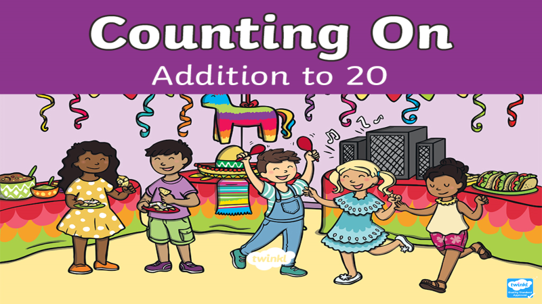
This week our first two lessons will focus on ‘counting on’ and addition.

Slide 6
When we add two numbers together like this:
+
=
5
+
2
=
7
our number or amount is increasing or ‘getting bigger’.
When we add we count up our number line to find our answer!

Slide 7

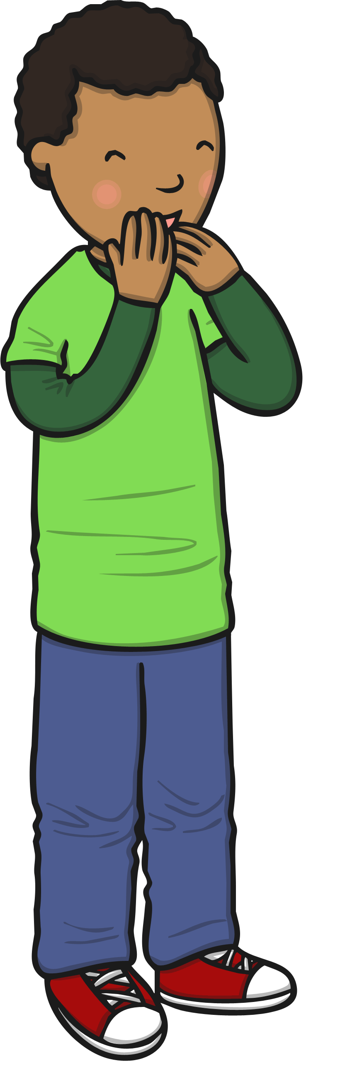
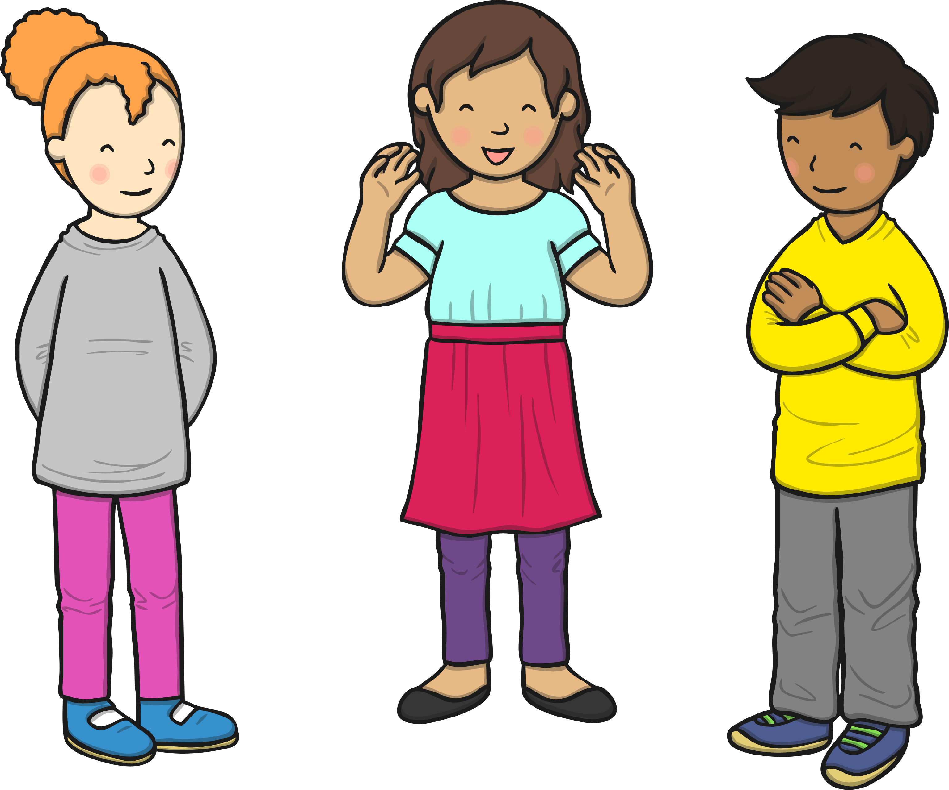
There are 6 children at the party already.
Can you count how many children will be at the party altogether?
+
=
?
10
6
4
How many jumps do you need?
0
1
2
3
4
5
6
7
8
9
10
11
12
13
14
15
16
17
18
19
20

Slide 8
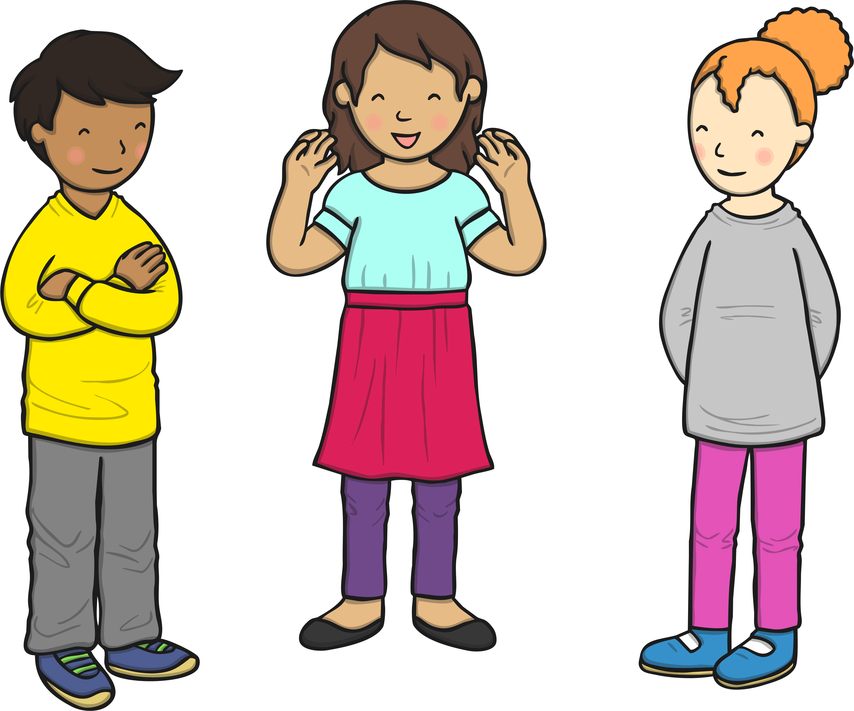
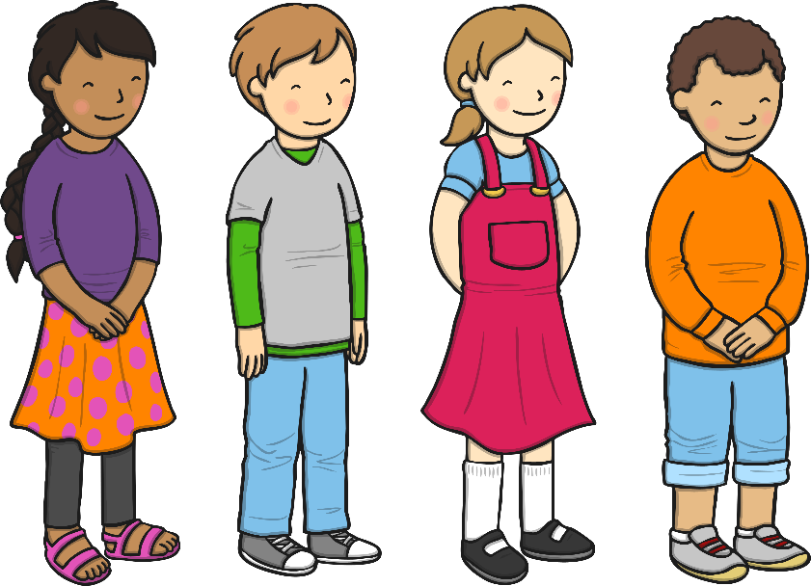
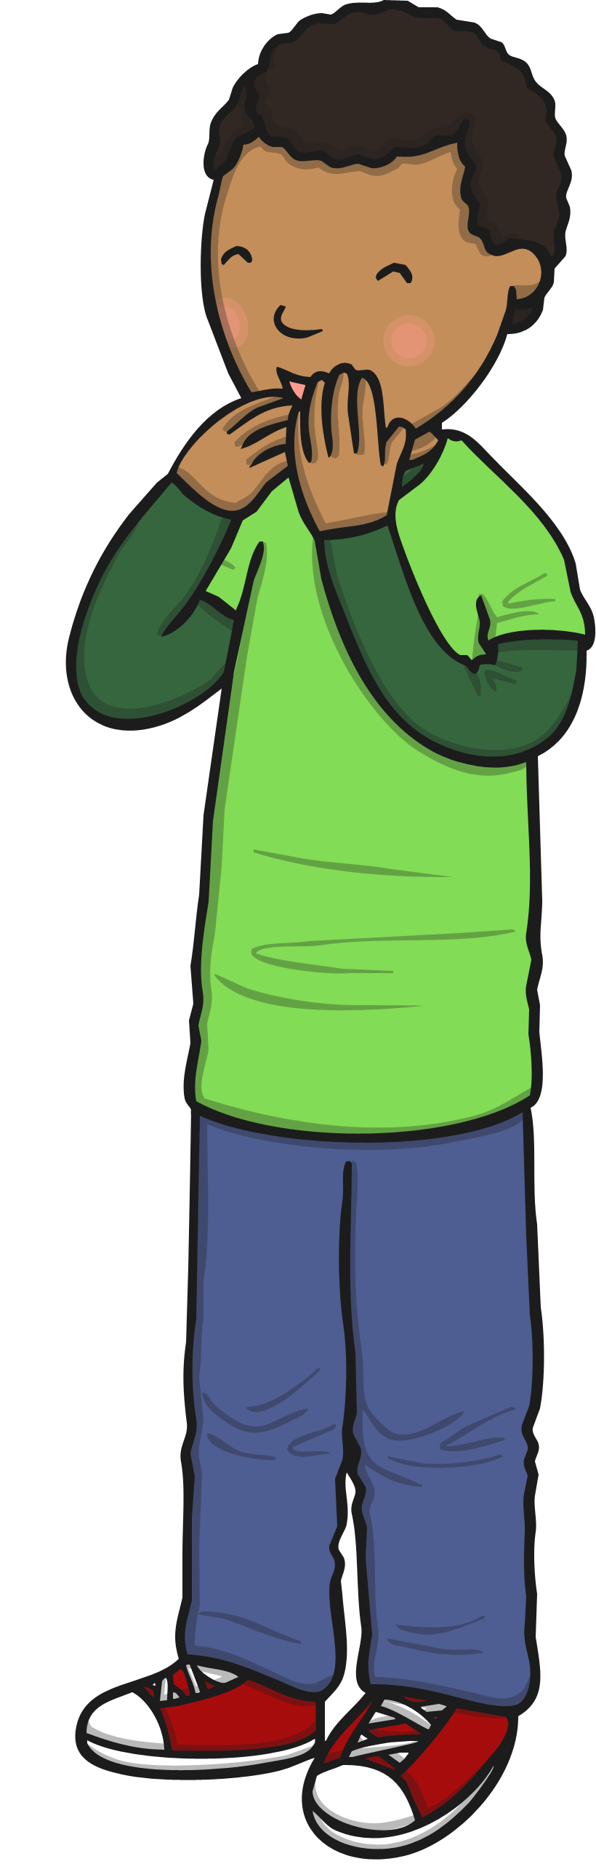
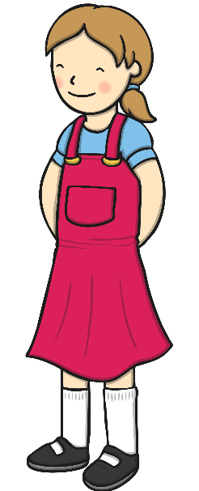
There are 7 children at the party already.
Can you count how many children will be at the party altogether?
+
=
14
?
7
7
How many jumps do you need?
0
1
2
3
4
5
6
7
8
9
10
11
12
13
14
15
16
17
18
19
20

Slide 9
Well Done!
Now have a go at the activity sheet provided.

