Slide 1
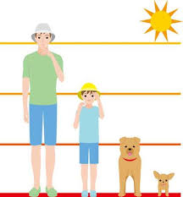


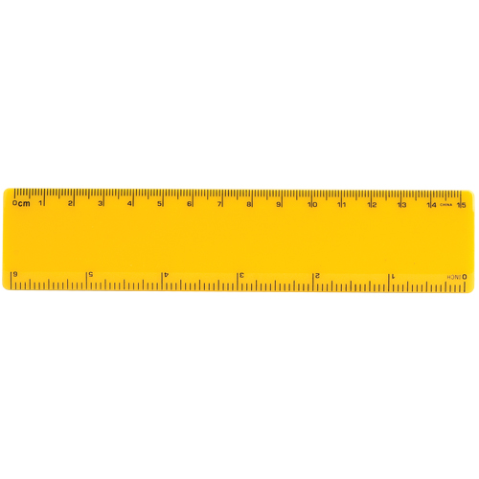
EYFS Maths
Session 2

Slide 2
Message to parents
Today the children will be learning about length. The activities provided are to be used alongside practical examples.
In EYFS, we use non-standard measures- cubes, hands, feet.
Reinforce the language as this will help your child to learn the concepts.
long
short
longer
shorter

Slide 3
Warm Up
Let’s warm up our brains ready to learn.
Name the shapes
What do we call all of these shapes?

Slide 4
Warm Up- Answer
cuboid
cylinder
cone
cube
These shapes are 3D solid shapes!

Slide 5

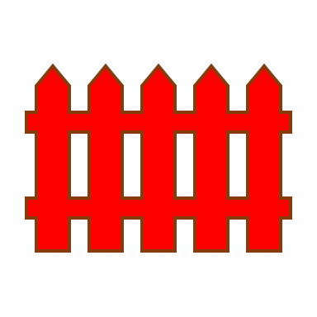
Length
How many bricks long is the fence? Let’s find out!

Slide 6
Length
The fence is 11 bricks long!
How do you know?
Did you measure the fence correctly?

Slide 7
Length
When measuring the length of an object, you need to make sure that you start as close to the edge as you can.
Try and get as close to the end of your object

Slide 8
Length
How many bricks long is the fence? Let’s find out!
Has the fence been measured correctly?
How many bricks long should the fence be?

Slide 9
Length
The fence is 13 bricks long.

Slide 10
Well Done!
Now have a go at the activity sheet provided.

