Slide 1
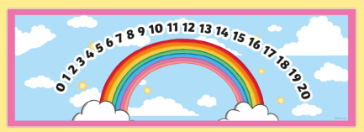
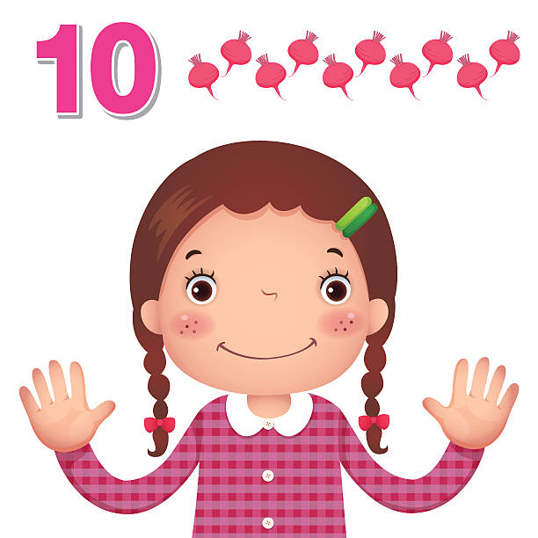

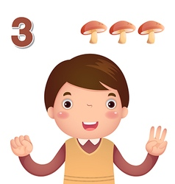
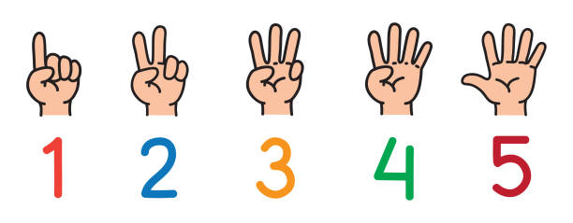
EYFS Maths
Session 4

Slide 2
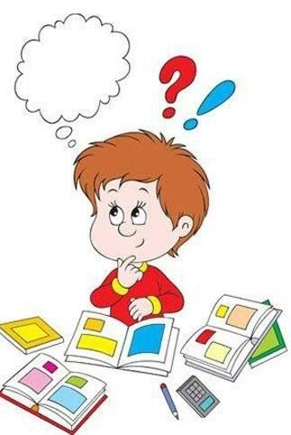
Message to parents
This week the children will be practising counting on and back to solve mathematical problems.
The focus of this week’s home learning is to
encourage mathematical thinking and reasoning.
On the next slide there are different question
types you can use to develop your child’s
mathematical thinking and reasoning.

Slide 3
Reinforce the language as this will help your child to learn the concepts.
Describing
How many were there at the start?
How many are there now?
Reasoning
How do you know?
How did you work it out?
Opening Out
What if we add two more?
What if we take one out? Two out?
Imagine there are 10 in there and I take out 6 – how would you know how many were left?
Recording
Can you show how many there were?
Can you show how many there are now?
Can you show how many there were and what happened?

Slide 4
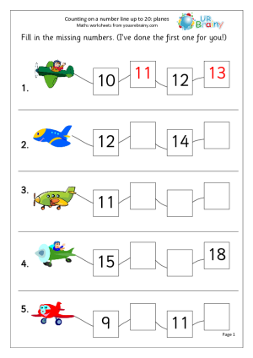
Warm Up
Let’s warm up our brains ready to learn.
Can you fill in the missing numbers?

Slide 5
Warm Up - Answers
Let’s warm up our brains ready to learn.
10 12
13 15
Well done!

Slide 6
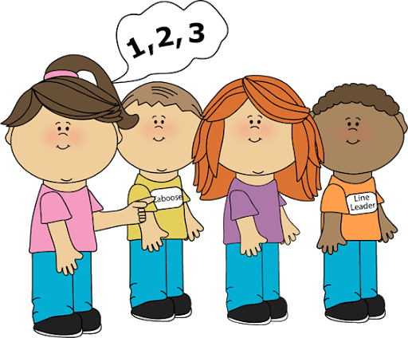
Now you’ve got the skills, it’s up to you how solve the following questions. You can use a number line, your fingers or even have a go in your head!
This week we have been learning how to count on and back to solve different mathematical problems!

Slide 7
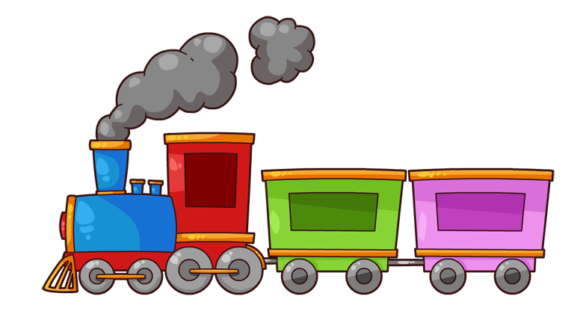
There are 6 passengers on the train. At the next station, 4 more passengers got on the train. How many passengers are now on the train?
How will you work out your answer?
6 + 4 =

Slide 8
The answer is …
+
=
10
6 + 4 =
10

Slide 9

There are 5 roses on rose bush A. There are 8 roses on rose bush B. How many roses are there altogether?
How will you work out your answer?
+
=
Rose Bush A
Rose Bush B

Slide 10
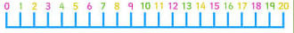
There are 5 roses on rose bush A. There are 8 roses on rose bush B. How many roses are there altogether?
+
=
13
Rose Bush A
Rose Bush B

Slide 11
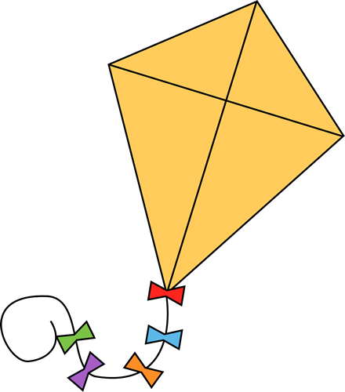
There were 9 kites in the sky. 7 flew away. How many were left?
How will you work out your answer?

Slide 12
There were 9 kites in the sky. 7 flew away. How many were left?
2!

Slide 13
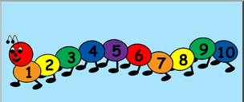


Well Done!
Now have a go at the activity sheet provided.

