Slide 1
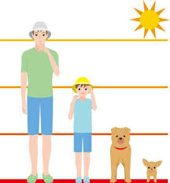
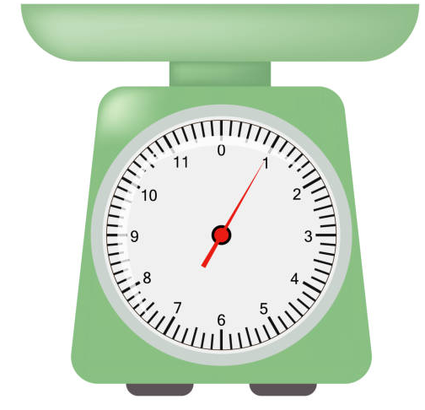
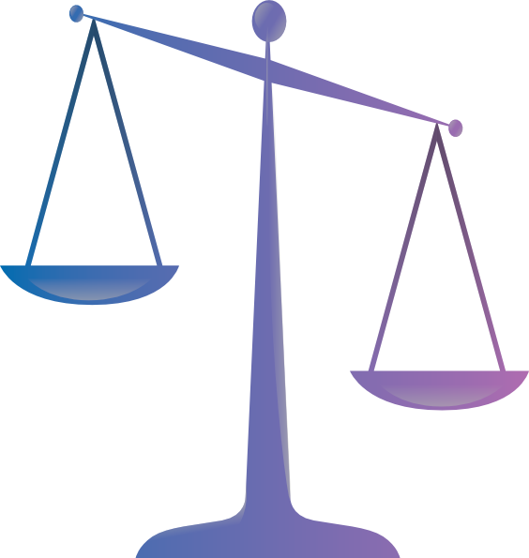
EYFS Maths
Session 4

Slide 2
Message to parents
Today the children will be learning about weight. The activities provided are to be used alongside practical examples.
Reinforce the language as this will help your child to learn the concepts.
lighter
light
heavy
heavier

Slide 3
Warm Up Let’s warm up our brains ready to learn.
Describe these shapes.
How are they the same?
How are they different?

Slide 4
Warm Up- Answer
A rectangle has:
4 sides
2 short sides
2 long sides
A square has:
4 sides
All the sides are the same size

Slide 5
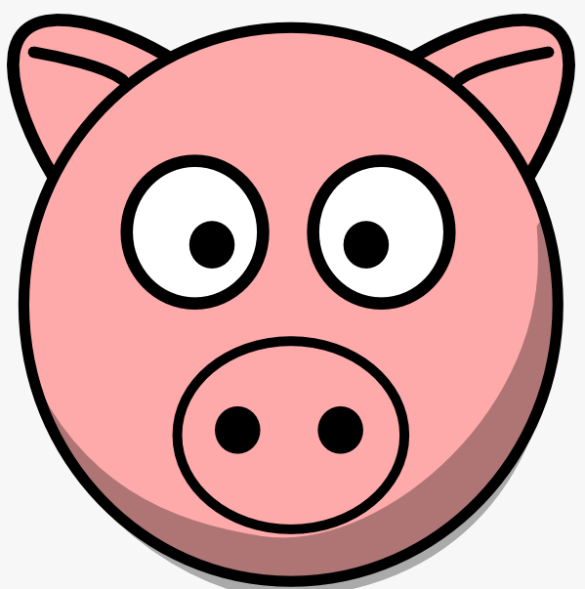
Weight
Who will be the heaviest?

Slide 6
Weight
I am the lightest.
I am the heaviest.

Slide 7
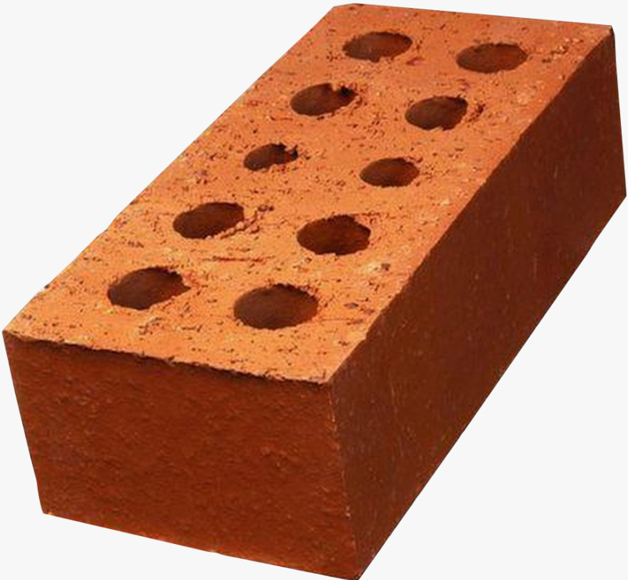
Weight
The brick is lighter than the stick.
No it is wrong!
Is this right?
Bricks are heavy.
Sticks are lighter than bricks.

Slide 8
Weight
Can you order the objects by their weight?
We are now going to order the weight of the objects.
Light
Heavy

Slide 9
Weight
bag
bed
game control
pencil
Heaviest
Lightest

Slide 10
Well Done!
Now have a go at the activity sheet provided.

