Slide 1




EYFS Maths
Week 1- Session 2

Slide 2
Message to parents
This week the children will be learning about doubling. The activities provided are to be used alongside practical examples.
Reinforce the language as this will help your child to learn the concepts.
The double of ___ is ___
double
___ is the double of ___

Slide 3


Warm Up
Let’s warm up our brains ready to learn.
+
=
?
+
=
?
Can you write these sums as a number sentence?

Slide 4
Warm Up- Answer
+
=
3
3
6
+
=
6
2
8

Slide 5
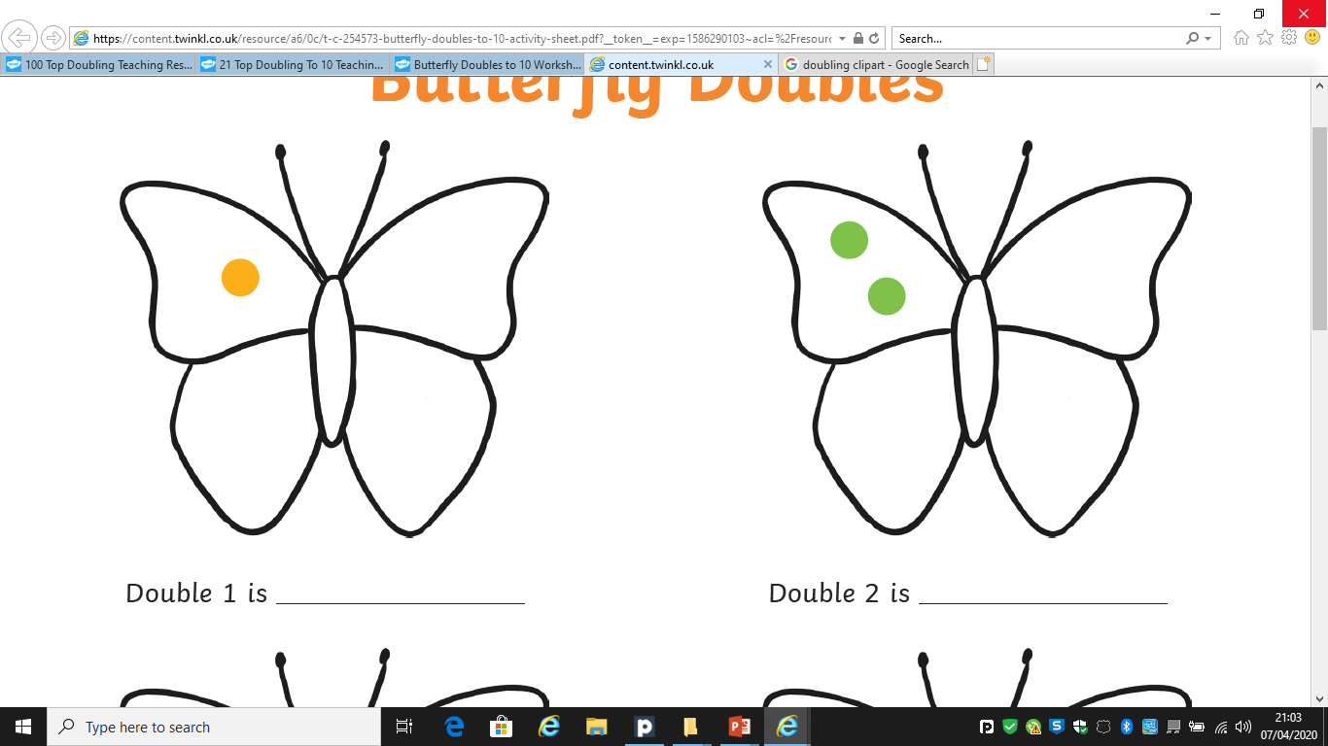
Doubling
I have 2 spots on this side.
How many do I need on this side?
I need 2 on this side.
The double of 2 is 4

Slide 6
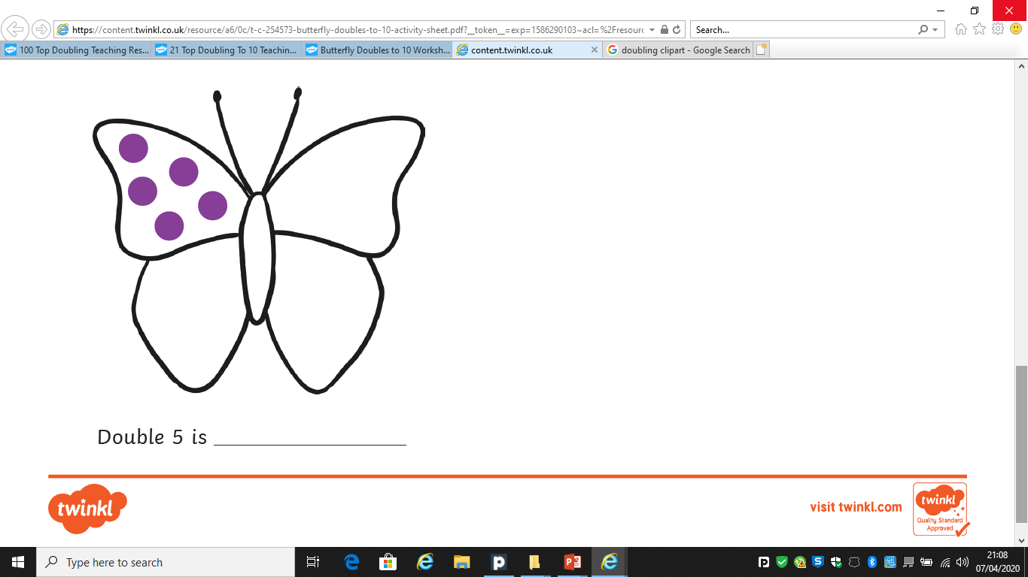
Doubling
I have 5 spots on this side.
How many do I need on this side?
I need 5 on this side.
The double of 5 is 10

Slide 7
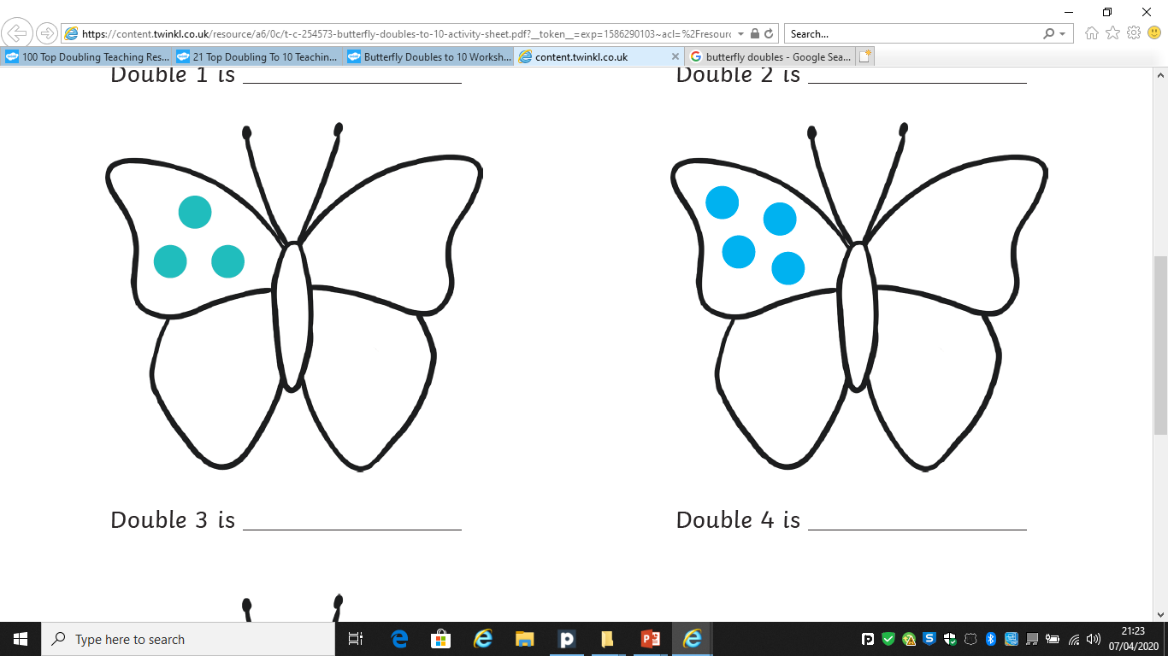
Doubling
I have 3 spots on this side.
How many do I need on this side?
I need 3 on this side.
The double of 3 is 6

Slide 8
Well Done!
Now have a go at the activity sheet provided.

