Slide 1

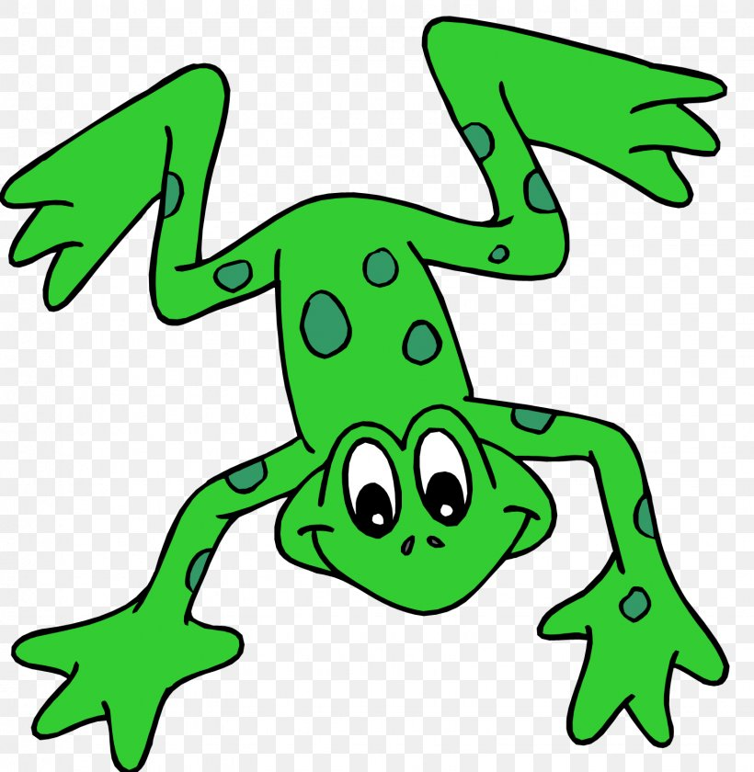


EYFS Literacy
w/c 1st June 2020

Slide 2
Phonics
Session 4

Slide 3
Phonics- Speedy Sounds
Click on the orange square to begin.
Each letter will appear and disappear each time you click.
How fast can you read each sound?
j
th
sh
a
ch
l
w
e
b
n
p
u

Slide 4




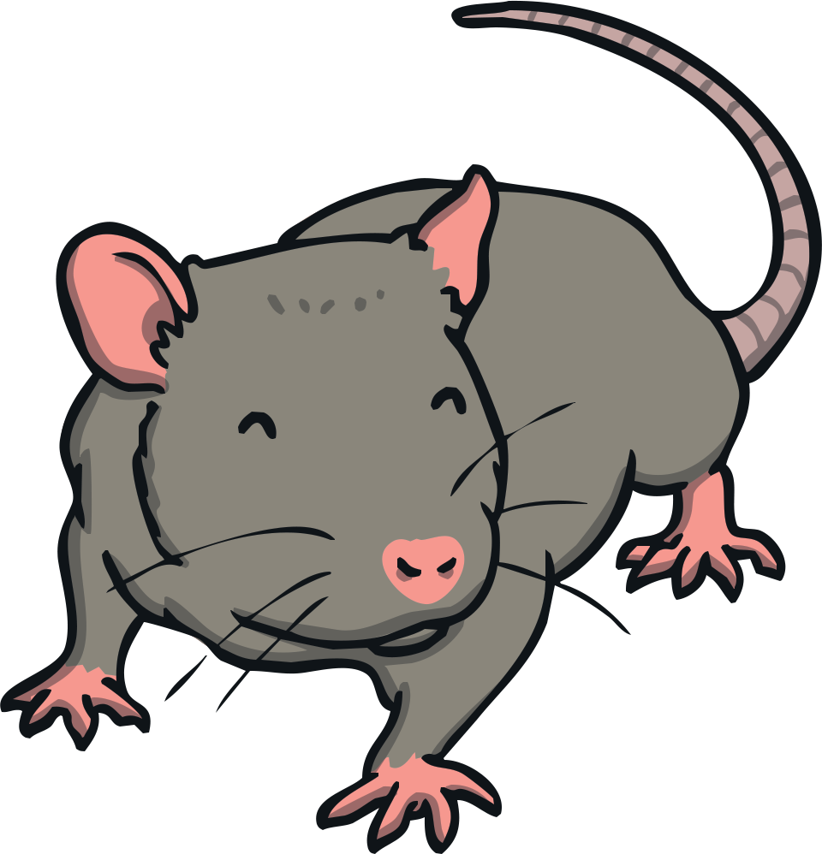

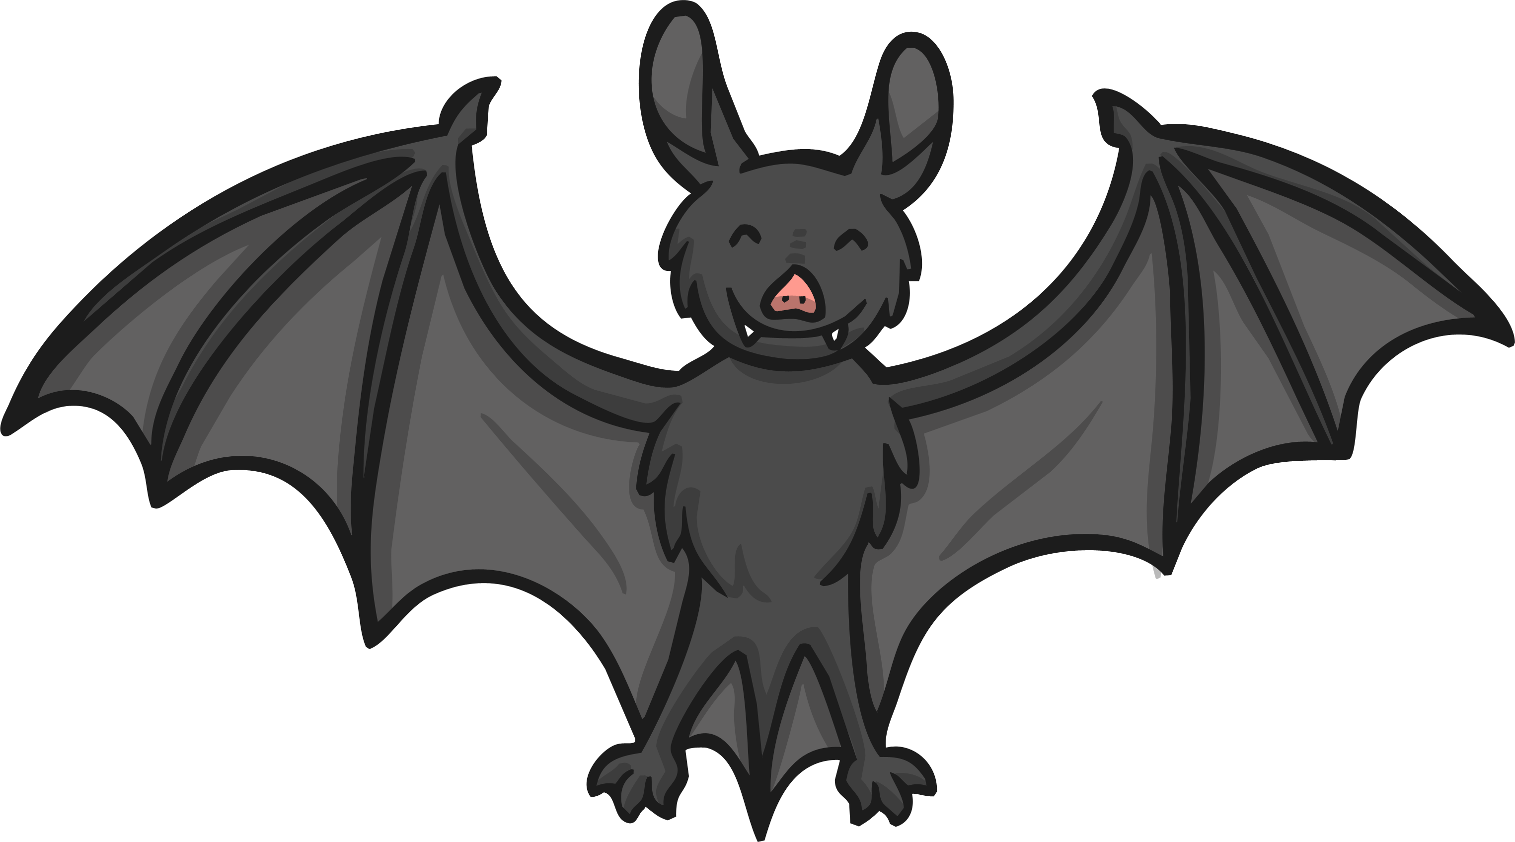
Phonics- Fred Talk
Match the Rhyming Words
Click the words that rhyme with cat.
cat
X
hat
pan
X
rat
leg
X
bat
sun

Slide 5


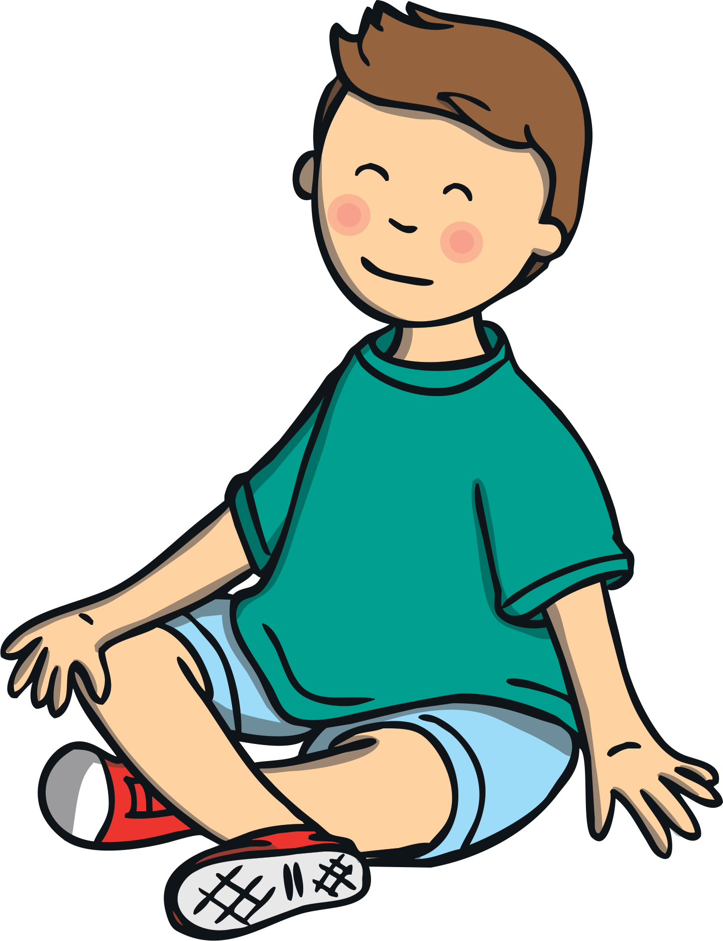

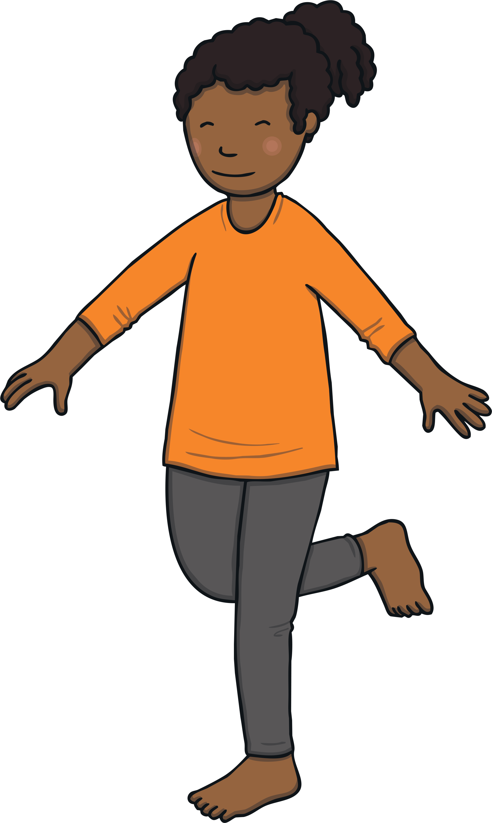

Phonics- Fred Talk
Click the words that rhyme with pop.
sit
pop
X
mop
X
X
peg
hat
hop
top

Slide 6

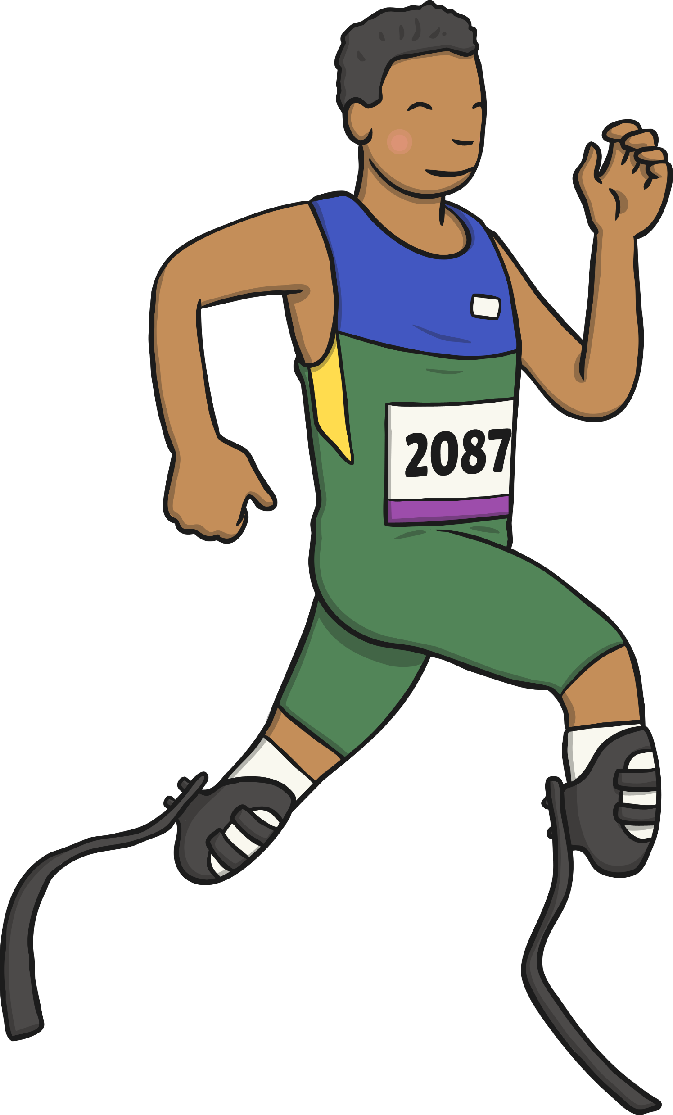



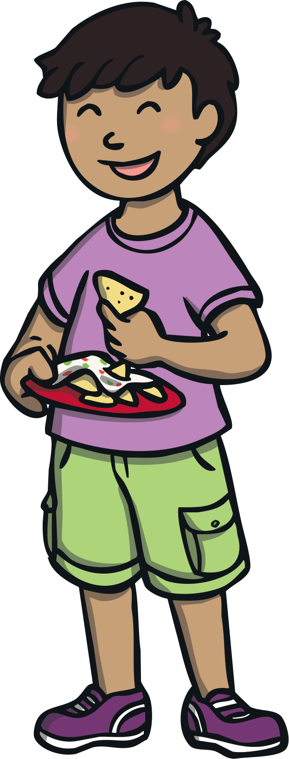


Phonics- Fred Talk
Click the words that rhyme with sun.
X
sun
cup
run
X
rock
bun
log
X
fun

Slide 7

Phonics- Ditty
a | sun
a | hot | sun
The | sun | is | big | and | hot
Hold a sentence:
The big hot sun.

Slide 8
Literacy
Session 4

Slide 9
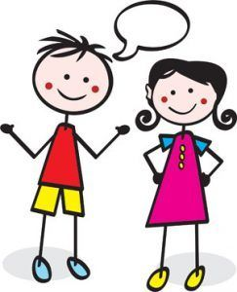
Literacy session 4
Yesterday you wrote sentences to describe a house you designed for the three little pigs.
You practised writing in full sentences!
Not only is it important to write in full sentences, it is also important to speak in a full sentence.

Slide 10
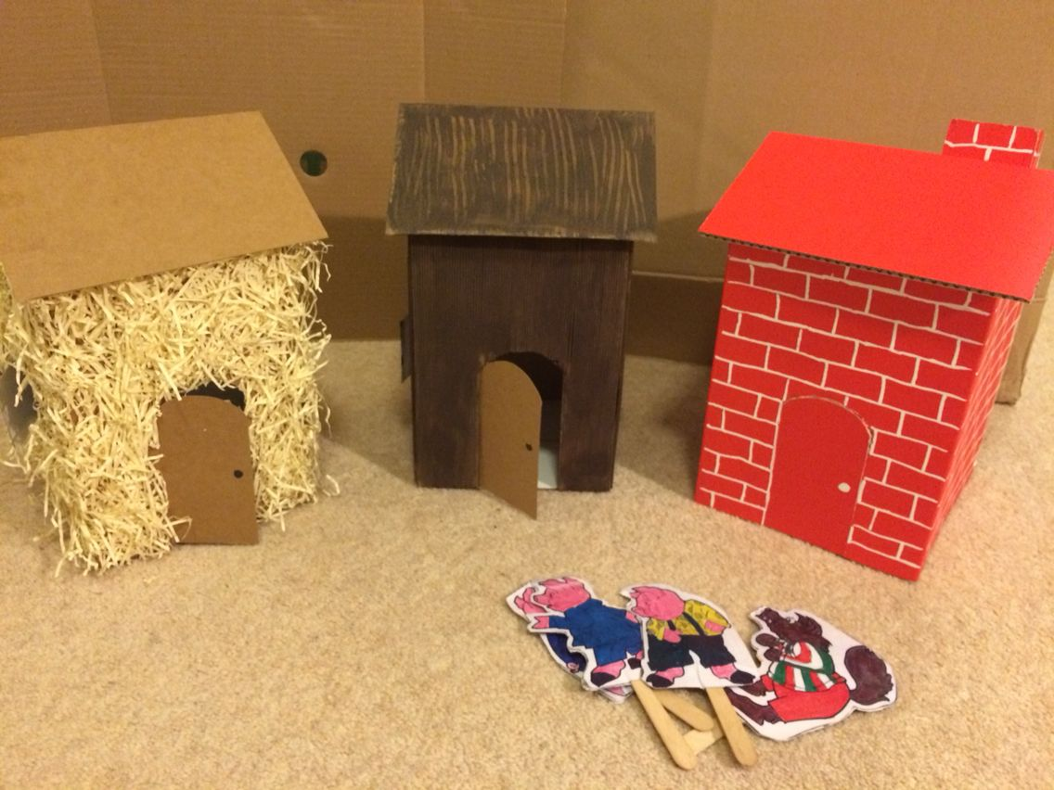
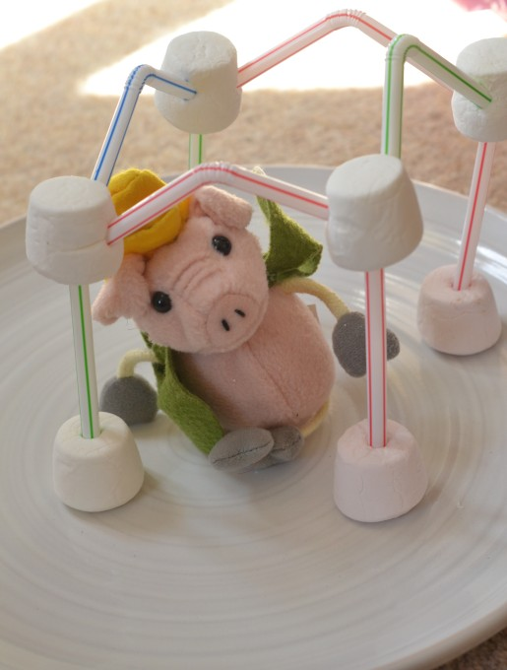
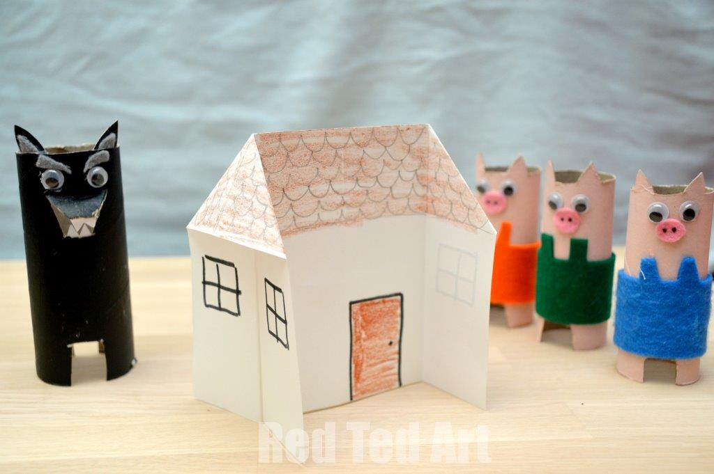
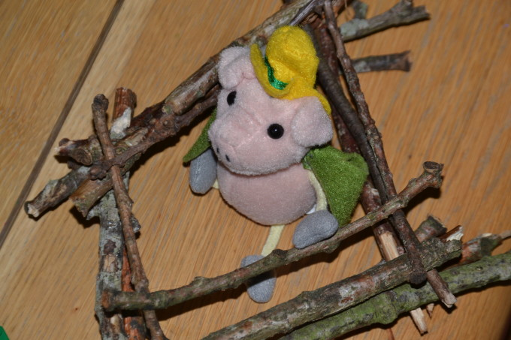
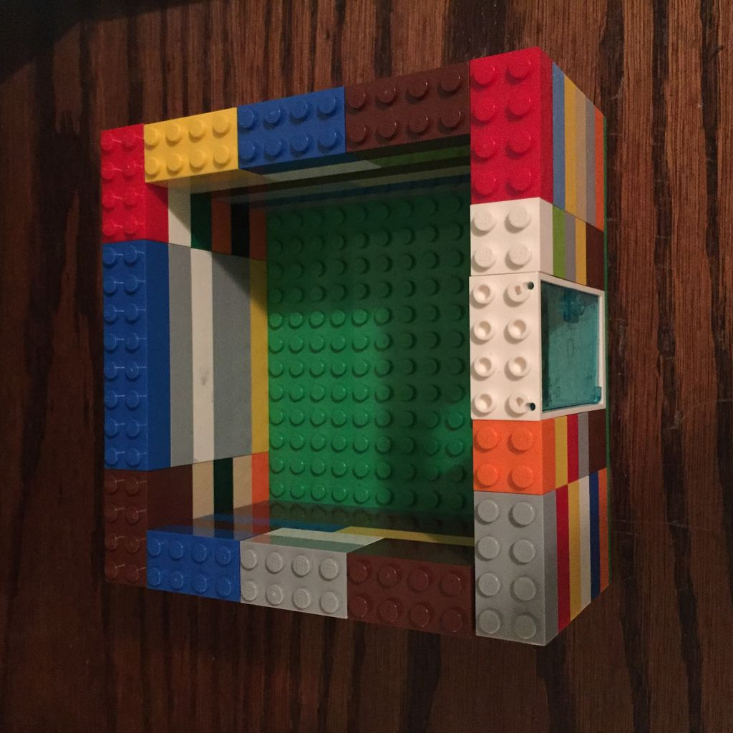
Today you are going to be building a house for the Three Little Pigs, using everyday objects!
You can use paper
straws
Or even lego!
sticks

Slide 11
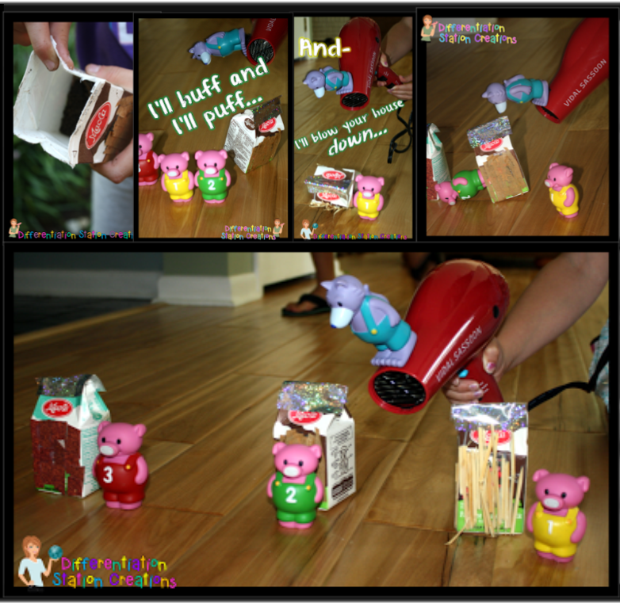
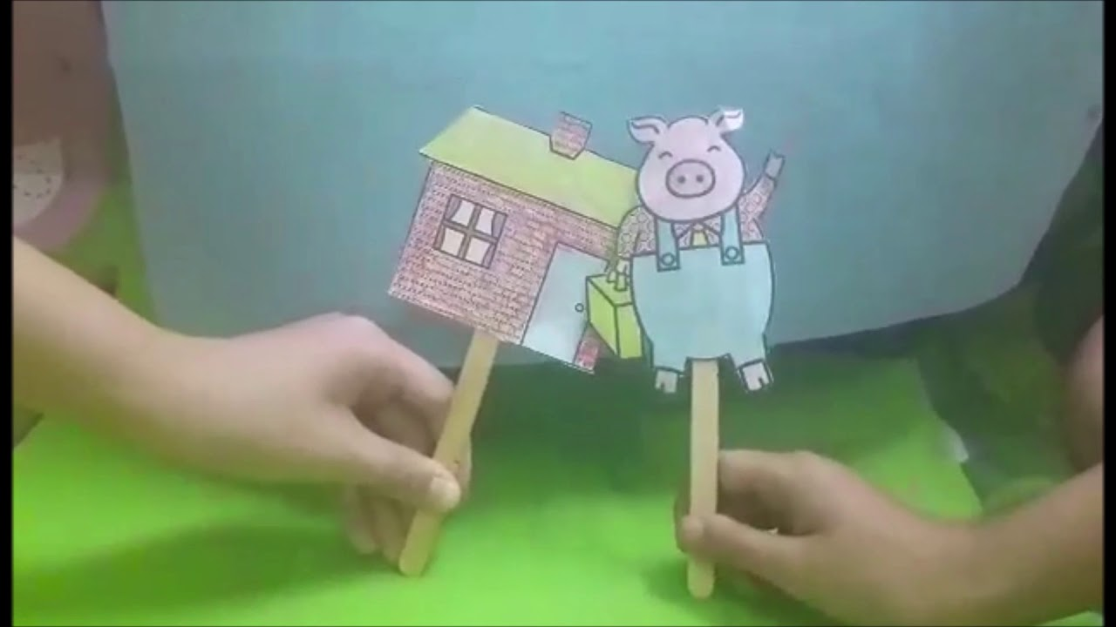
Remember to describe your house and how you’ve made it using full sentences!
Then have a go at
retelling the story or
creating your own version
with new characters!

