Slide 1
EYFS Literacy
Week 2

Slide 2
Phonics
Session 2

Slide 3
Phonics- Speedy Sounds
Click on the orange square to begin.
Each letter will appear and disappear each time you click.
How fast can you read each sound?
b
s
z
v
o
l
w
n
t
j
sh
i

Slide 4
Phonics- Fred Talk
l
e
g
h
e
n

Slide 5
Phonics- Fred Talk
b
e
d
n
e
t

Slide 6
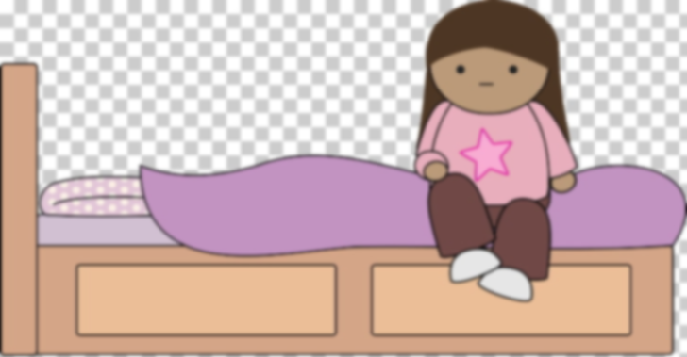
Phonics- Ditty
a | bed
I | sat | on | a | bed
I | sat | on | a | soft | bed
Hold a sentence:
I can sit on the bed.

Slide 7
Literacy
Session 2-
Story Mapping

Slide 8
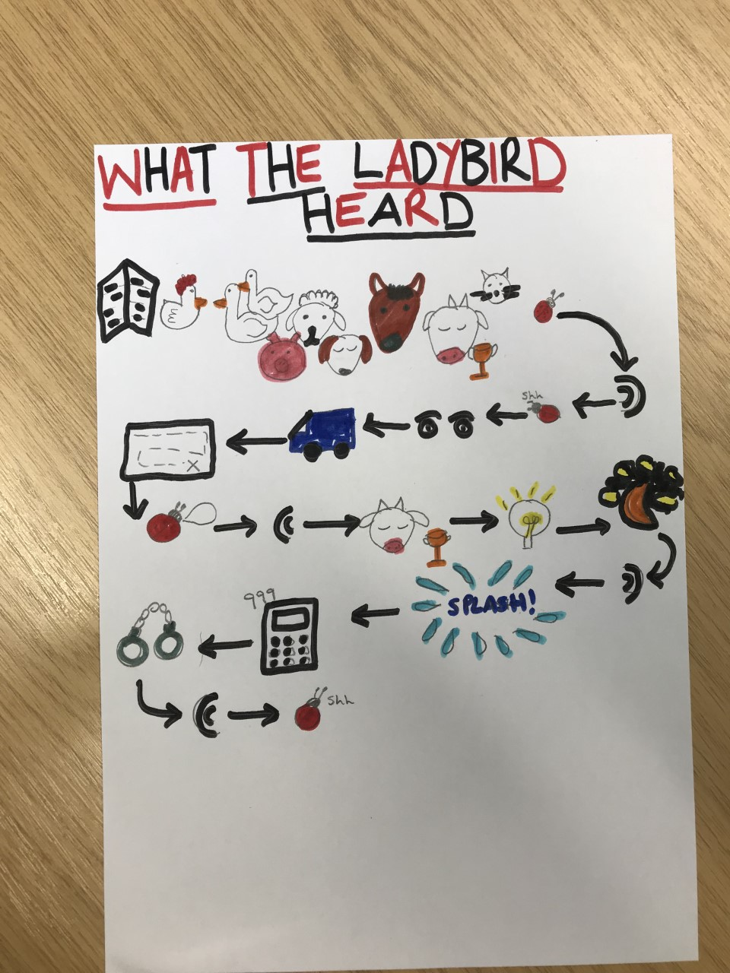
Literacy- Session 2
Can you remember what happened in the story?
Use the story map to help you remember.

Slide 9
Now it’s your turn to make a story map of “What the ladybird heard”

