Slide 1
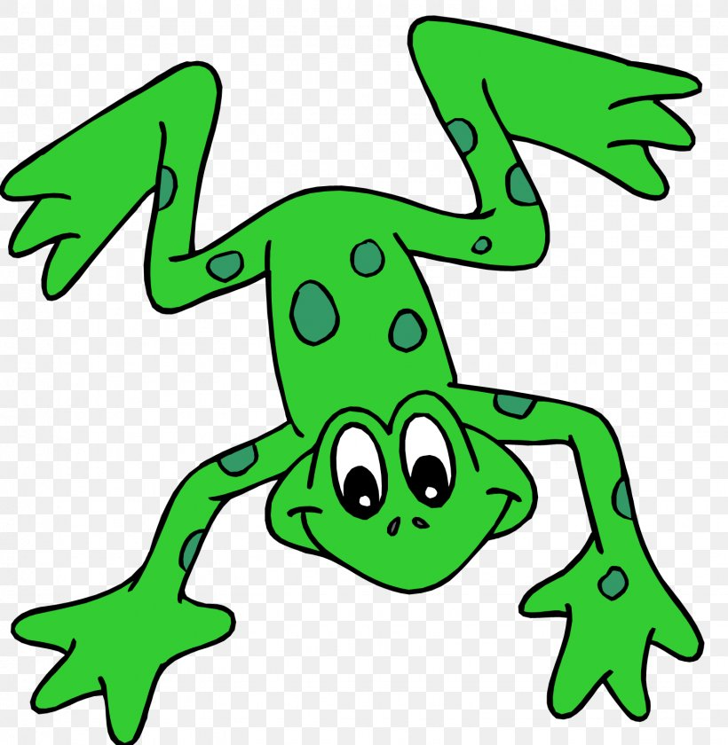
EYFS Literacy
Week 1

Slide 2
Phonics
Session 4

Slide 3
Phonics- Speedy Sounds
s | p | d | b
nk | sh | v | j
ch | r | u | th

Slide 4
Phonics- Fred Talk
d
i
g
s
u
n

Slide 5
Phonics- Fred Talk
v
a
n
w
e
b

Slide 6
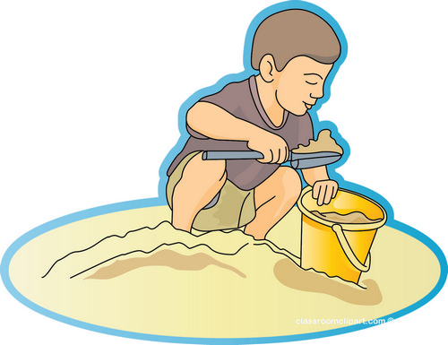
Phonics- Ditty
the | sun
dig | in | the | sun
dig | in | the | hot | sun
Hold a sentence (children to keep repeating the sentence whilst writing it down):
I will dig in the sand.

Slide 7
Literacy
Session 4-
Making a sentence

Slide 8
Literacy- Session 4
Here are 3 sentences. They are jumbled up! Can you unscramble them to make sense?
duck
.
is
The
hot

Slide 9
Literacy- Session 4
Here are 3 sentences. They are jumbled up! Can you unscramble them to make sense?
duck
sad
The
.
is

Slide 10
Literacy- Session 4
Here are 3 sentences. They are jumbled up! Can you unscramble them to make sense?
man
is
.
fat
The

Slide 11
Now it’s your turn to write a sentence.

