Slide 1

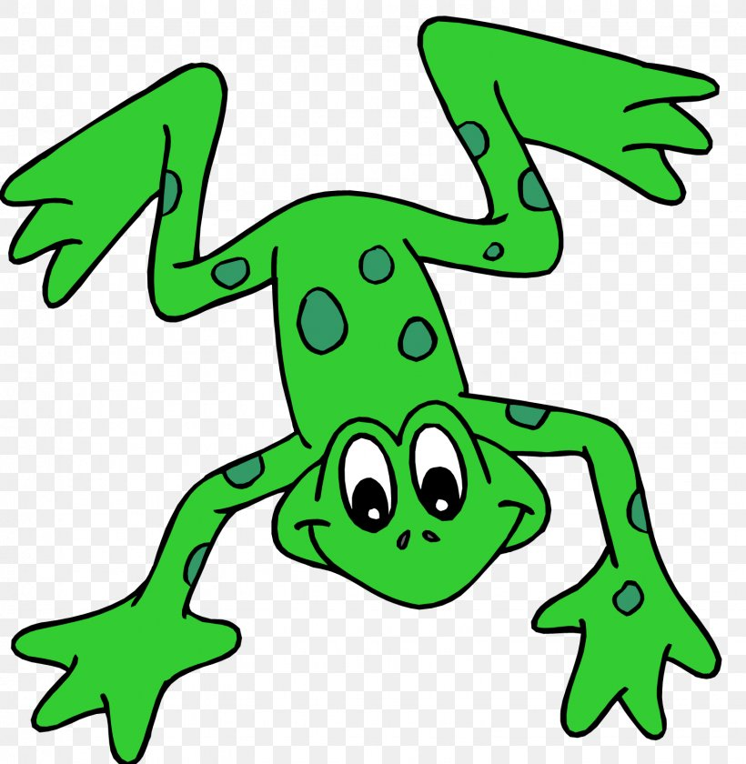


EYFS Literacy
Week 3

Slide 2
Phonics
Session 1

Slide 3
Phonics- Message for Parents
Each session has been designed to replicate how the children learn phonics at school. Although some of what they learn, they may already know, it is good practise for them to develop these skills independently.
Each session will follow the same format-
  Speedy sounds- Each sound will appear automatically after the first click. The sounds will change on a daily basis. There will be a maximum of 12 speedy sounds a day.
  Fred Talk- (Fred the frog can only speak in sounds.) The children say the sounds then the whole word. The words will get progressively challenging as the weeks continue.
  Ditty- These short sentences will develop your child’s ability to read. They sound out each word, re-read the word then re-read the sentence. At the end there is a ‘hold the sentence’ whereby you read the sentence to your child, they repeat back and keep repeating. At the same time they will write it down.

Slide 4
Phonics- Speedy Sounds
Click on the orange square to begin.
Each letter will appear and disappear each time you click.
How fast can you read each sound?
n
g
u
c
o
l
th
d
p
sh
k
e

Slide 5
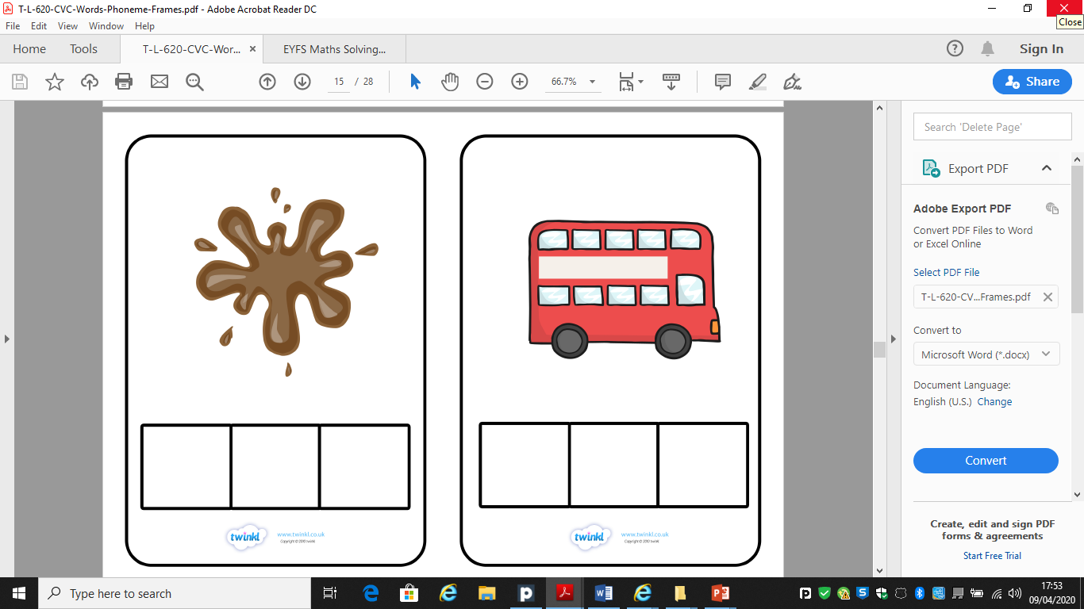
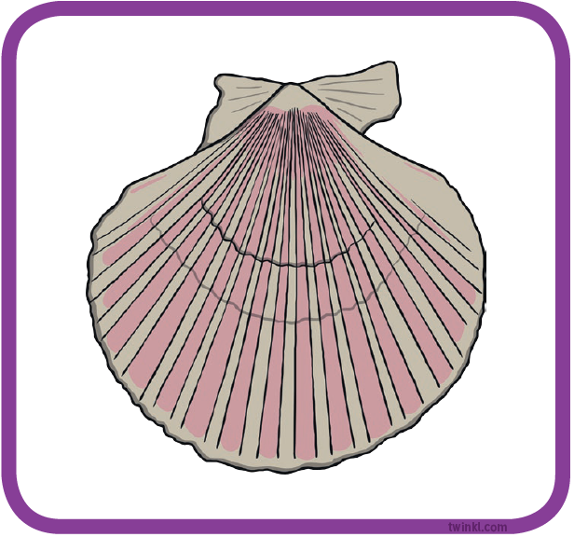
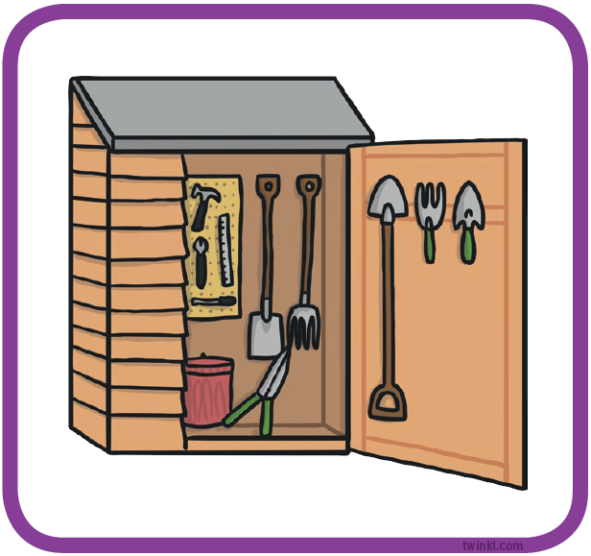
Phonics- Fred Talk
sh
e
ll
sh
e
d

Slide 6
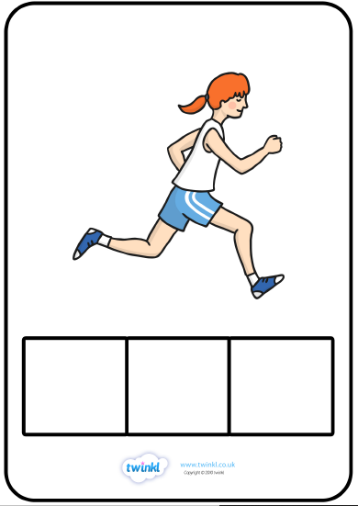
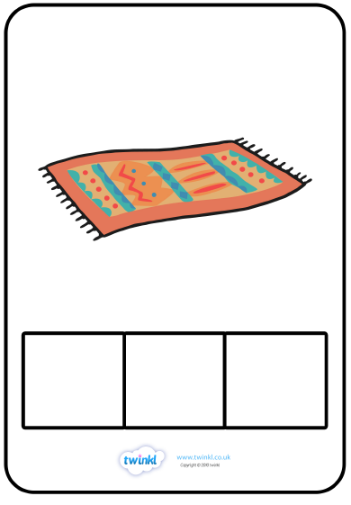
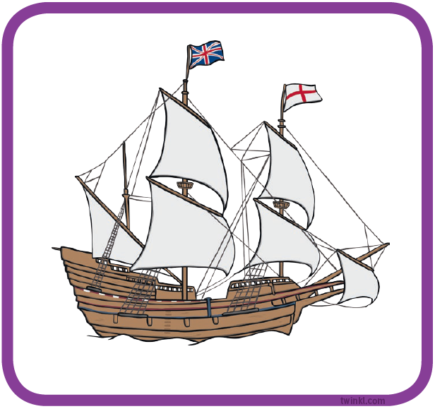
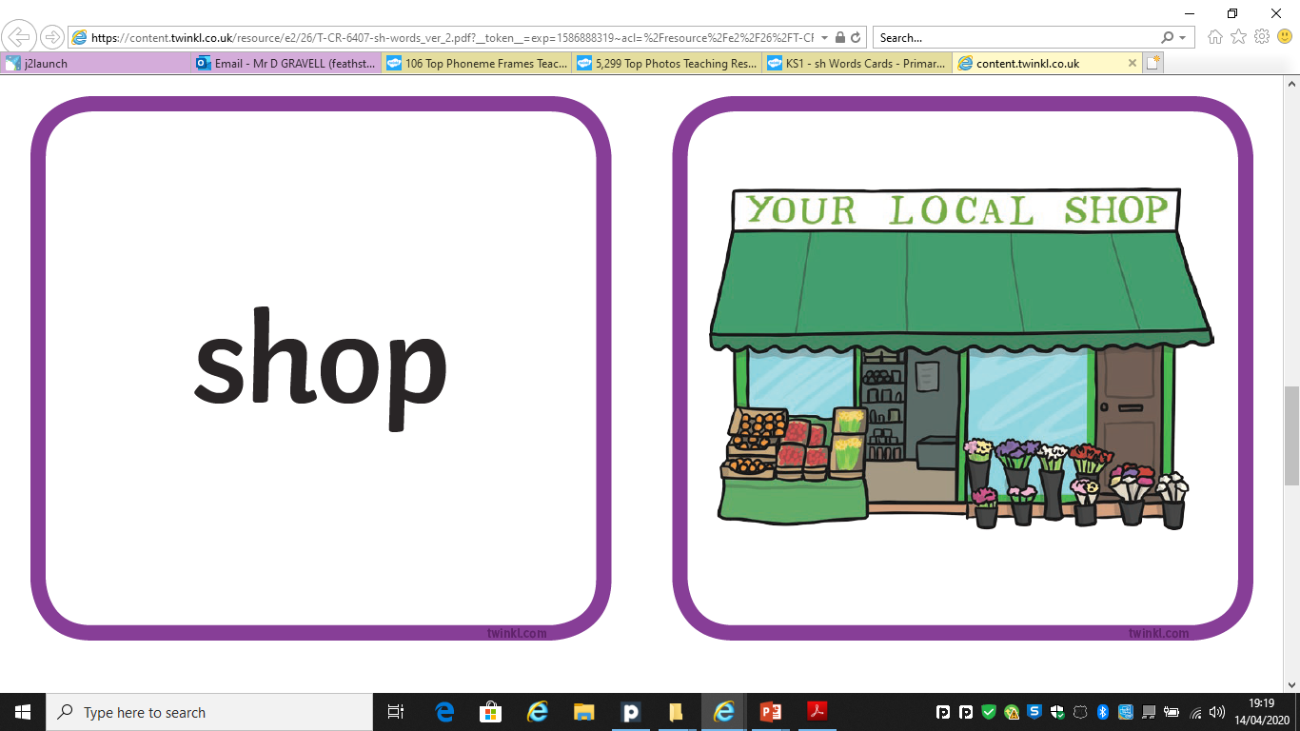
Phonics- Fred Talk
sh
i
p
sh
o
p

Slide 7
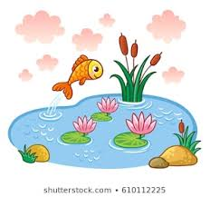
Phonics- Ditty
a | fish
a | big | fish
a | big | fish | in | a | pond
Hold a sentence:
A fish in a big pond.

Slide 8
Literacy
Session 1-
Comprehension

Slide 9
Literacy- Message for Parents
The aim of these sessions is to build the children’s confidence and independence in writing, however they will cover other skills too.
In writing children will use their phonic knowledge to write words in ways which match their spoken sounds. They will also try and write some irregular common words (High Frequency Words). They write simple sentences which can be read by themselves and others. Some words are spelt correctly and others are phonetically plausible.
Below are the Early Learning Goals for Communication and Language. These are important as children will be able to listen, think about and respond to what is asked.
Listening & Attention | Understanding | Speaking
Children listen attentively in a range of situations. They listen to stories, accurately anticipating key events and respond to what they hear with relevant comments, questions or actions. They give their attention to what others say and respond appropriately, while engaged in another activity. | Children follow instructions involving several ideas or actions. They answer ‘how’ and ‘why’ questions about their experiences and in response to stories or events. | Children express themselves effectively, showing awareness of listeners’ needs. They use past, present and future forms accurately when talking about events that have happened or are to happen in the future. They develop their own narratives and explanations by connecting ideas or events.

Slide 10
Literacy- Session 1
This week we are going to read the story of “The magic paintbrush.”
If you have a copy, get your grown-up to read it to you.
If not, here is a link to YouTube so that you can watch and listen.
https://www.youtube.com/watch?v=z-0JZPzBDMc

Slide 11
Literacy- Session 1
Your grown-up will now ask you some questions. I hope you were listening! Try and answer in a full sentence.
1- What does Shen use to draw with at the beginning of the story?
Shen uses a stick to draw in the sand
2- Who is Shen only allowed to paint for?
Shen must only paint for the poor.
4- How does Shen scare The Emperor?
3- What does Shen paint to escape the prison?
Shen paints a dragon to scare The Emperor.
Shen paints a horse and a key.

Slide 12
Now complete the accompanying activity.

