Slide 1



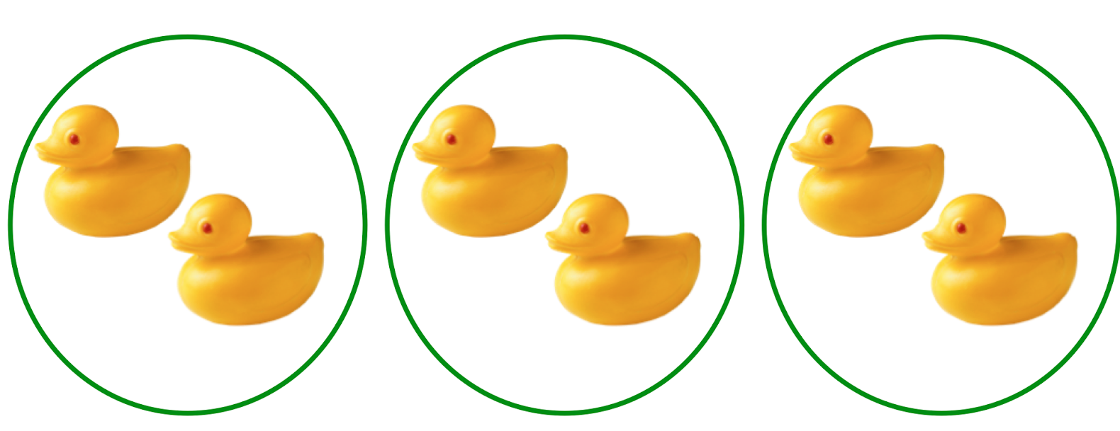
EYFS Maths
Session 3

Slide 2
Message to parents
This week the children will be sharing quantities equally. The activities provided are to be used alongside practical examples.
Reinforce the language as this will help your child to learn the concepts.
___ shared between ___ groups is ___.
groups
equal
shared

Slide 3
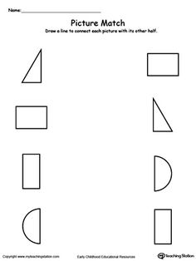
Warm Up
Let’s warm up our brains ready to learn.
Can you match the shape halves?

Slide 4
Warm Up Answer
Can you match the shape halves?

Slide 5

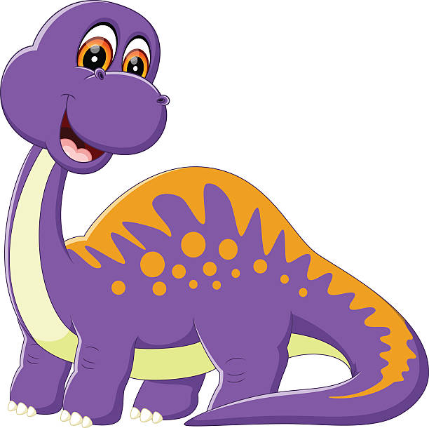
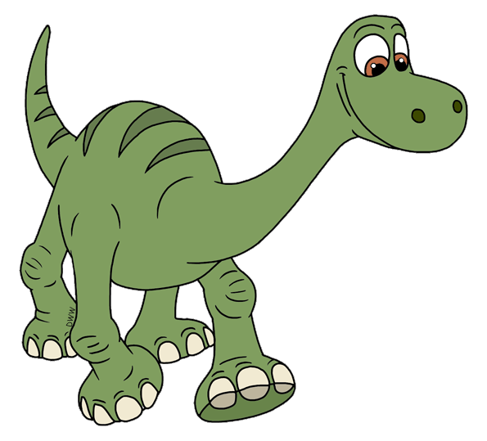
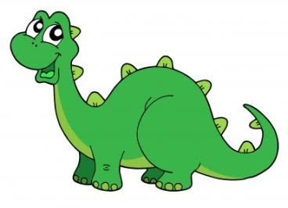
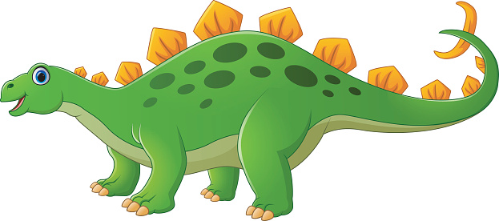
Can you share the leaves equally between the dinosaurs?
12 shared between ___ is ___.

Slide 6
Can you share the leaves equally between the dinosaurs?
4
3
12 shared between ___ is ___.

Slide 7



Can you help the queen bee share the bees equally?
12
12 shared between 2 is 6

Slide 8
Well Done!
Now have a go at the activity sheet provided.

