Slide 1




EYFS Literacy
Week 5

Slide 2
Phonics
Session 4

Slide 3
Phonics- Speedy Sounds
Click on the orange square to begin.
Each letter will appear and disappear each time you click.
How fast can you read each sound?
j
th
sh
a
ch
l
w
e
b
n
p
u

Slide 4
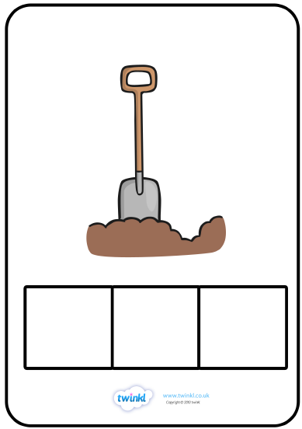
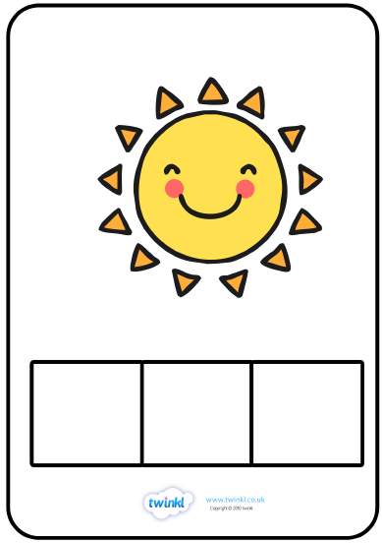


Phonics- Fred Talk
f
u
ll
z
i
p

Slide 5
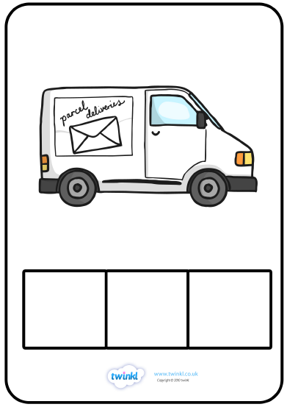
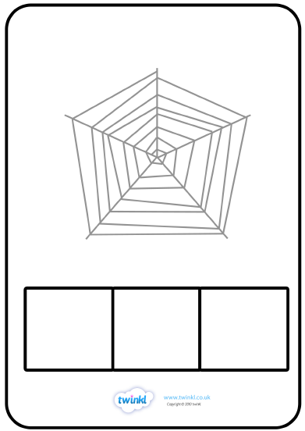

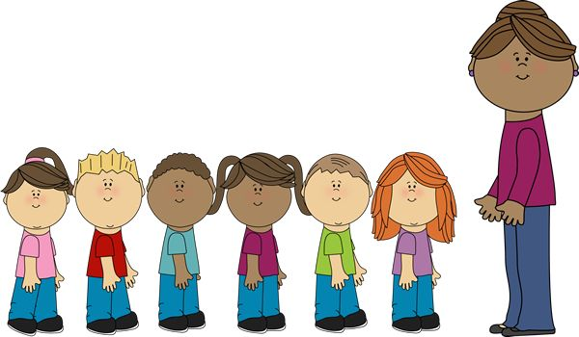
Phonics- Fred Talk
a
n
t
e
n
d

Slide 6

Phonics- Ditty
it | is | full
my | cup | is | full
my | cup | is | full | of | pop
Hold a sentence:
The pop is yum in my tum

Slide 7
Literacy
Session 4-
Writing

Slide 8

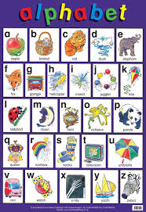
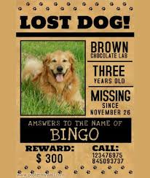
Literacy- Session 4
The aliens have stolen Vinnie and Violet’s underpants!
How will we get them back?
A learning poster
An information poster
A poster to find something lost
We could make a poster to help find them!
A poster gives us information in different ways

Slide 9
Literacy- Session 4
To make a poster, we need to include (put in) important information.
What do they look like?
The colour
What is missing?
The size
The pattern
When did they go missing?
Who stole them?
What is the reward?

Slide 10
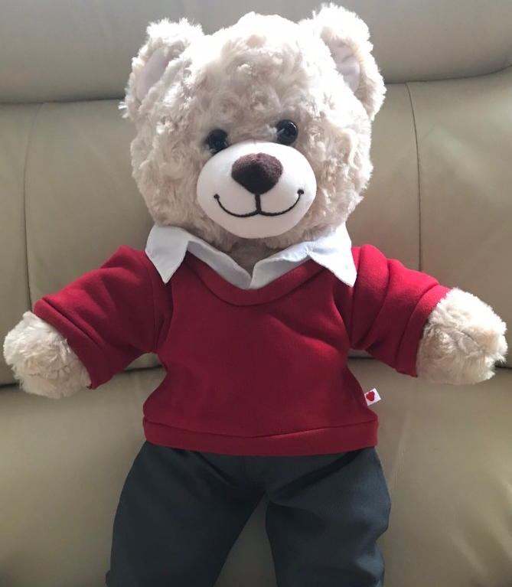
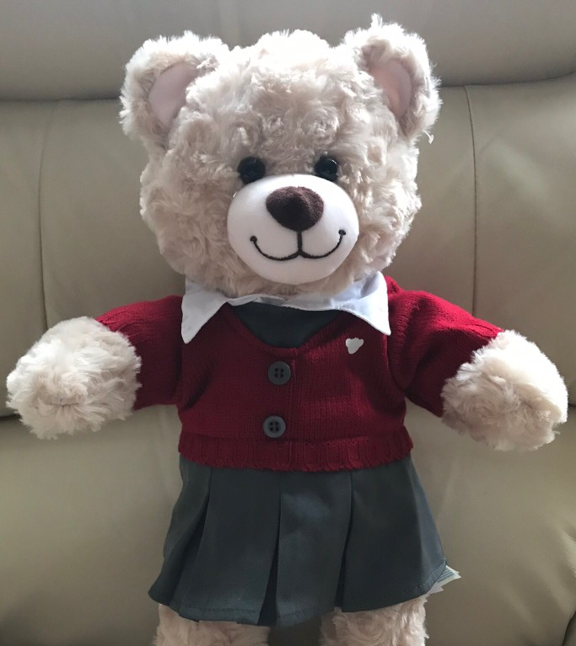
Literacy- Session 4
Click on your class teddy.

Slide 11
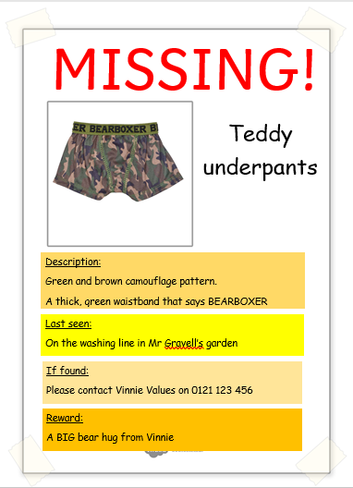
Literacy- Session 4
What do they look like?
What is missing?
When/Where did they go missing?
The pattern
The colour
What to do if they are found?
A reward

Slide 12
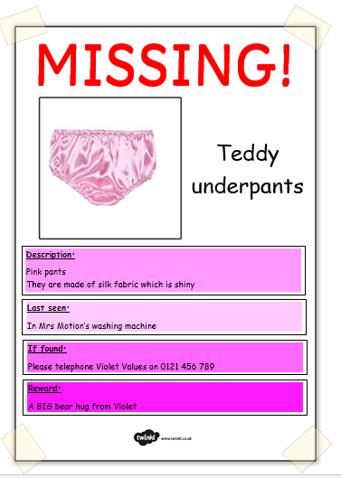
Literacy- Session 4
What do they look like?
What is missing?
When/Where did they go missing?
The pattern
The colour
What to do if they are found?
A reward

Slide 13
Now it’s your turn to make a poster to find the underpants thief!

