Slide 1
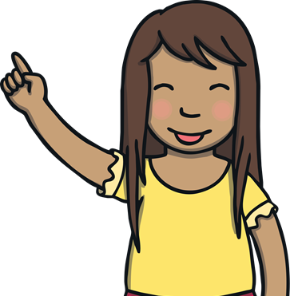
Suffix
A suffix is extra letters added onto the end of the word to change it’s meaning.

Slide 2
Suffix –ed
jumped
gasped
shouted
When you see an -ed at the end of a verb, it means that it happened in the past. Let’s say these examples:
-ed goes at the end of a root word. It changes present tense to past tense.

Slide 3
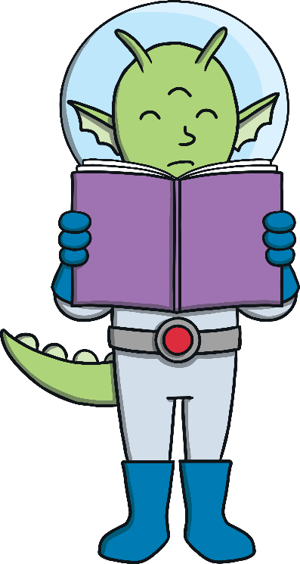
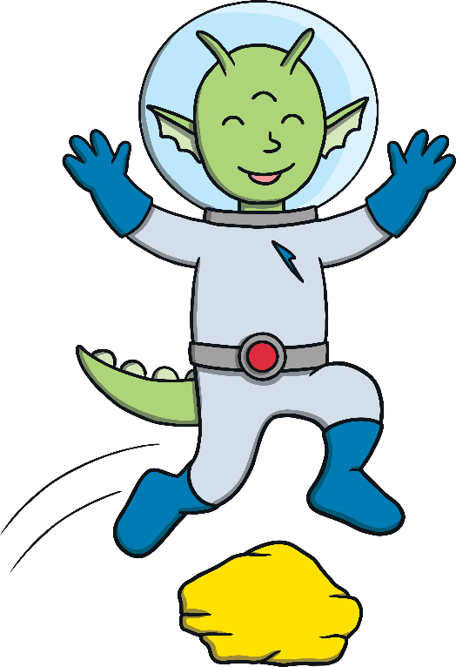
Can you add the –ed suffix onto the root words to make them past tense?
Root word
Suffix
look
ed
looked
jumped
jump
ed

Slide 4
