Slide 1

Suffix
A suffix is extra letters added onto the end of the word to change it’s meaning.

Slide 2
Suffix –ing
jumping
walking
shouting
Adding ing rule:
We add the –ing suffix onto the end of a verb. Remember a verb is a doing word!
Remember the rules:
If the word has a silent ‘e’ take it off
Sometimes we need to double the last letter of the verb.
Skate skating
Skip skipping

Slide 3
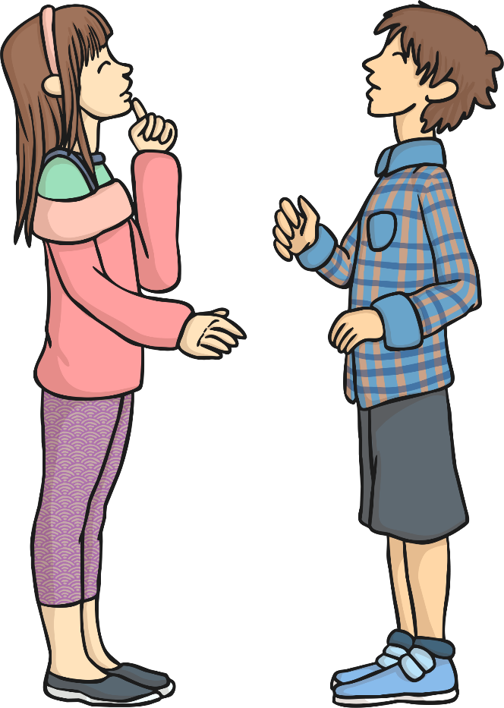
Let’s read these words together:
talk
talking
How is the second word different?
What has been added?

Slide 4

Let’s read these words together:
read
reading
How is the second word different?
What has been added?

Slide 5
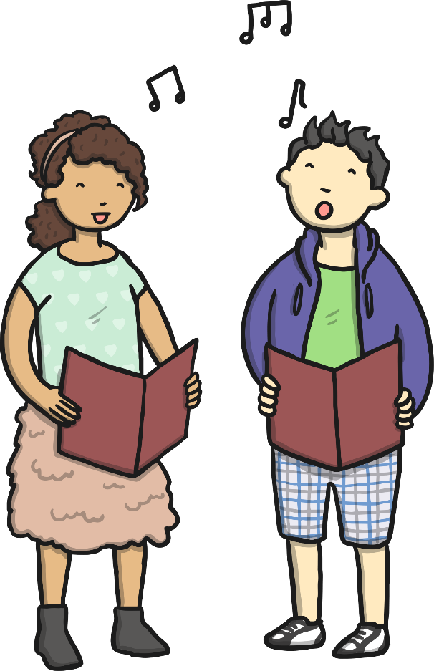
Let’s read these words together:
sing
singing
How is the second word different?
What has been added?

Slide 6
Have a look at the verb word bank. Can you choose some verbs to add the –ing suffix onto the end? Can you think of any other verbs?
walk melt
jump drink
skip sew
cook pick
swim help

Slide 7
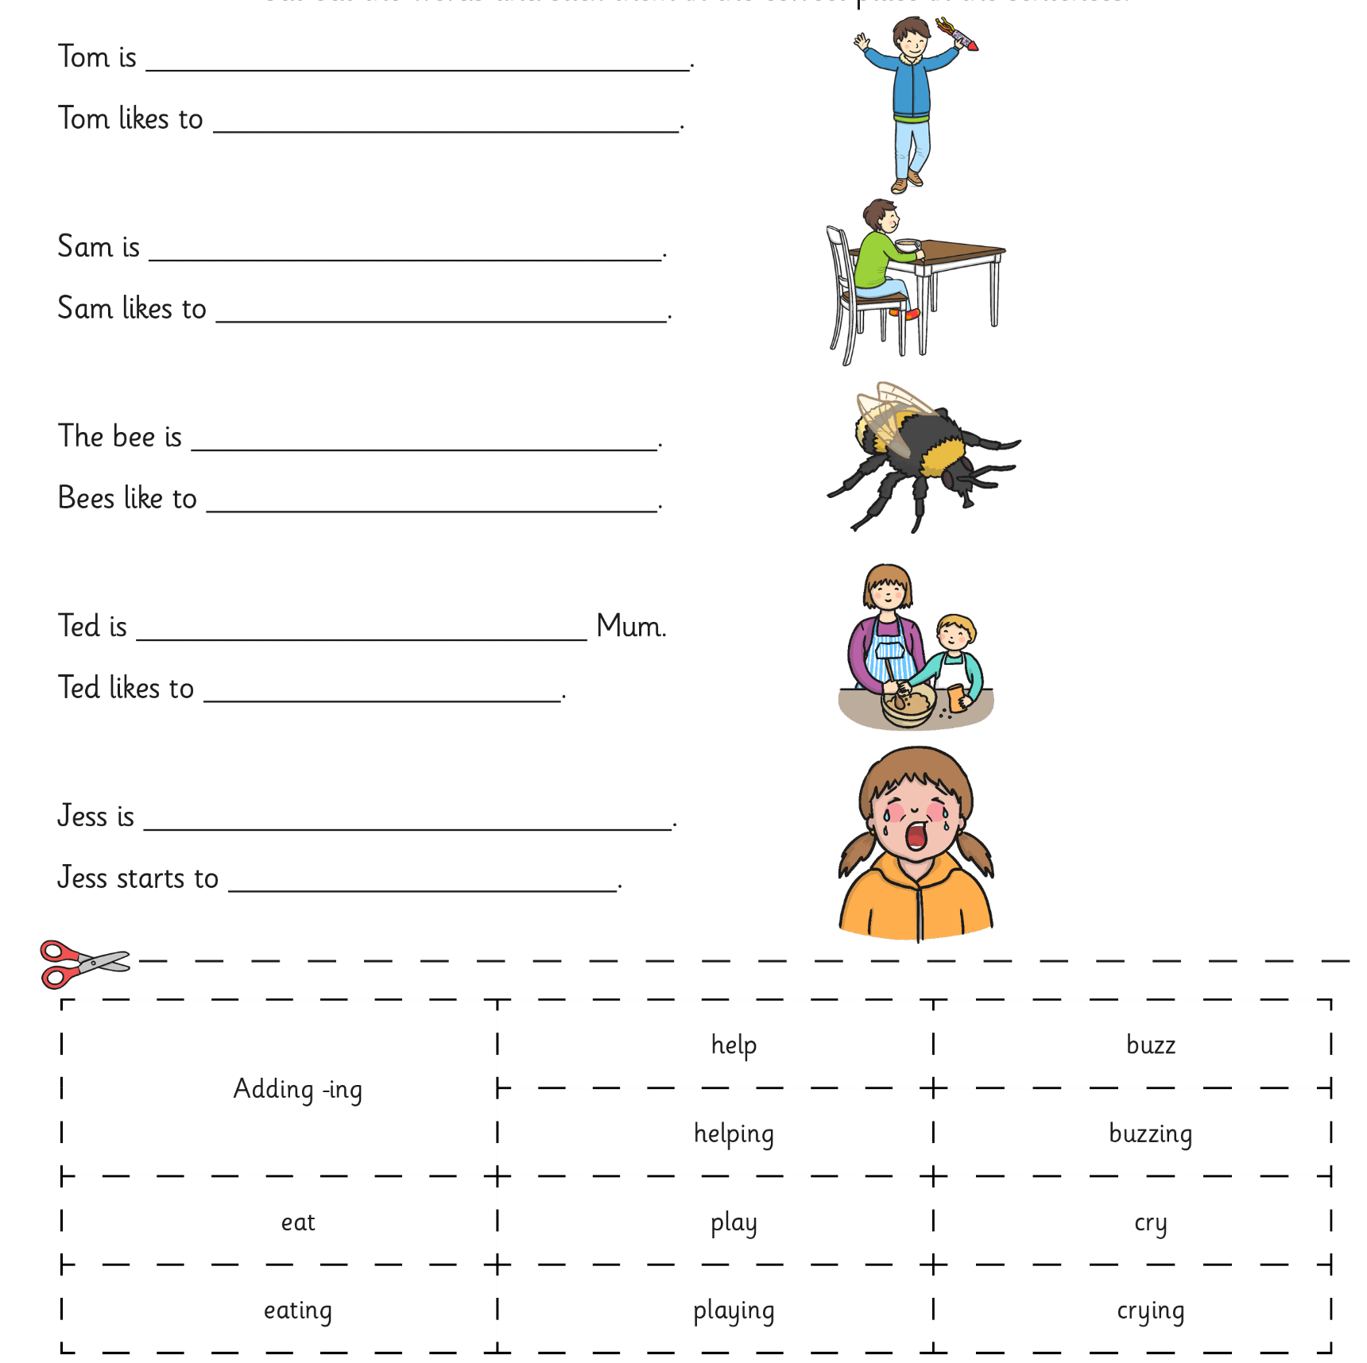
Use the word bank at the bottom of the sheet to help you fill in the missing words. Read the sentence aloud once you have completed it.

