Slide 1

Lesson 4
https://www.youtube.com/watch?v=0gyI6ykDwds
Questions for discussion:
Where was the first place they got to on their hunt?
What was the river like?
What was the forest like?
Did the family want to go on another bear hunt?
Would you on a bear hunt?
Listen to the story once more. Join in with the words and actions.

Slide 2
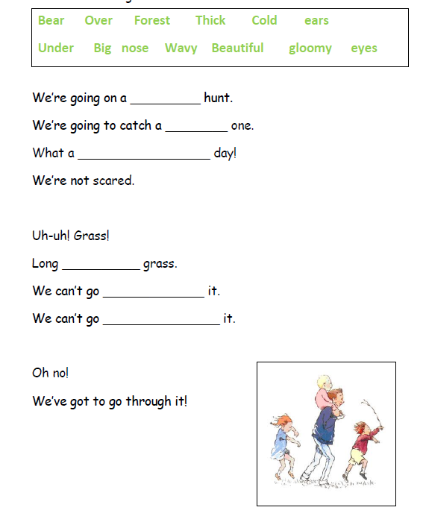
Lesson 4
Activity: Use your knowledge of the story to fill in the missing words.
If you need to, use your story map to help you!

Slide 3
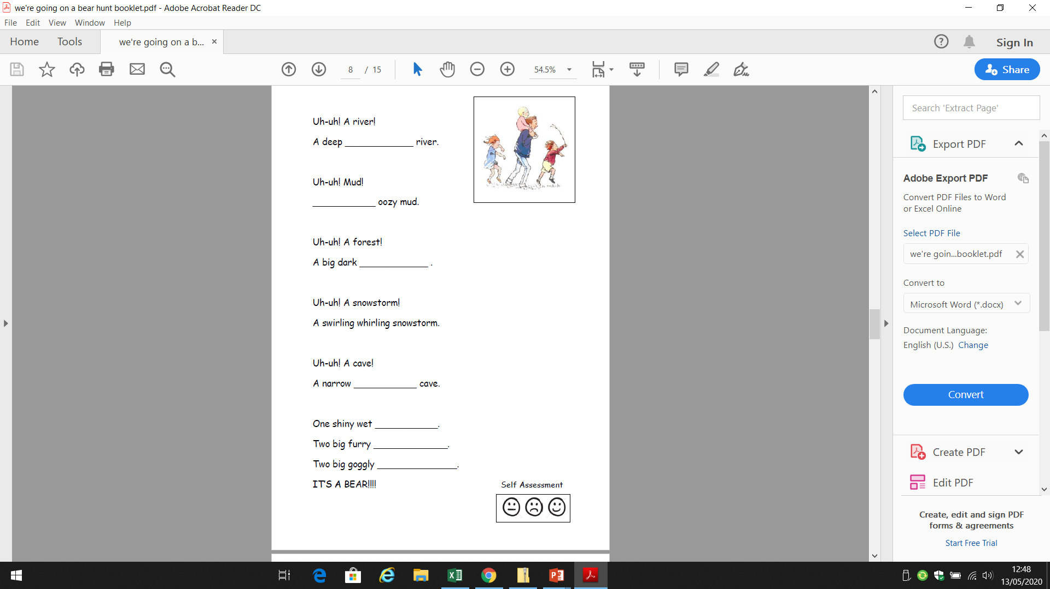
Lesson 4
Activity: Use your knowledge of the story to fill in the missing words.
If you need to, use your story map to help you!

